Slide 1
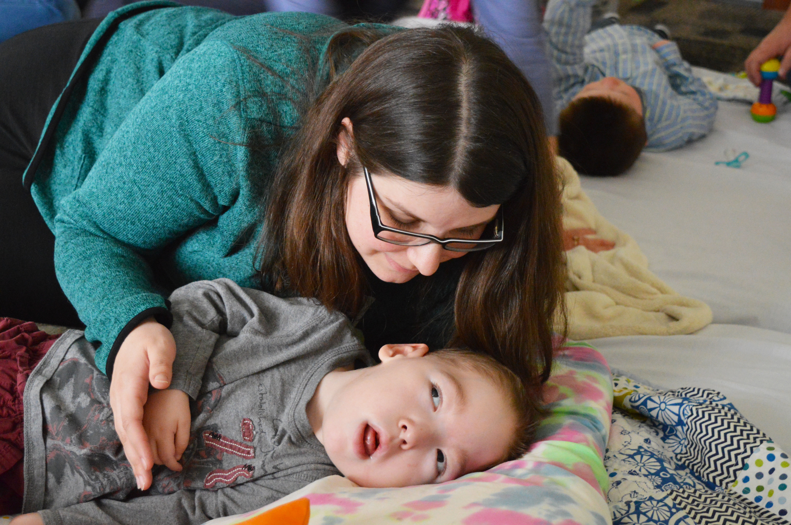

Making Connections: Vermont’s Early Intervention Partnerships

Slide 2
Outcomes
Participants will:
  Learn how and why the partnership between the Vermont Sensory Access Project and the I-Team Early Intervention Project was forged
  What outcomes have been achieved as a result of collaboration
  What steps have been taken over the last three years to improve outcomes

Slide 3
EI & R Self Assessment Guide Findings
Completed Self Assessment Guide in Spring 2014
Determined Vermont needed to focus on both an identification and referral for infants and toddlers who are Deafblind
Determined Part C was best system to target

Slide 4
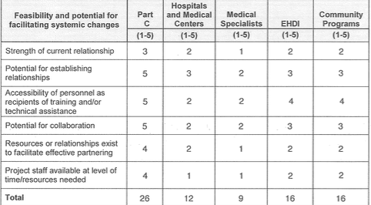
Feasibility and Potential for Facilitating Systematic Changes in Vermont

Slide 5
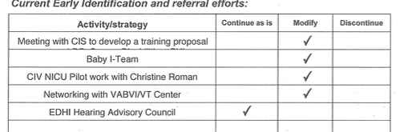
Current Early Identification and Referral Efforts

Slide 6
Action Plan
Developed Outcomes:
  Immediate: Increase the awareness and knowledge of CIS Providers and Administrators throughout Vermont regarding the impact of combined vision and hearing loss on development in the first two years of life
  Long Term: Increase the number of CIS personnel identifying infants and toddlers with a combined vision and hearing loss and making referrals to the Vermont Sensory Access Project

Slide 7
Success!
Child Count Year | Children 0-2
2013 | 1
2014 | 1
2015 | 3
2016 | 4
2017 | 3

Slide 8
Key Partner: I-Team Early Intervention Project
Developed in partnership with:
  Center on Disability and Community Inclusion, VT UCEDD at UVM
  Part C- Children’s Integrated Services Early Intervention
Annual Funding from:
  Small grant from Part C
  Medicaid Match: Vermont Child Health Improvement Program

Slide 9
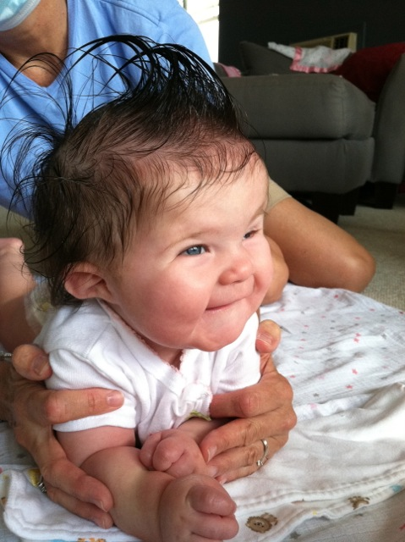
I-Team EI Mission
  Increase capacity of approximately 20 local early intervention teams including families in the delivery of quality early intervention services to Medicaid-eligible children with complex medical and developmental needs from birth to age three, through training, technical assistance, and collaboration.

Slide 10
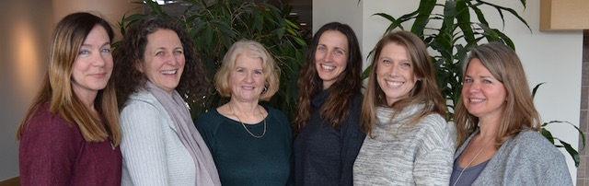
I-Team EI
Interdisciplinary team of highly qualified professionals including:
  Early Childhood Special Educator with expertise in deafblindness
  Speech and Language Pathologist with expertise in Alternative and Augmentative Communication (AAC)
  Pediatric Occupational Therapist
  Pediatric Physical Therapist
  3 regional Family Resources Consultants

Slide 11
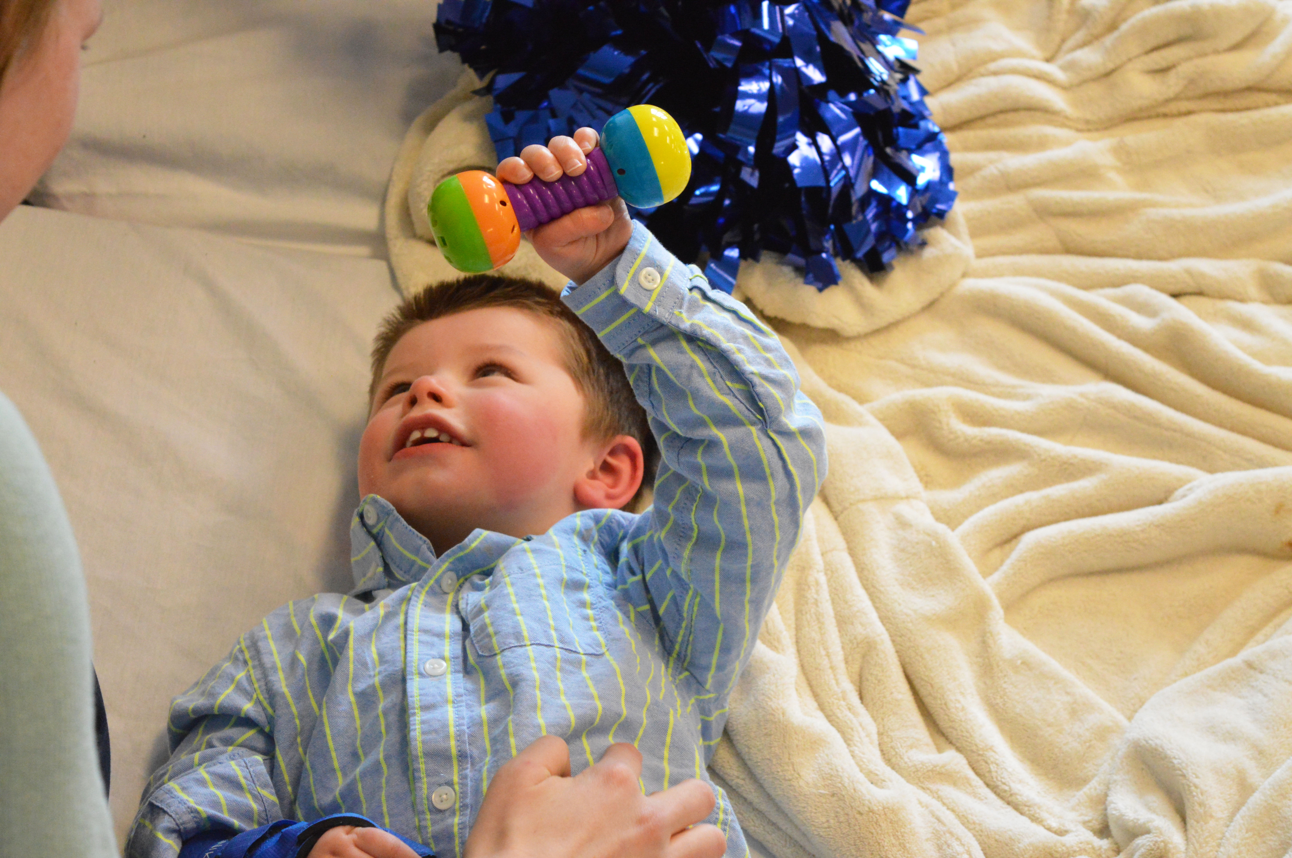
Making Partnerships
From 12/2016 to 12/2017
  25 total, 19 active referrals
  5 Deafblind
  All children on the Deafblind Census were referred to I-Team Early Intervention

Slide 12
Outcomes Achieved 12/15 – 12/18
Active Participation in OHOA Modules by I-Team EI PT, Family Consultants
Active Participation in OHOA Modules by 66% of EI Teams & preschool teams in anticipation of transition
Deafblind Project collaboration with I-Team to integrate best practices in Deafblindness into I-Team EI TA including: Communication, Feeding, Positioning & Mobility, Play, and Activities of Daily Living

Slide 13
Outcomes Achieved 12/15 - 12/18 cont…
I-Team EI regional and statewide training content included deafblind child examples to increase awareness of diversity of population
I-Team EI partnerships made with statewide, regional, & local EI teams increased visibility of Deafblind Project
I-Team EI actively works with local partners to facilitate and support identification and referrals to Deafblind Census (increased ID & Referral)

Slide 14
Next Steps
Complete EI & R Self Assessment Guide Again: Identification and Referrals from Local Early Intervention Providers/Teams have not yet increased
  Referrals come from I-Team EI or other Statewide Partners
  Self Assessment Guide may point to other Systems
Work with Part C to develop a protocol for ID & Referral
Utilization of The Sooner the Better Framework to supplement trainings completed by other statewide partners

Slide 15
Questions?

