Slide 1

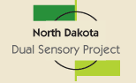



Dakota Cohort Trainings in Deaf-Blindness for Early Interventionists
Rose Moehring, South Dakota Center for Disabilities Deaf-Blind Project
Sherri Nelson, North Dakota Dual Sensory Project

Slide 2
The Dakota Cohort
Trainings in Deaf-Blindness:
Began in the Summer of 2015
State collaboration:
  South Dakota, Rose Moehring, Project Director, University of South Dakota, Center for Disabilities, Deaf-Blind Project. The Center for Disabilities is a UCED
  North Dakota, Sherri Nelson, Project Director, employed by the North Dakota School for the Deaf
  Use of NCDB on-line training modules
  Credit options through University of South Dakota and Texas Society of Interpreters

Slide 3
Open Hands Open Access Modules (1 of 2):
Series 1:
Welcome and Orientation
An Overview of Deaf-Blindness and Instructional Strategies
The Sensory System, the Brain and Learning
The Role of the Intervener
4. Building Trusted Relationships and Positive Self-
Image
Series 2:
5. Availability for Learning
6. Understanding Communication Principles
7. Emergent Communication
8. Progression from Non-Symbolic to Symbolic
Communication and complex language
Series 3:
9. Routines for Participation and Learning
10. Concept Development and Active Learning
11. Intervener Strategies
13. Calendars

Slide 4
Open Hands Open Access Modules (2 of 2):
Series 4: Varies
Intervener Strategies
Maximizing Vision and Hearing
Introduction to Orientation and Mobility for Interveners
Orientation and Mobility in Everyday Routines
Self Determination
Social Skills
Collaborative Teaming and Family Partnerships
Accessing the Curriculum and Environment
Values, Ethics and Professionalism
Sexuality
Introduction to Sign Language and Braille
Behavioral and Environmental Supports
Transition to Adulthood and Community Living
Touch for Connecting and Learning
Touch for Connection and Communication
Putting It All Together
E-Portfolio/Practicum

Slide 5
Graduate Credit Assignments:
Assignments (explore and write 1 page reflection paper):
  Series 1:
    Perkins School for the Blind, Barbara Miles Video “Reflections on Deafblindess Hands & Touch”
    Series 2:
    Communication Matrix Website
    Series 3: (2 options)
    Texas School for the Blind, Calendars Website
    NCDB Literacy Site
  Series 4: (varies)
    Perkins-Learning Media Assessment
    NCDB Family Matters Story of Jake
    TSBVI-ADAMLS
    HKNC
    iCanConnect

Slide 6
Advertisement Efforts!
North Dakota:
  Teachers of the Deaf/Hard Hearing
  Teacher of the Visually Impaired
  Family Voices and Pathfinder parent organizations
  Vocational Rehabilitation Programs statewide
  Newsletters
  Early Intervention Directors
  Universities
  Interpreters
  Conferences
  Interpreter list serv.
South Dakota:
  Center for Disabilities list serv.
  Deaf-Blind Program Constant Contact Newsletter
  Deaf-Blind List Serv.
  SD Dept. of Newsletter
  USD Summer Booklet for teachers
  State Interpreter list serv.
  SD School for the Blind Newsletter
  SD School for Deaf
  SD School for Blind
  Conferences

Slide 7
Credit Options:
University of South Dakota Credit (graduate and undergraduate)
Interpreter Registered Interpreter of the Deaf Credit (RID)
Dakota Cohort Certificates of Completion
State level continuing education (SLP, OT, Interpreters)
American Speech Hearing Association (ASHA continuing education unit)
NCDB Badges

Slide 8
Dakota Cohort Training Progression:
Summer 2015: Series 1 (modules 1-4) 18 Participants
Fall 2015: Series 1 and Series 2 (modules 5, 6, 7, 8) 30 Participants
Spring 2016: Series 1, 2 and 3 (modules 9-11 and 13) 49 Participants
Summer 2016: Series 1, 2, 3, and 4 (modules 12, 14-16) 39 Participants
Fall 2016: Series 1, 2, 3, and 4 (modules 12, 16,17-18) 30 Participants
Spring 2017: Series 1, 2, 3 and 4 (modules 19, 22, 25, 26) 30 Participants
Summer 2017: Series 1, 2, 3, 4 (modules 19, 22, 25, 26) and 5 (modules 20, 21, 23, 24, 27) 32 Participants
Total Participants (some signed up more than once): 228

Slide 9
Dakota Cohort Training Participants:
Actual Number of Participants: 110
Number of Early Interventionists: 37
  Early Childhood Special Education Teachers (11)
  Early Interventionists (7)
  Speech Language Pathologists (8)
  TOD working with children 0-5 through H.S. (2)
  TOBVI working with children 0-5 through H.S. (5)
  Special Education Teachers (4)

Slide 10
Building Capacity through the Dakota Cohort!
Summer
2015
Fall 2015
Fall 2016
Summer 2016
Spring 2016
Summer 2017

Slide 11
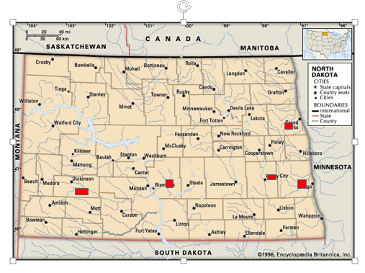
North Dakota Summer 2015:
A map of North Dakota with the counties outlines and the city names listed. The cities of Grand Forks, Dickinson, Bismarck, Fargo, and Valley City have small red rectangles and squares of varying sizes on them. The red squares and rectangles represent information from Summer of 2015.

Slide 12
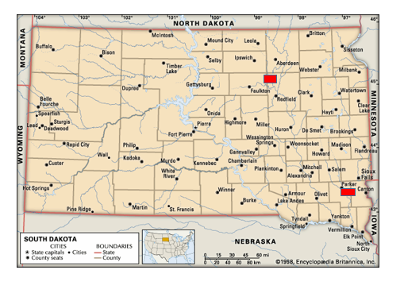
South Dakota Summer 2015:
A map of South Dakota with the counties outlined and the cities listed. The cities of Aberdeen and Sioux falls have red rectangles on them representing Summer of 2015 data.
Notes:
Image: A map of South Dakota with the counties outlined and the cities listed. The cities of Aberdeen and Sioux falls have red rectangles on them representing Summer of 2015 data.

Slide 13
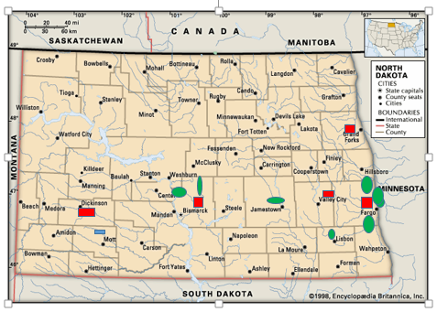
North Dakota Fall 2015:
A map of North Dakota with the counties outlines and the city names listed. The cities of Grand Forks, Dickinson, Bismarck, Fargo, and Valley City have small red rectangles and squares of varying sizes on them. The red squares and rectangles represent information from Summer of 2015.
The cities of Center, Bismarck, Jamestown, Lisbon, and Fargo all have green ovals on or near them. Fargo has four green ovals and the other cities have one.
The green ovals represent information from the fall of 2015.
There is one blue rectangle near the city of Mott. Blue rectangles represent information from spring of 2016.
Notes:
Image: A tan map of North Dakota with the counties outlines and the city names listed. The cities of Grand Forks, Dickinson, Bismarck, Fargo, and Valley City have small red rectangles and squares of varying sizes on them. The red squares and rectangles represent information from Summer of 2015.
The cities of Center. Bismarck, Jamestown, Lisbon, and Fargo all have green ovals on or near them. Fargo has four green ovals and the other cities have one.
The green ovals represent information from the fall of 2015.
There is one blue rectangle near the city of Mott. Blue rectangles represent information from spring of 2016.

Slide 14
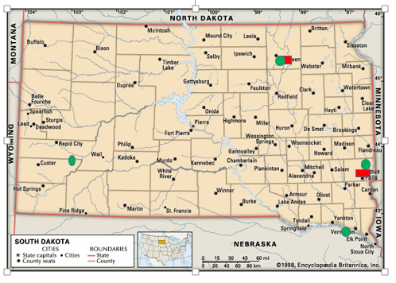
South Dakota Fall 2015:
A map of South Dakota with the counties outlined and the cities labeled. The cities of Aberdeen, Custer, Sioux Falls, and Vermillion all have one green oval on or near them representing information from Fall of 2015. The Cities of Sioux falls and Aberdeen also have red rectangles on them representing information from summer of 2015.
Notes:
Image: A map of South Dakota with the counties outlined and the cities labeled. The cities of Aberdeen, Custer, Sioux Falls, and Vermillion all have one green oval on or near them representing information from Fall of 2015. The Cities of Sioux falls and Aberdeen also have red rectangles on them representing information from summer of 2015.

Slide 15
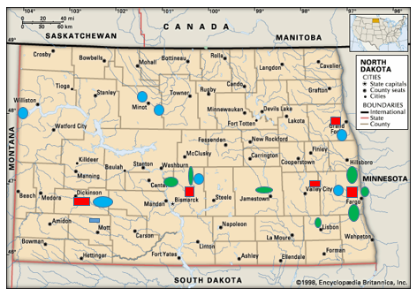
North Dakota Spring 2016:
A map of North Dakota with the counties outlined and the cities listed.
The cities of Grand Forks, Fargo, Bismarck, Valley City and Dickinson have red rectangles on them representing data from summer of 2015.
The cities of Fargo, Jamestown, Bismarck, and Lisbon all have green ovals on or near them representing data from the fall of 2015. Bismarck has two green ovals near it, Fargo has three and Jamestown and Lisbon have one each.
The cities of Mott, Dickinson, Williston, Minot, Bismarck, Fargo and Grand Forks have blue shapes on them representing data from spring of 2016. Minot has two blue circles on or near it whereas the other cities have one each.
Notes:
Image: A map of North Dakota with the counties outlined and the cities listed.
The cities of Grand Forks, Fargo, Bismarck, Valley City and Dickinson have red rectangles on them representing data from summer of 2015.
The cities of Fargo, Jamestown, Bismarck, and Lisbon all have green ovals on or near them representing data from the fall of 2015. Bismarck has two green ovals near it, Fargo has three and Jamestown and Lisbon have one each.
The cities of Mott, Dickinson, Williston, Minot, Bismarck, Fargo and Grand Forks have blue shapes on them representing data from spring of 2016. Minot has two blue circles on or near it whereas the other cities have one each.

Slide 16
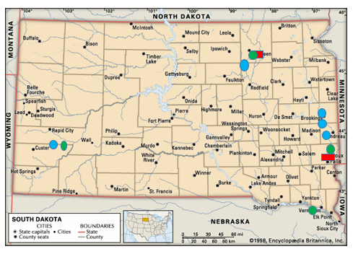
South Dakota Spring 2016
A map of South Dakota with the counties outlined and the cities listed. The cities of Aberdeen and Sioux falls have red rectangles on them representing Summer of 2015 data.
The cities of Vermillion, Sioux Falls, and Custer have green ovals on them representing information from Fall of 2015.
The Cities of Custer, Flandreau, Brookings, Aberdeen, all have blue circles on them representing data from Spring 2016. All of the cities with blue circles have one blue circle on or near them other than brookings which has two.
Notes:
Image: A map of South Dakota with the counties outlined and the cities listed. The cities of Aberdeen and Sioux falls have red rectangles on them representing Summer of 2015 data.
The cities of Vermillion, Sioux Falls, and Custer have green ovals on them representing information from Fall of 2015.
The Cities of Custer, Flandreau, Brookings, Aberdeen, all have blue circles on them representing data from Spring 2016. All of the cities with blue circles have one blue circle on or near them other than Brookings which has two.

Slide 17
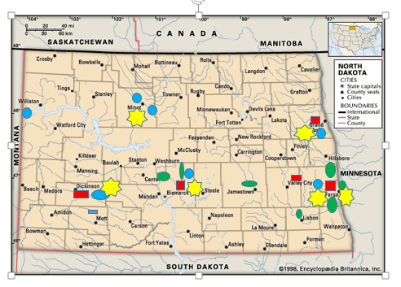
North Dakota Summer 2016:
A map of North Dakota with the counties outlined and the cities listed.
The cities of Grand Forks, Fargo, Valley City, Bismarck, and Dickinson all have one red rectangle on or near them representing data from summer of 2015.
The cities of Bismarck, Jamestown, Lisbon, and Fargo all have green ovals on or near them representing data from fall of 2015. Bismarck has two green ovals on or near it and Fargo has three. The rest of the cities have one.
The cities of Williston, Minot, Dickinson, Mott, Bismarck, Fargo, and Grand Forks have blue ovals on or near them. Minot has two ovals, and the rest of the cities have one oval. The blue ovals represent data from spring of 2016.
The cities of Minot, Dickinson, Bismarck, Grand Forks, and Fargo all have yellow seven pointed stars on or near them. These yellow stars are larger than any of the other previously stated shapes. Fargo has two stars near it whereas the other cities have one star. The yellow stars represent data from summer of 2016
Notes:
Image: A map of North Dakota with the counties outlined and the cities listed.
The cities of Grand Forks, Fargo, Valley City, Bismarck, and Dickinson all have one red rectangle on or near them representing data from summer of 2015.
The cities of Bismarck, Jamestown, Lisbon, and Fargo all have green ovals on or near them representing data from fall of 2015. Bismarck has two green ovals on or near it and Fargo has three. The rest of the cities have one.
The cities of Williston, Minot, Dickinson, Mott, Bismarck, Fargo, and Grand Forks have blue ovals on or near them. Minot has two ovals, and the rest of the cities have one oval. The blue ovals represent data from spring of 2016.
The cities of Minot, Dickinson, Bismarck, Grand Forks, and Fargo all have yellow seven pointed stars on or near them. These yellow stars are larger than any of the other previously stated shapes. Fargo has two stars near it whereas the other cities have one star. The yellow stars represent data from summer of 2016

Slide 18
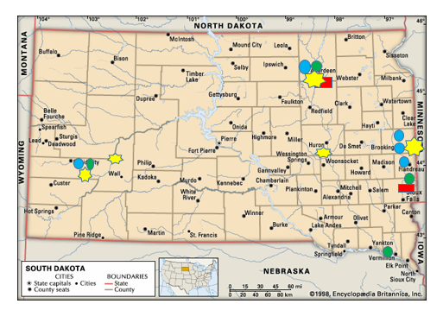
South Dakota Summer 2016
A map of South Dakota with the counties outlined and the cities listed. The cities of Aberdeen and Sioux falls have red rectangles on them representing Summer of 2015 data.
The cities of Vermillion, Sioux Falls, and Custer have green ovals on them representing information from Fall of 2015.
The Cities of Custer, Flandreau, Brookings, Aberdeen, all have blue circles on them representing data from Spring 2016. All of the cities with blue circles have one blue circle on or near them other than Brookings which has two.
The cities of Aberdeen, Huron, Brookings, Wall, and Rapid City all have yellow seven-pointed stars on or near them. The stars are slightly larger than all of the previous shapes. They represent the data from summer 2016.
Notes:
Image: A map of South Dakota with the counties outlined and the cities listed. The cities of Aberdeen and Sioux falls have red rectangles on them representing Summer of 2015 data.
The cities of Vermillion, Sioux Falls, and Custer have green ovals on them representing information from Fall of 2015.
The Cities of Custer, Flandreau, Brookings, Aberdeen, all have blue circles on them representing data from Spring 2016. All of the cities with blue circles have one blue circle on or near them other than Brookings which has two.
The cities of Aberdeen, Huron, Brookings, Wall, and Rapid City all have yellow seven-pointed stars on or near them. The stars are slightly larger than all of the previous shapes. They represent the data from summer 2016.

Slide 19
North Dakota Fall 2016:
A map of North Dakota with the counties outlined and the cities listed.
The cities of Grand Forks, Fargo, Valley City, Bismarck, and Dickinson all have one red rectangle on or near them representing data from summer of 2015.
The cities of Bismarck, Jamestown, Lisbon, and Fargo all have green ovals on or near them representing data from fall of 2015. Bismarck has two green ovals on or near it and Fargo has three. The rest of the cities have one.
The cities of Williston, Minot, Dickinson, Mott, Bismarck, Fargo, and Grand Forks have blue ovals on or near them. Minot has two ovals, and the rest of the cities have one oval. The blue ovals represent data from spring of 2016.
The cities of Minot, Dickinson, Bismarck, Grand Forks, and Fargo all have yellow seven pointed stars on or near them. These yellow stars are larger than any of the other previously stated shapes. Fargo has two stars near it whereas the other cities have one star. The yellow stars represent data from summer of 2016

Slide 20
South Dakota Fall 2016
A map of South Dakota with the counties outlined and the cities listed. The cities of Aberdeen and Sioux falls have red rectangles on them representing Summer of 2015 data.
The cities of Vermillion, Sioux Falls, and Custer have green ovals on them representing information from Fall of 2015.
The Cities of Custer, Flandreau, Brookings, Aberdeen, all have blue circles on them representing data from Spring 2016. All of the cities with blue circles have one blue circle on or near them other than brookings which has two.
The cities of Aberdeen, Huron, Brookings, Wall, and Rapid City all have yellow seven-pointed stars on or near them. The stars are slightly larger than all of the previous shapes. They represent the data from summer 2016.

Slide 21
North Dakota Summer 2017:
A map of North Dakota with the counties outlined and the cities listed.
The cities of Grand Forks, Fargo, Valley City, Bismarck, and Dickinson all have one red rectangle on or near them representing data from summer of 2015.
The cities of Bismarck, Jamestown, Lisbon, and Fargo all have green ovals on or near them representing data from fall of 2015. Bismarck has two green ovals on or near it and Fargo has three. The rest of the cities have one.
The cities of Williston, Minot, Dickinson, Mott, Bismarck, Fargo, and Grand Forks have blue ovals on or near them. Minot has two ovals, and the rest of the cities have one oval. The blue ovals represent data from spring of 2016.
The cities of Minot, Dickinson, Bismarck, Grand Forks, and Fargo all have yellow seven pointed stars on or near them. These yellow stars are larger than any of the other previously stated shapes. Fargo has two stars near it whereas the other cities have one star. The yellow stars represent data from summer of 2016

Slide 22
South Dakota Summer 2017
A map of South Dakota with the counties outlined and the cities listed. The cities of Aberdeen and Sioux falls have red rectangles on them representing Summer of 2015 data.
The cities of Vermillion, Sioux Falls, and Custer have green ovals on them representing information from Fall of 2015.
The Cities of Custer, Flandreau, Brookings, Aberdeen, all have blue circles on them representing data from Spring 2016. All of the cities with blue circles have one blue circle on or near them other than brookings which has two.
The cities of Aberdeen, Huron, Brookings, Wall, and Rapid City all have yellow seven-pointed stars on or near them. The stars are slightly larger than all of the previous shapes. They represent the data from summer 2016.

Slide 23

What do Early Interventionists say? (1 of 6)
Summer 2015: Residential Setting Early Interventionist
“The Dakota Cohort has been an exceptional learning experience. As a new early interventionist, I had very little experience working with the DB population. I can now say I feel prepared to teach and assist in the learning process of individuals with DB. These modules not only provide you with valuable information on research on educating the DB population, but with hands on learning. The simulations you complete helps put the inf. being presented into real life application. Whether you have experience or do not have experience working the DB, I highly recommend this training for anyone who is in the Ed./Spec. Ed., field.”

Slide 24

What do Early Interventionists say? (2 of 6)
Fall 2016: Residential Setting Early Interventionist:
“I have learned so much through these first four modules and the Barbara Miles video. Trust, respect and integrity through teaching can lead children in wanting to explore and learn in an environment that they feel comfortable in, lowering their anxiety and raising their self esteem in the process.”

Slide 25

What do Early Interventionists say? (3 of 6)
Fall 2016: ECSE Teacher Public School: A.C.
“It is really difficult to describe to my paras that when a child does not have hearing or vision, they are seeing and hearing through touch. I taught them how to touch a child so you create that bond and they can communicate with us. After taking the modules and watching the Barbara Miles video, I am really altering how I am teaching my students.” (modules 1-4)
“Before taking this module I had never thought of a calendar as being part of a huge communication network. However, as I have now learned calendars are very much an important part of communication, especially for people who are DB.” (modules 5-8)

Slide 26
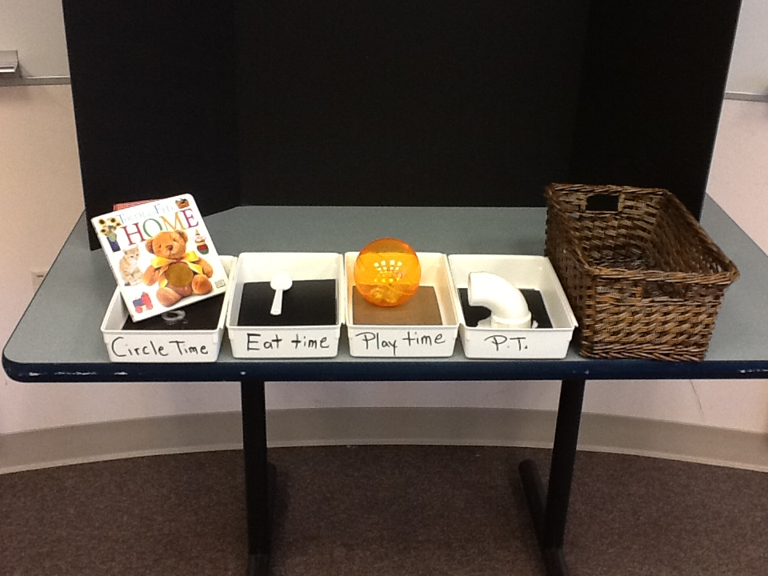
What do Early Interventionists say? (4 of 6)
Fall 2017: Residential Setting-Early Interventionist: S.R.
“Throughout this class I have been thinking about how I can make accommodations for toddlers, who at daycare, are “learning” the Calendar.”

Slide 27
What do Early Interventionists say? (5 of 6)
Summer 2016: Residential Setting Early Intervention: K.K.
I have studied levels of communication in the past and am familiar with the categories of communication behavior. However, exploring the Communication Matrix was a real “eye opener” for me. I can better understand how the levels of learning and behaviors have an impact on communication attempts and success for each individual child. After filling out the Matrix on my student, I came to see that while he has made tremendous progress he still has a ways to go. His parents and I have been focusing on the progress which is wonderful but I still have a lot of coaching to do when encouraging them to continue to work with him. The Matrix form easily shows which categories are mastered, emerging, or not used yet. He is a strong level 3. He does well in levels 4 and 5 except for social communication. This is an area we know is a challenge for him but the Matrix really points out thee special area of needs and gives details about how to address each area.”

Slide 28
What do Early Interventionists say? (6 of 6)
Fall 2017: ECSE (K.C.)
My opinion prior to taking this class and watching the Barbara Miles video is that my student who is 4 years od and has a visual impairment, along with cognitive and motor delays, is not ready to identify items by touch. However, I have learned how important touch is to students with visual impairment and that it MUST BE a part of their life because it is how he will learn. I will take items that are completely different form each other and have distinct features to start introducing this task to my student. I will also want these items to be functional for him and items that he uses or has in his environment (i.e. cup, spoon, plate, fork, sock, sunglasses, toothbrush, and car). I have approached the early childhood speech therapist that sees my student and we are going to work on this together. Our plan is to work on the same 3 items in her room and in the classroom so the he has more chances to become familiar with the items.”

Slide 29

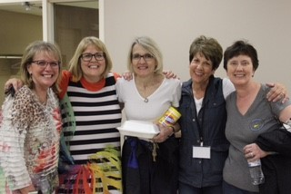
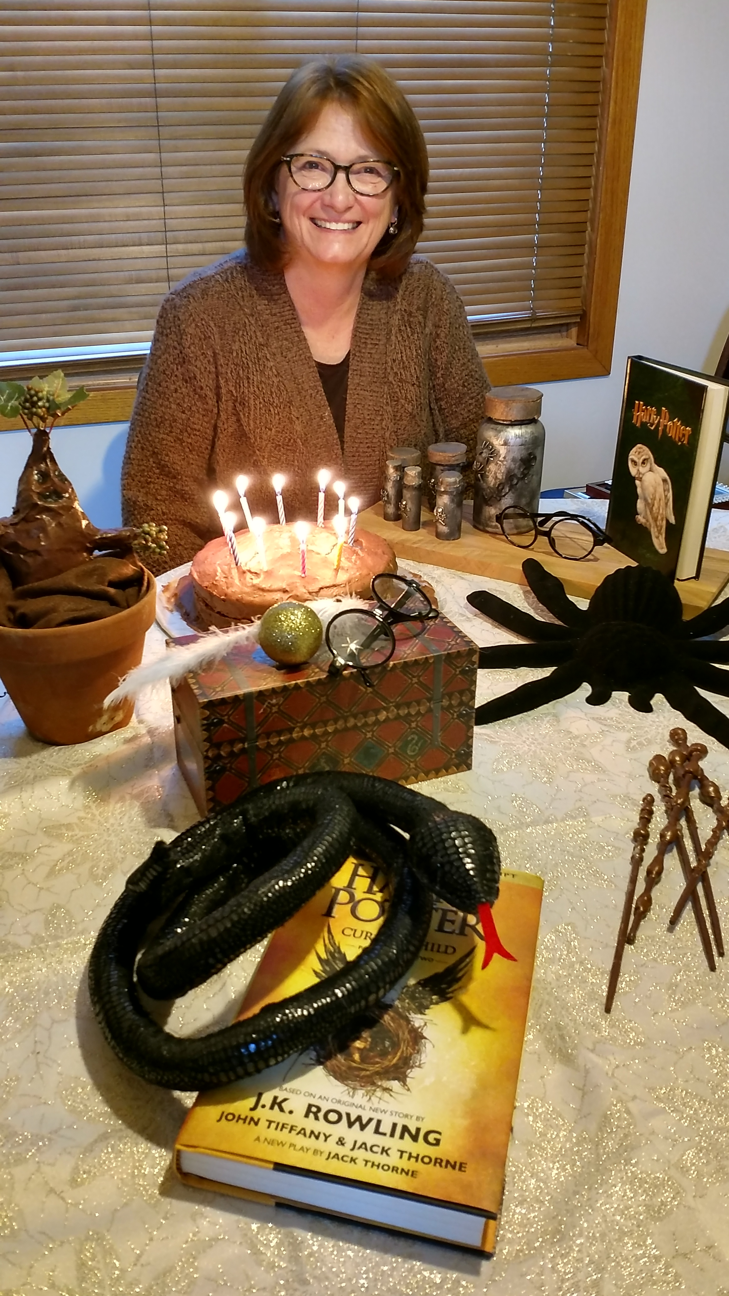
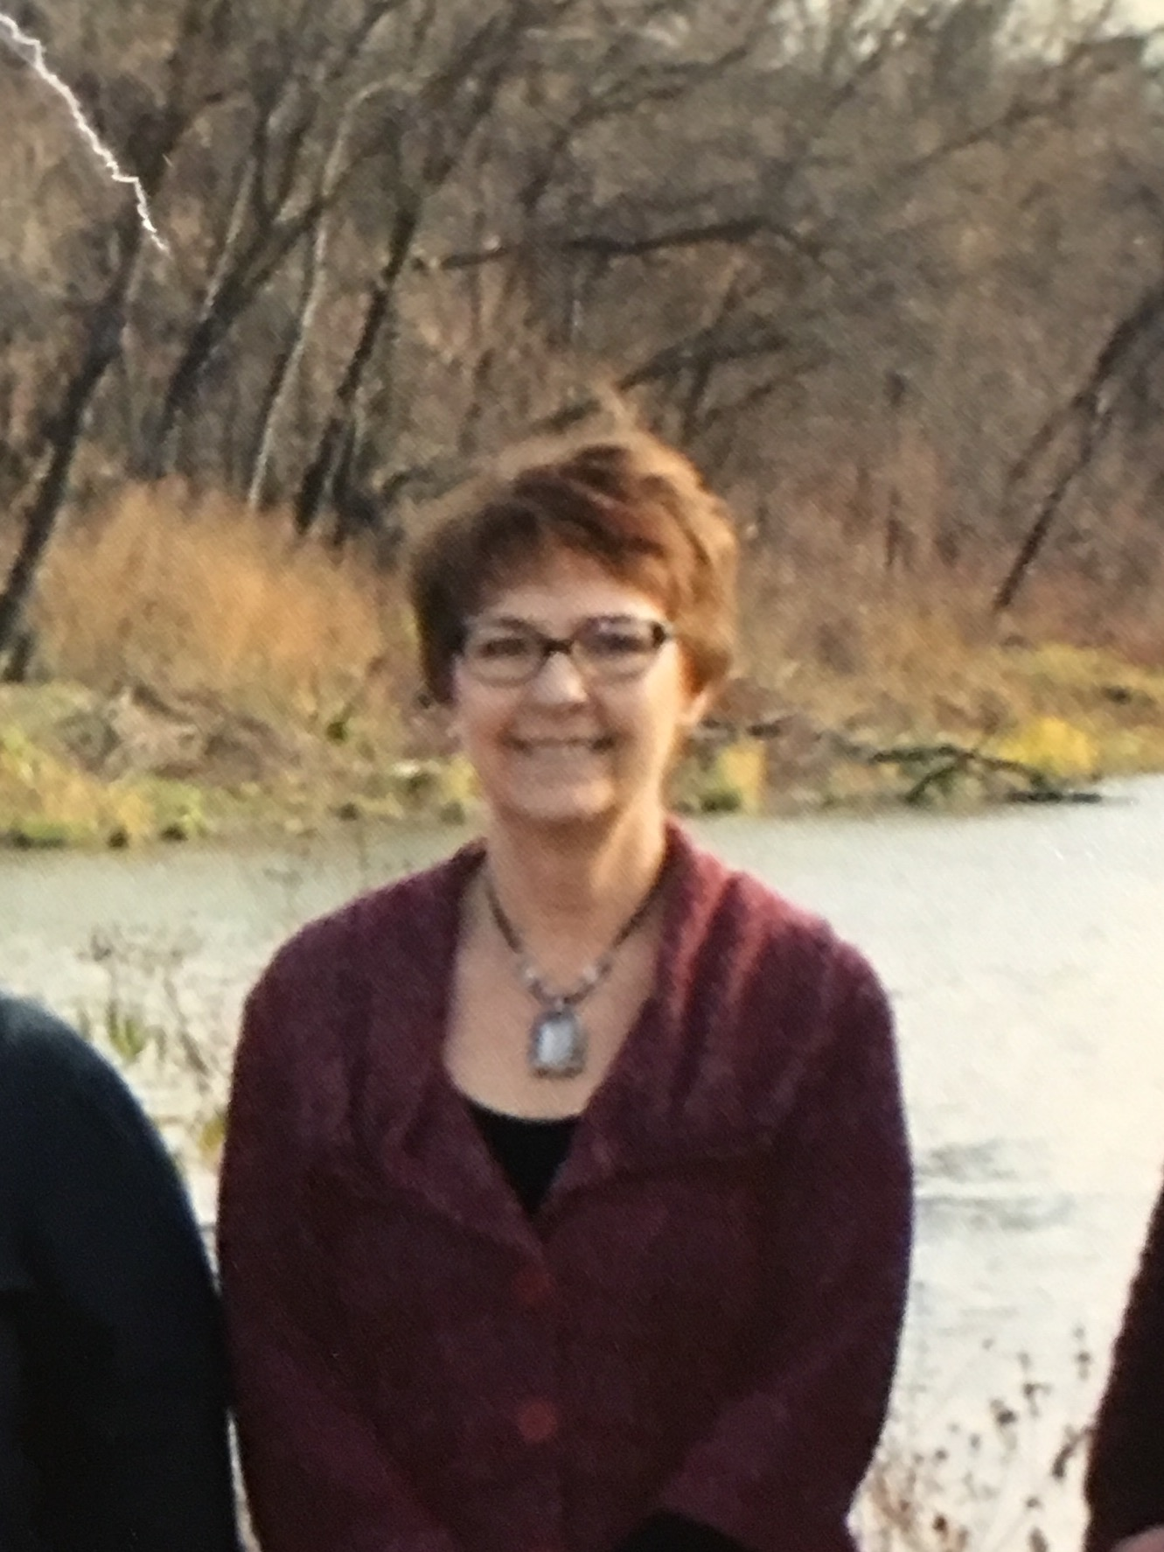
Early Interventionist Interviews by Sherri!
ND Vision Services:
  Lana-TVI
Anne Carlsen Center:
Kathy-ECSE Sandy-ECSE

Slide 30
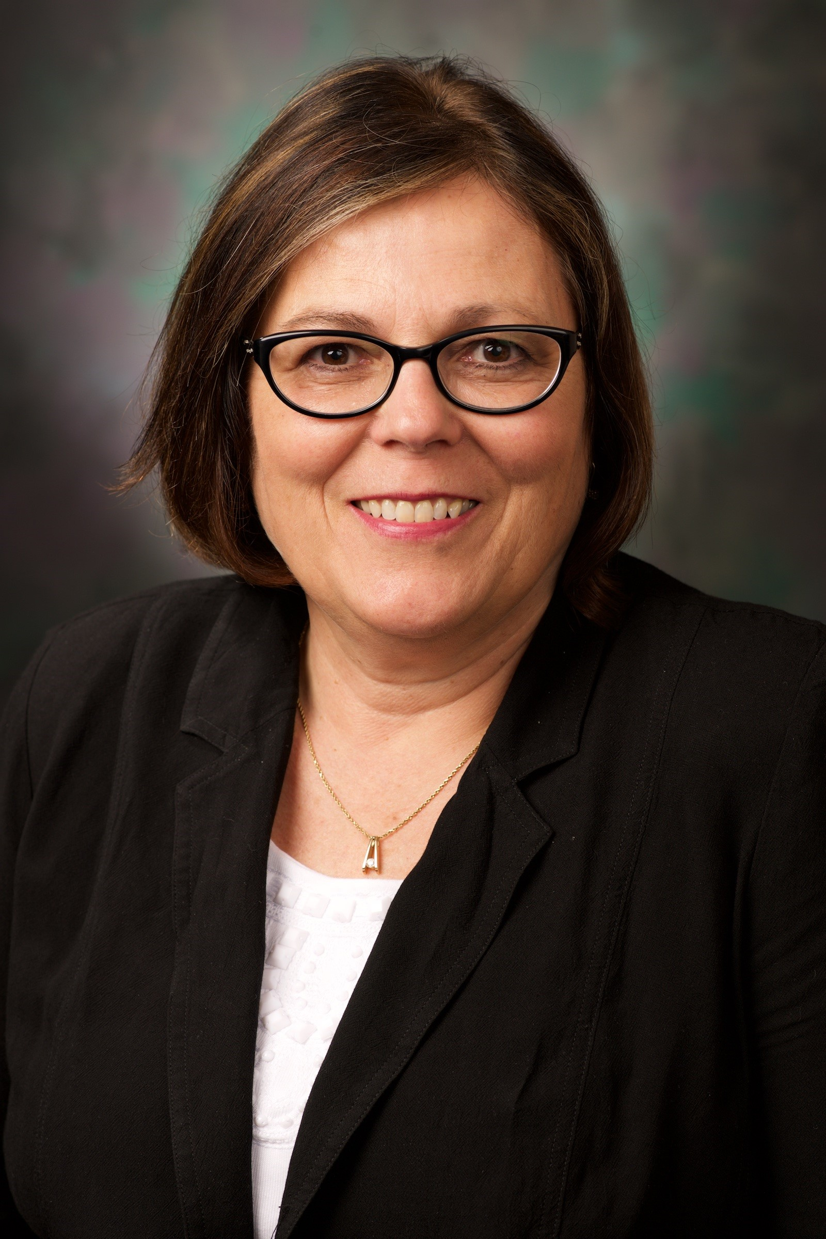
Early Interventionist Interviews by Rose!
Douglas School District:
Sarah Reimer, SLP, Early Childhood
Aberdeen Public School:
Preschool:
Angie Hanson, SLP, Early Childhood

Slide 31
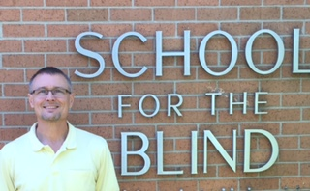
ENDING REMARKS FROM PAUL OLSON
ND VISION SERVICES/SCHOOL FOR THE BLIND

Slide 32

Any Questions?????

Slide 33
Contact Information:
Rose Moehring
SD Deaf-Blind Project
USD Center for Disabilities
1400 W. 22nd Street
Sioux Falls, SD 57108
PH: 605-357-1437
Email: rose.Moehring@usd.edu
Sherri Nelson
ND Dual Sensory Project
1321 S. 23rd St. Suite A
Fargo, ND 58103
PH: 701-239-7376
Email: Shnelson@nd.gov

Slide 34
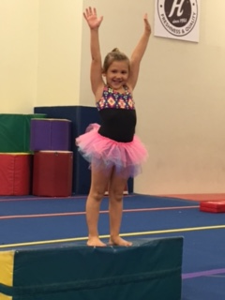
TA-DA!

Slide 35
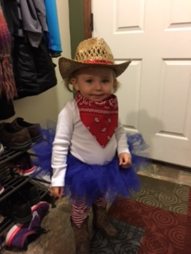
Thank You from the Dakotahs!
Can’t leave out Sherri’s 3rd grandchild! Can’t get more Dakota than that!

