Slide 1

Deaf-Blind Child Count
December 7, 2016
Welcome
Housekeeping
Child Count Webpage Tour
2015 Child Count Report
2016 Child Count Preparations
Questions & Answers

Slide 2
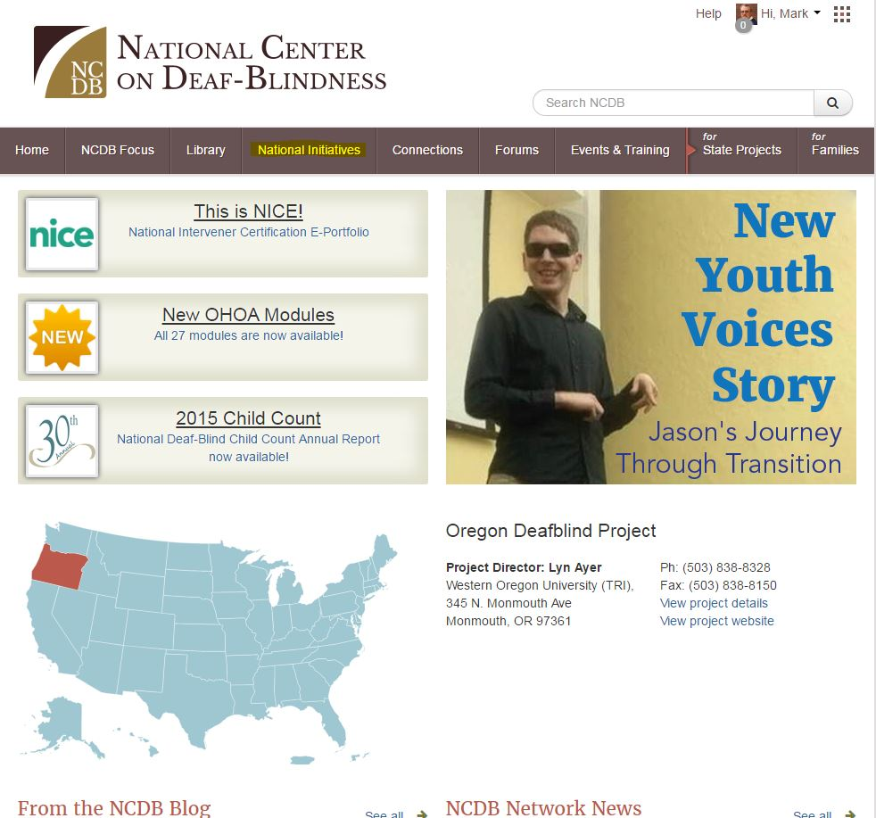
Child Count Group Page Tour:
NCDB Home Page

Slide 3
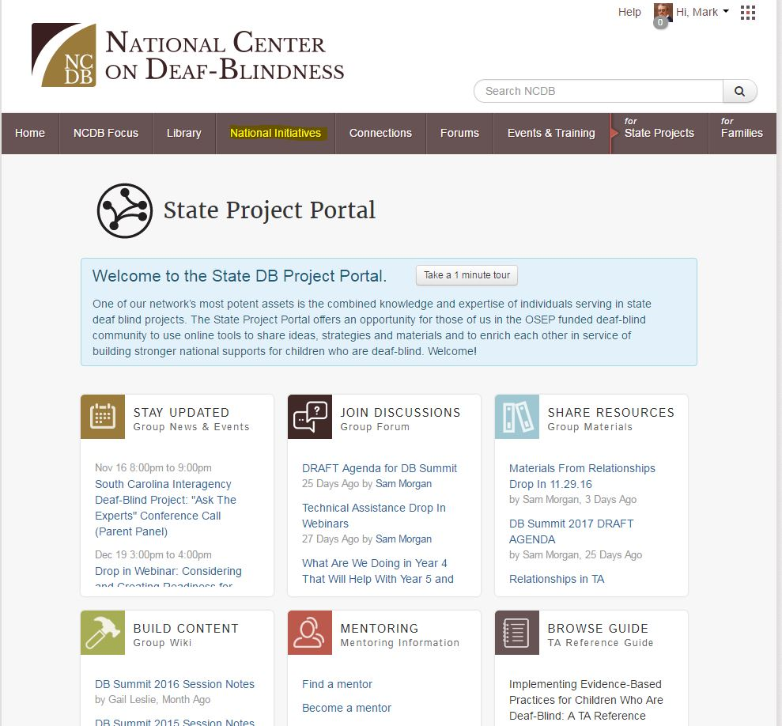
Child Count Group Page Tour:
State Project Portal

Slide 4
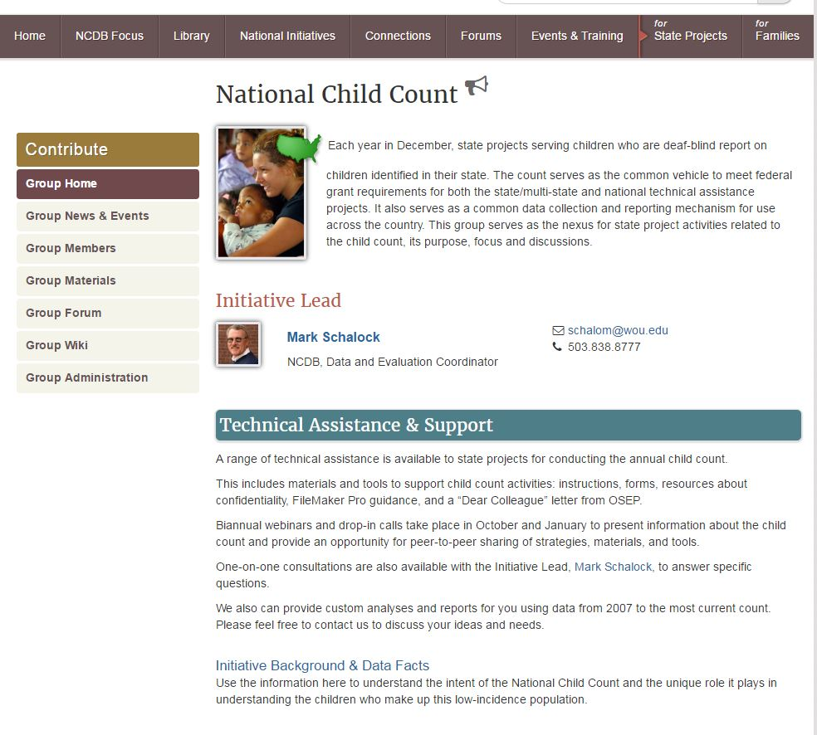
Child Count Group Page Tour:
National Child Count Group Home

Slide 5
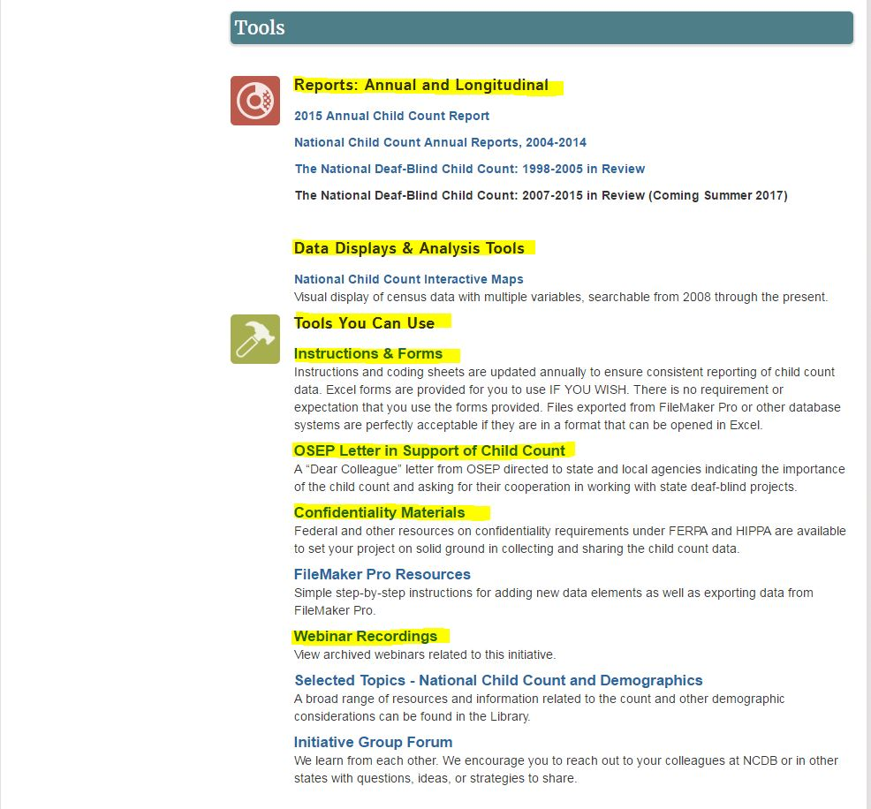
Child Count Group Page Tour:
National Child Count Group Home Tools

Slide 6
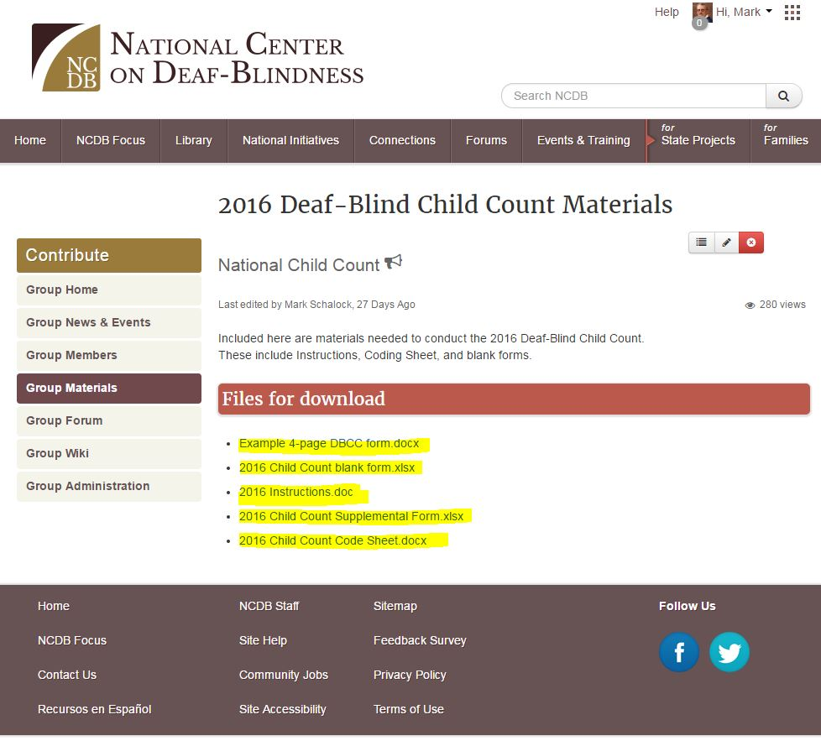
Child Count Group Page Tour:
National Child Count Group Forms/Instructions

Slide 7
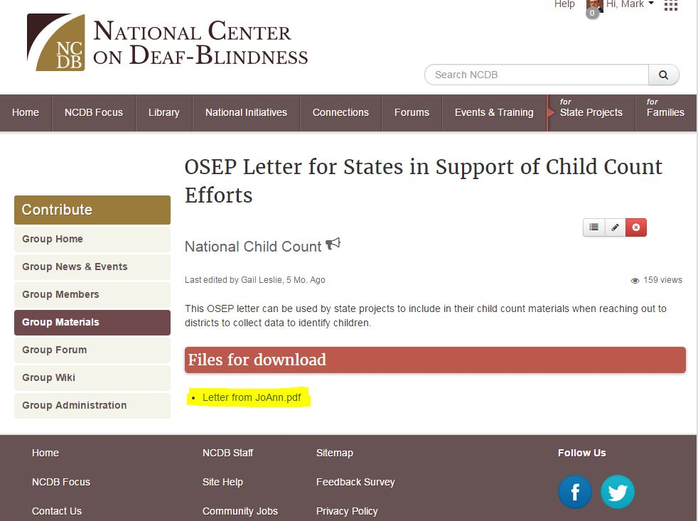
Child Count Group Page Tour:
Find OSEP Letter

Slide 8
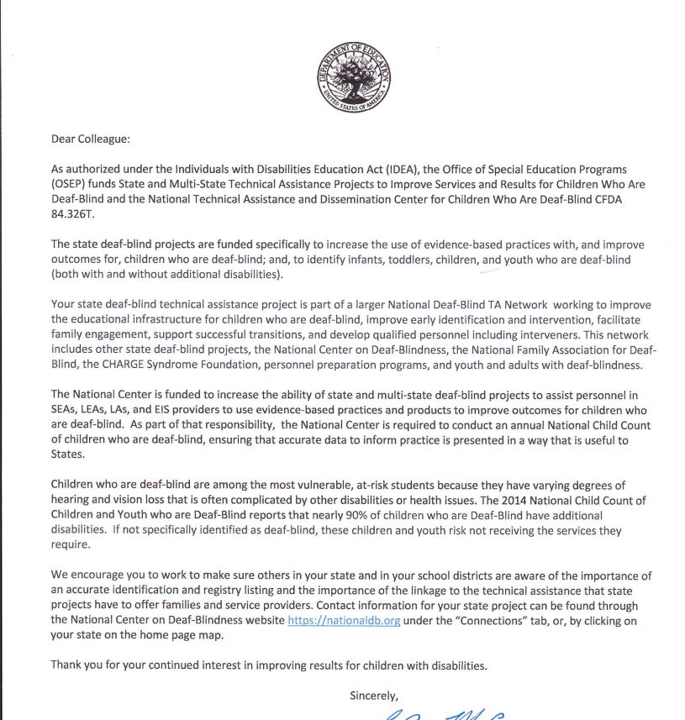
Child Count Group Page Tour:
Dear Colleague Letter

Slide 9
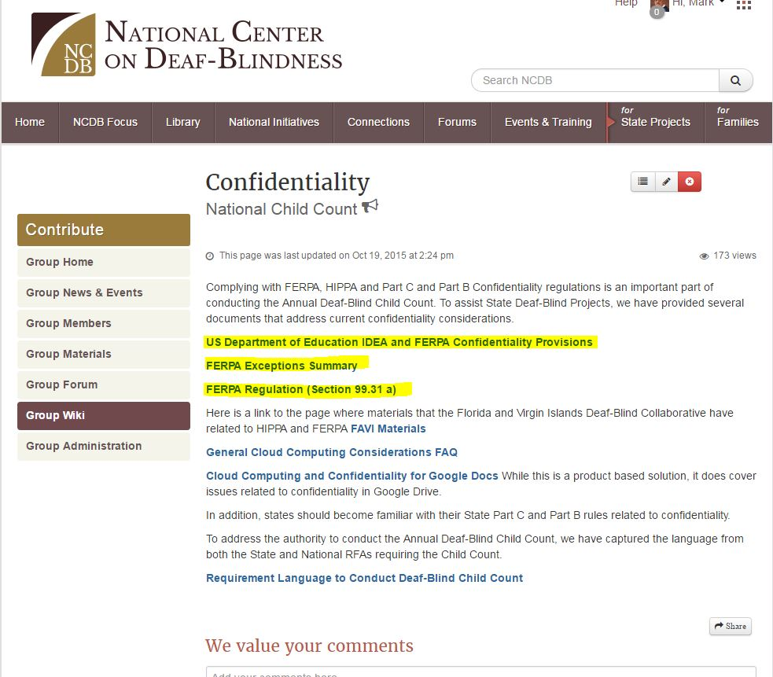
Child Count Group Page Tour:
Confidentiality Resources

Slide 10
Child Count Group Page Tour:
Reports

Slide 11
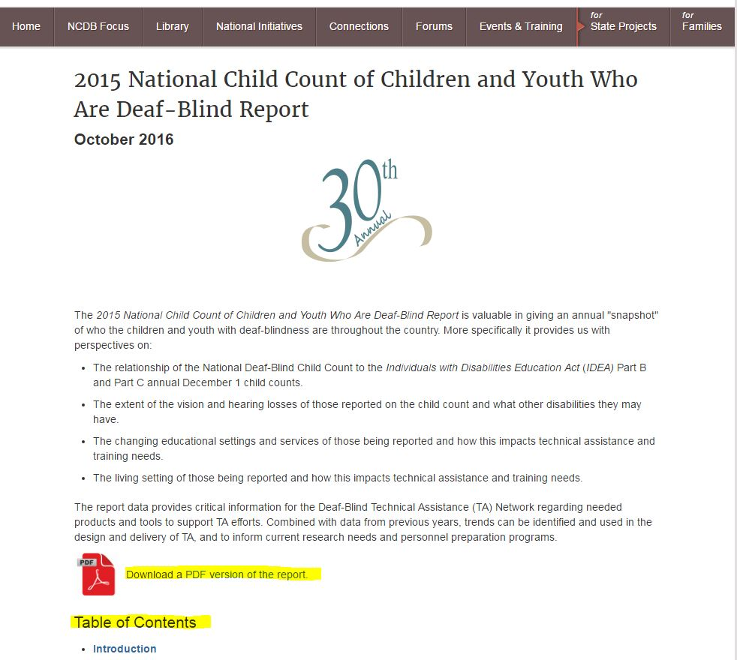
Child Count Group Page Tour:
2015 National Deaf-Blind Child Count Report

Slide 12
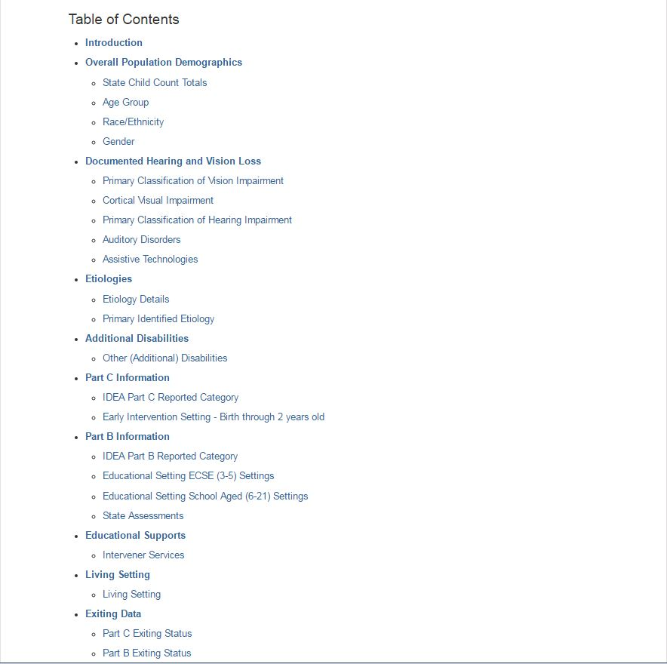
Child Count Group Page Tour:
2015 Report Table of Contents

Slide 13
2015 Child Count Report
30th annual report
Slight increase from 2014
Past trends continuing
Emerging trends

Slide 14
2016 Child Count - Preparation
Deaf-Blind Child Count Group page on the NCDB website.
Data Submission
  Dates
  Format
  Critical elements
  Early Submissions
  Requesting an extension
Contact Mark Schalock or Robbin Bull anytime with questions you may have (contact information on last slide)

Slide 15
2016 Child Count - Logistics
Dates
  May 1, 2017
  APR
  Extensions
Submitting your data file
  Excel
  Make sure columns are correctly titled
  Blank cells/missing data

Slide 16
2016 Child Count - “Must Have” Data
Critical Data Fields
  Vision and Hearing Loss
  Part C, Part B and Project Exiting Status
  Birth date
  Intervener Services

Slide 17
2016 Child Count - Additional Details
State Assessments
  Column 27
  Instructions and definition
  Directions for editing Filemaker Pro

Slide 18
Q & A
Questions?
Mark Schalock (503) 838-8777 schalom@wou.edu
Robbin Bull (503) 838-8562 bullr@wou.edu
Webinar Evaluation
http://alturl.com/4c85u

