Slide 1
CEC Knowledge and Skill Competencies for Interveners and Teachers
Dr. Linda McDowell, Director of NCDB
Dr. Amy Parker, Coordinator of Professional Development and Products

Slide 2
Focus of Our Conversation
Share some information about the CEC Knowledge and Skills Competencies for Teachers and Interveners
Share some of our thinking about how competencies might be useful to our field, it’s development, and recognition
Share some information about how competencies are currently being used- personnel prep, technical assistance, & product development
Describe our expansion in the Intervener Initiative to include Qualified Personnel with network partners (based on your input)

Slide 3
Competencies as National Assets
As there is increased recognition around the need for access to trained interveners and teachers, it is helpful to have national competencies as a guide in our planning, dialogues, and network-based efforts.
personnel prep;
professional development;
intensive technical assistance;
family leadership & education
Notes:
There have been many efforts by leaders in the field to recognize and address the needs of students by having standards for educators. Today we are going to address competencies that have been developed by one professional organization. Examples exist from Perkins as well as from other programs and universities. The importance of looking at competencies through the CEC is because it is a respected international special education organization that is recognized by accrediting organizations for universities and is also recognized by the U.S.Office of Special Education. We have also been different that our other low incidence fields as far as sustaining specialized knowledge and skills for teachers.

Slide 4
What are the competencies?
Professionally agreed upon specialized knowledge and skills to enable teachers or interveners to begin their practice with students.
Competencies are designed to recognize quality training programs in special education. They may also be used to guide what interveners and teachers believe, know, and do with students who are deaf-blind (and how to measure those knowledge, skills and beliefs).
The CEC encourages every special educator to use the standards as guides for ongoing professional growth and development.

Slide 5
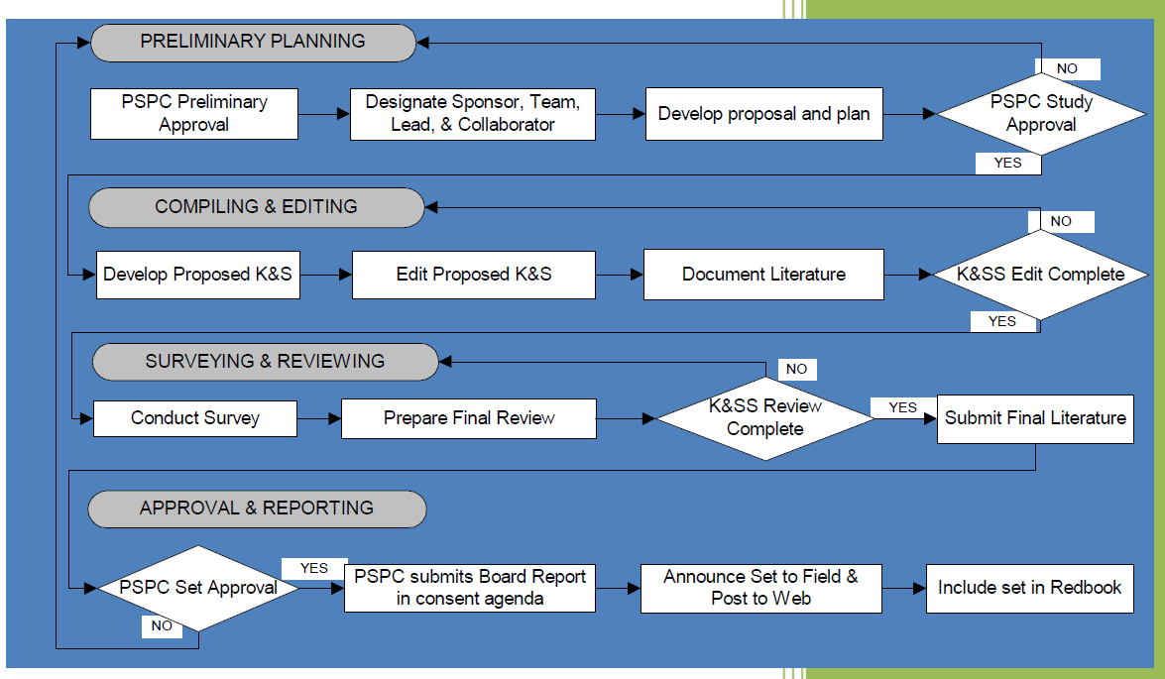
Council for Exceptional Children Validation Study
Figure from CEC Validation Study Resource Manual, 2010
Notes:
The CEC uses a systematic process for reviewing and validating competencies. The CEC Divisions also have a role in updating and maintaining competencies that are related to specialized roles.

Slide 6
A Brief History of DB Competencies
Zambone & Alsop (2009) described the process of working with the CEC to develop a set of knowledge and skills competencies.
Zambone & Alsop worked with Dr. Mary Jean Sanspree to engage in preliminary planning; compiling and editing; surveying and reviewing; & approval and reporting.
For more information on the process for setting and validating standards please see: https://www.cec.sped.org/Standards/Special-Educator-Professional-Preparation/CEC-Initial-and-Advanced-Specialty-Sets
Notes:
For over 30 years, the CEC has developed competency sets.
Zambone and Alsop also worked with partners to align each competency under the then 10 standards with the research, theory and practice base (literature review).

Slide 7
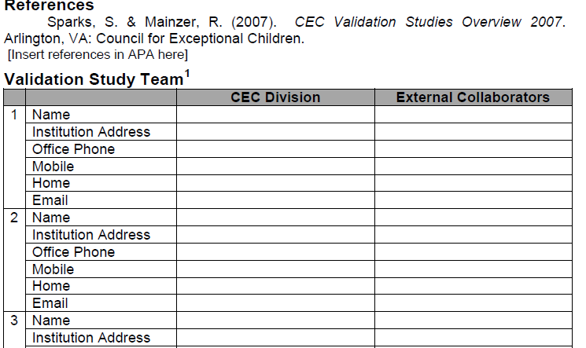
Validation Study Process- Work with Partners
External collaborators for the DB Competencies included the Association for Education and Rehabilitation of the Blind and Visually Impaired (AER) and the Directors of the State Deaf-Blind Projects; and NCDB

Slide 8
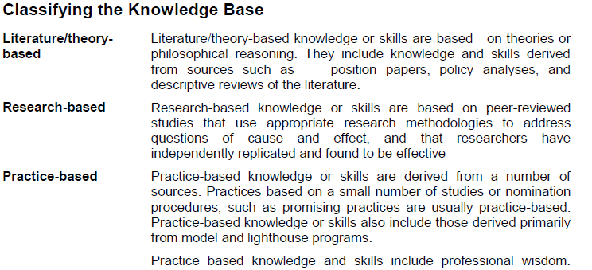
Aligning competencies with evidence

Slide 9
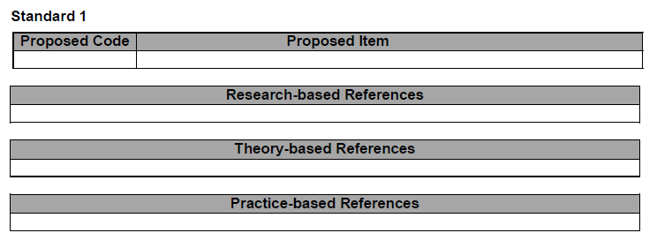
Item Analysis Process
Zambone and Alsop worked with partners such as NCDB’s personnel preparation group to systematically align each proposed competency with the available research, theory, and practice references.
I asked Alana for a copy of her item analysis and received a 65 page report!
Notes:
After the item analysis process is completely developed and submitted, the survey and reviewing and final literature review is done. It is then sent to the professional standards committee for final review, approval and publishing on the web.

Slide 10
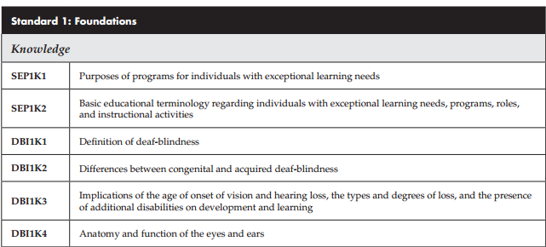
Anatomy of Competencies- Intervener, 2009
Aligns with Special Educator Paraprofessional Standards (SEP)
Deafblind Intervener (DBI)
10 Standards Recognized

Slide 11
Anatomy of Competencies-
Initial DB Speciality Set 2012
ISCI= Initial Specialty Common Items, 2012
ICC = Initial Common Core from 2010 competencies

Slide 12
Explore The Competencies
http://community.cec.sped.org/dvi/professionalstandards
http://www.cec.sped.org/Standards/Special-Educator-Professional-Preparation/CEC-Initial-and-Advanced-Specialty-Sets

Slide 13
Why do the competencies matter?
Rarest of low incidence fields
Alignment process around professions in our field- how do we align our efforts?
Recognition of roles at the local and state level
Please share other ways that the competencies may matter in your state. (chat pod)

Slide 14
Competencies Currently Being Used
Personnel preparation programs
Program development
Product development
Time for a poll: Current relevance, usefulness in TA and future use in TA
Please share ways that you may be using competencies in your work in states. (chat pod or raise hand to share comment)
Please share ways that you think NCDB may promote the use of competencies? (chat pod or raise hand to share comment)

Slide 15
What Ways Have We Used Competencies?
Lately...
Notes:
Personnel Prep Group- some literature reviews
OHOA Modules Creation
OHOA Modules Surveys and Assignments
OHOA Modules Alignment
Mahara E-portfolio Development
Conversations with UT, TX, personnel prep, the CEC, and other partners

Slide 16
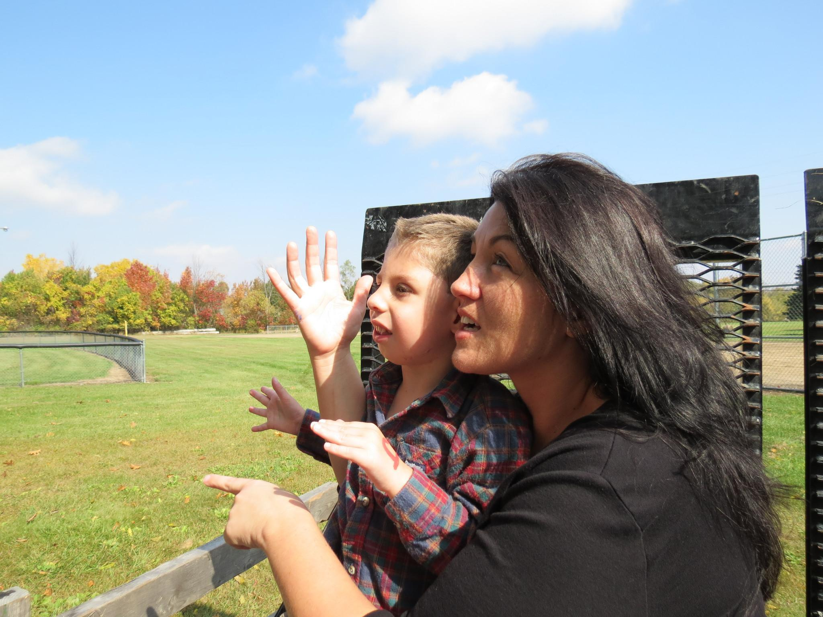
2012 Rationale from National Consortium on Deaf-Blindness Recommendations for Improving Intervener Services:
Goal 2- Training & Support
Establish a strong national foundation for intervener training and workplace supports.
Recommendation 3- Develop a national open-access training resource that aligns with the CEC's Knowledge and Skills Competencies
http://interveners.nationaldb.org/

Slide 17
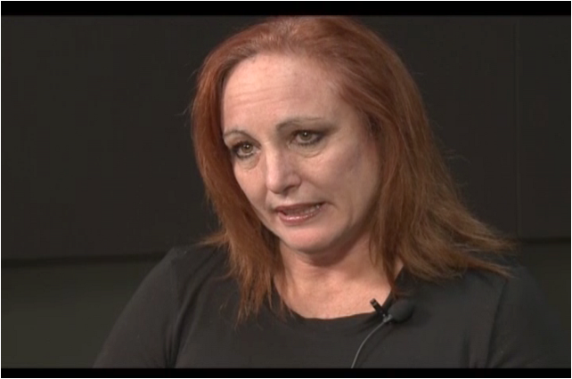
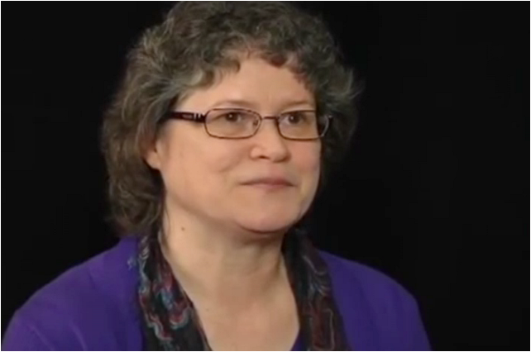
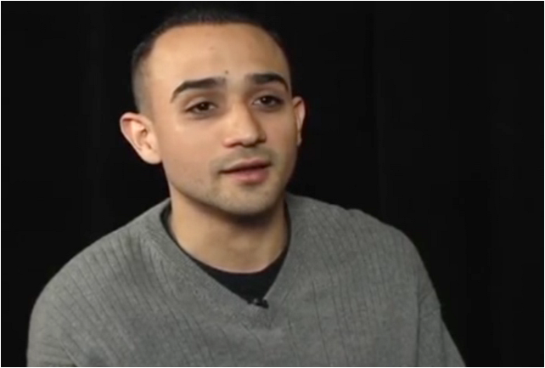
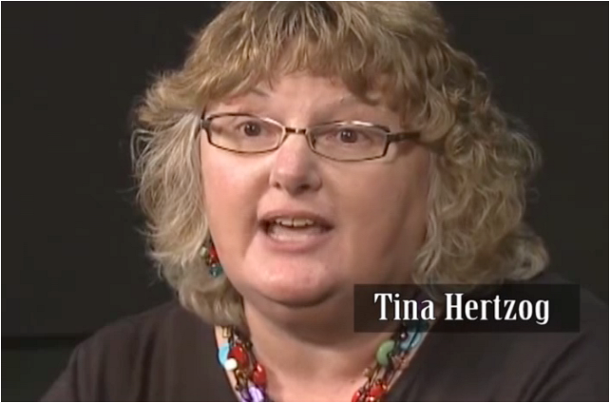
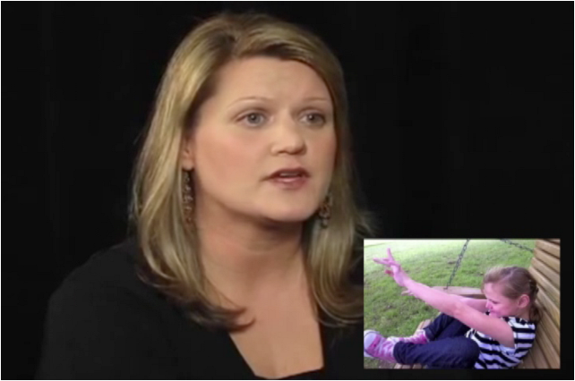
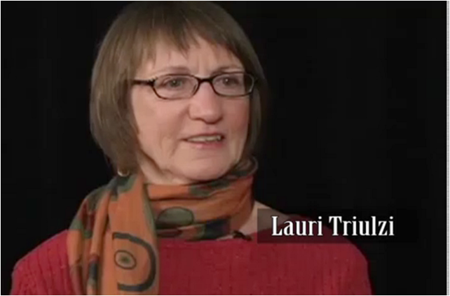
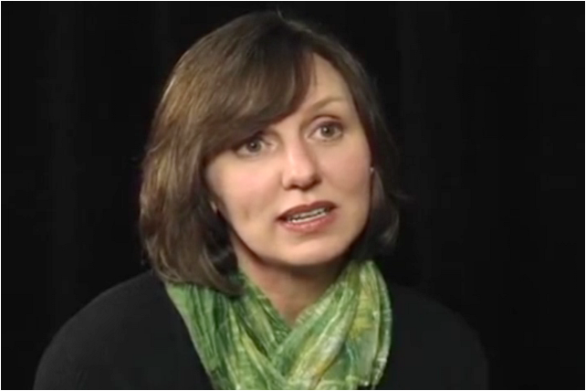
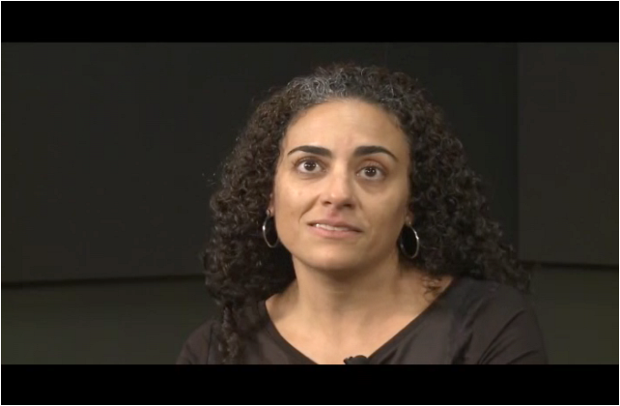
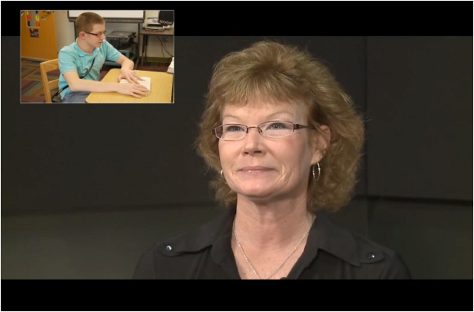
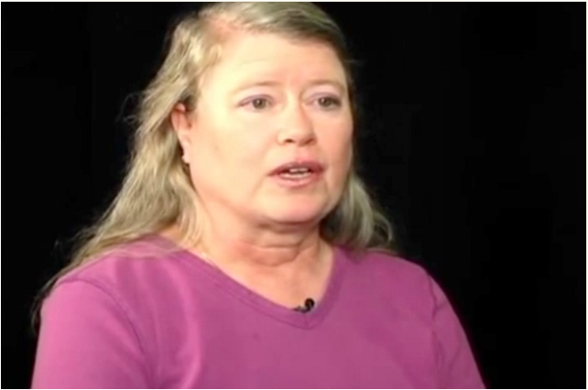
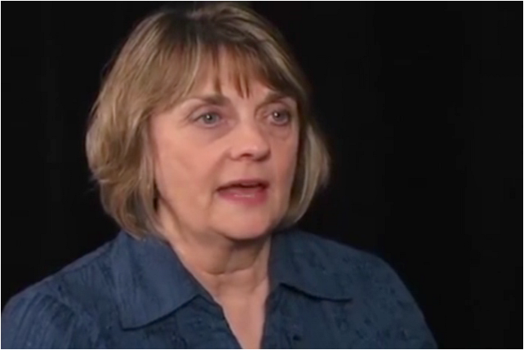
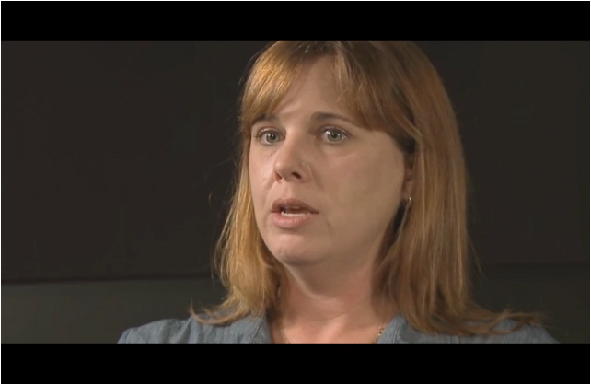
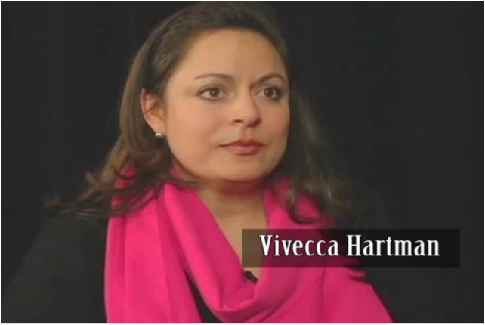
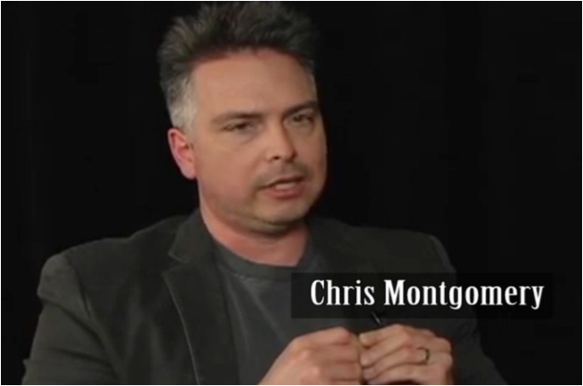
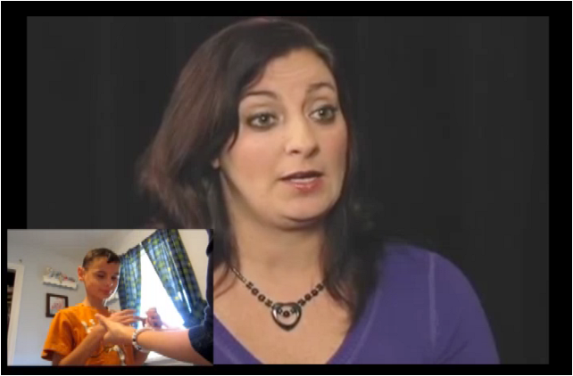
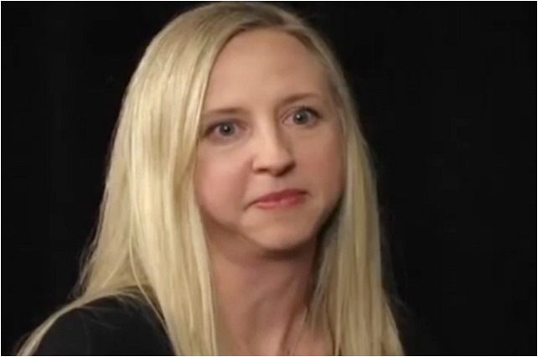
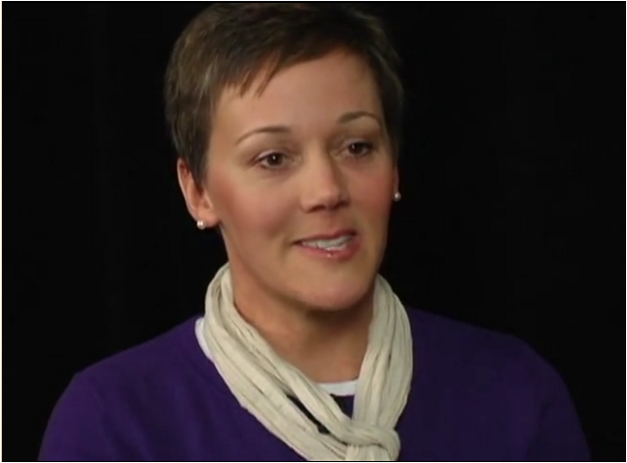
We have over 76 module creators!
TA providers, parents, teachers, educational interpreter, and interveners

Slide 18
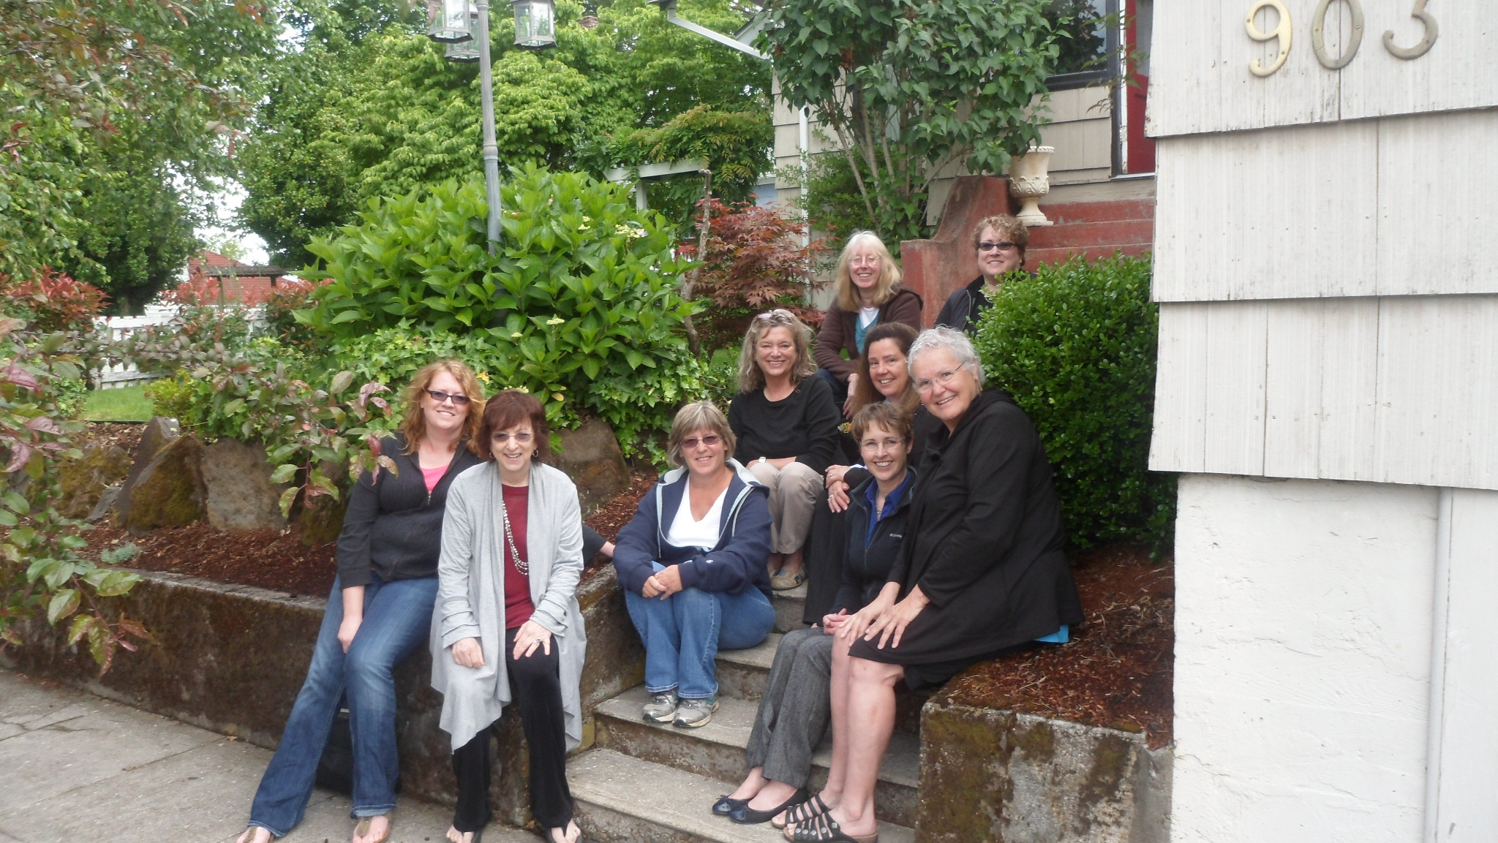
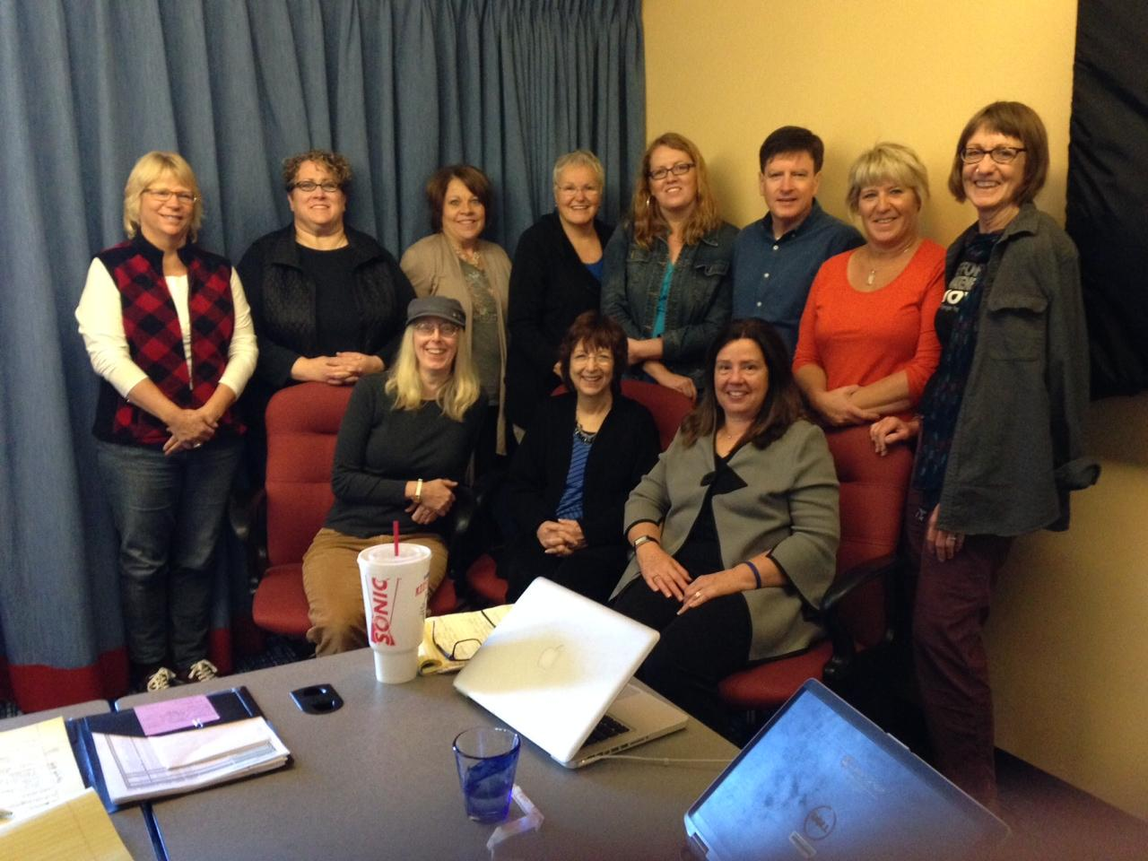
Bloom's Taxonomy Meeting & CEC Competency Alignment
Denver, 2013- Alignment of Modules 9-18
Portland, 2013- Alignment of Modules 1-8
So far, we have hosted two meetings to align OHOA modules with national intervener competencies

Slide 19
National Certificate Beta Test
Solving a complex challenge through participatory efforts
Interveners + State DB Projects + University Experts + NCDB

Slide 20
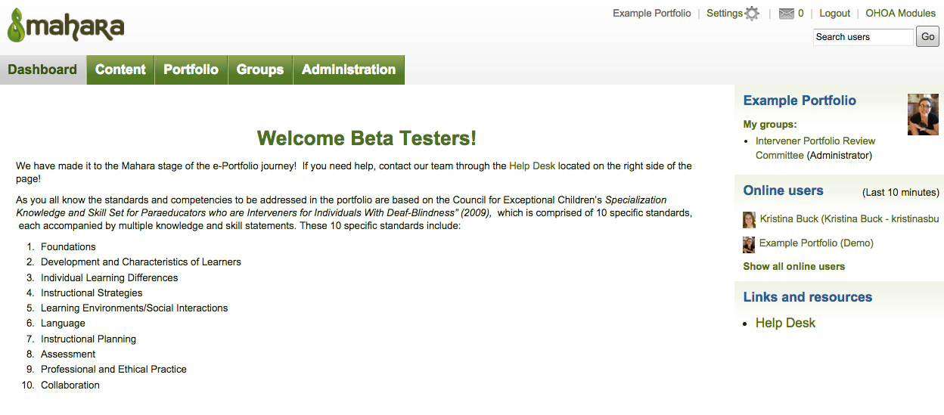
Mahara is Live! (and sustainable)

Slide 21
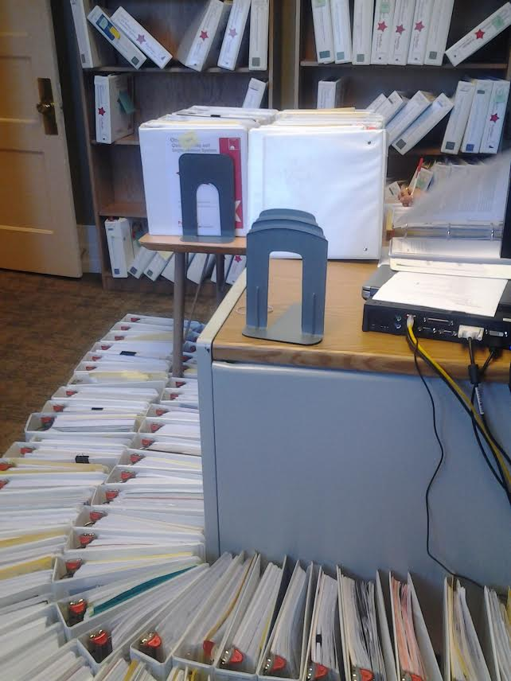
Measuring Competencies in Practice
Competency-based e-portfolio assessment- not program based
Working with identified competent interveners and partners to build and refine a process
Using developed portfolios to pilot and refine a review protocol
Measuring IOA across reviewers

Slide 22
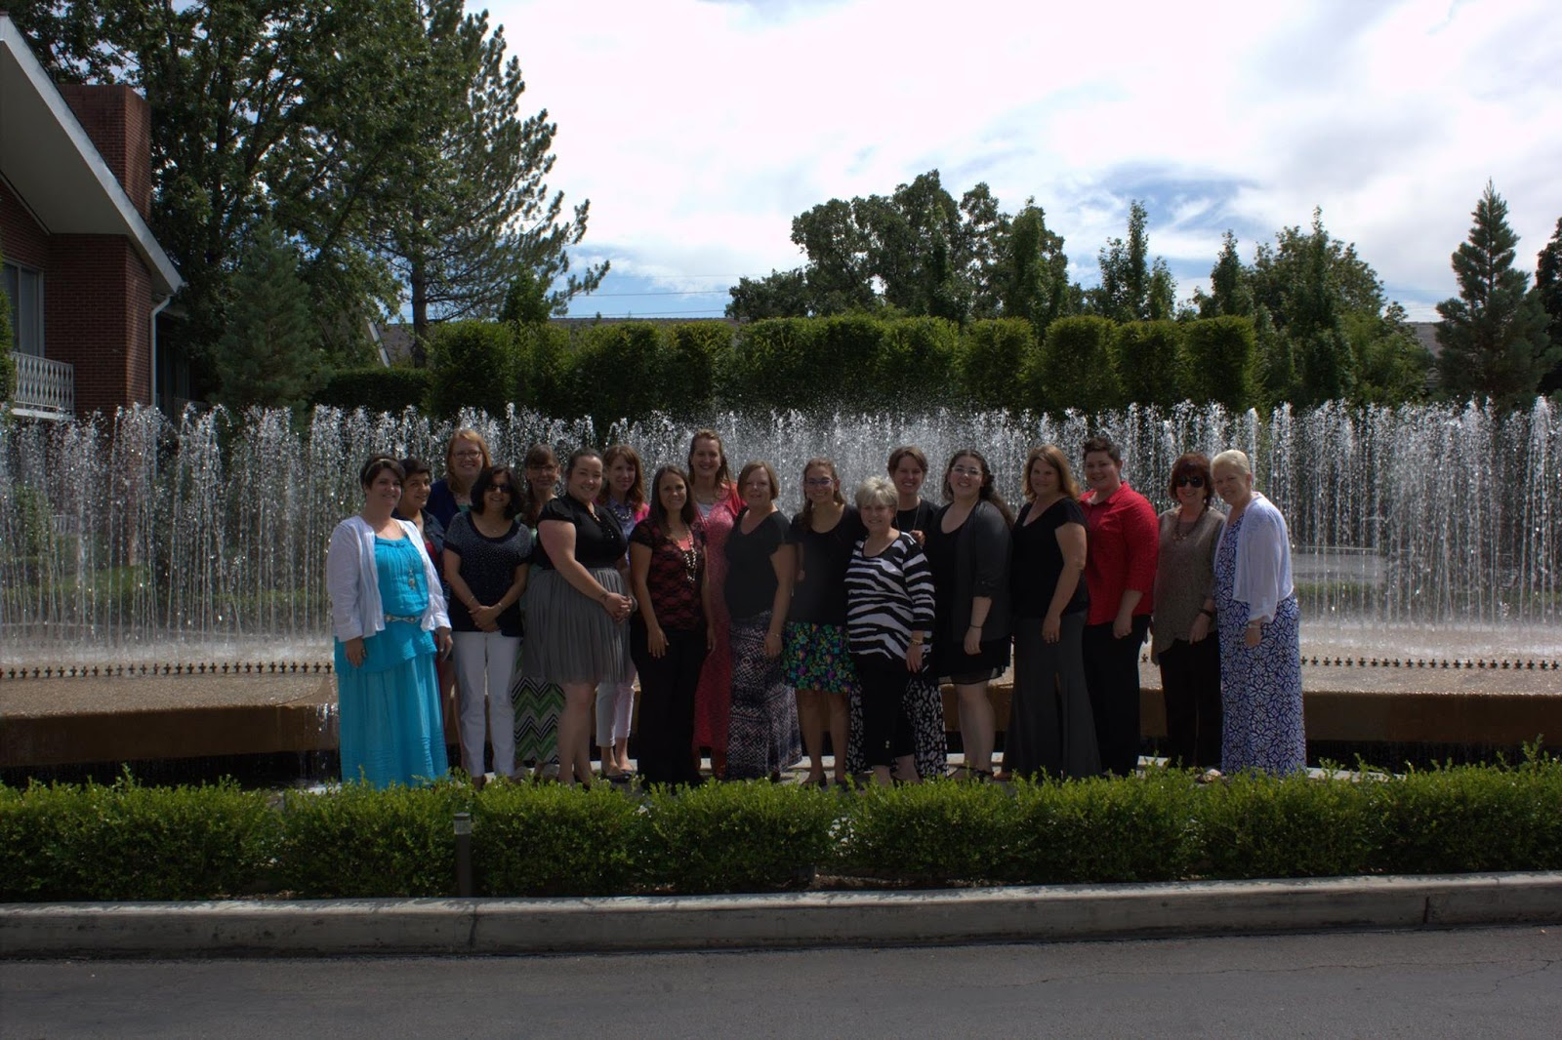
What’s on the horizon?
Mahara beta testers in Salt Lake gather their strength for the next part of the journey.

Slide 23
How do we plan to engage with the community?
Continue to complete the OHOA modules (field testing and refinement) and national certification effort with our network partners
Continue to explore the use of the OHOA modules with practicing teachers, educational teams, and family members- Moodle Users Group
Formally establish a Teachers Supporting Students with Deaf-Blindness workgroup as a part of the initiative
Formally establish Personnel Preparation workgroup within this initiative

Slide 24
Qualified Personnel Initiative
OHOA Field Testing/Revision
Advisory TWG
Literacy
Certification Group & Mahara Beta Testers
Moodle Users Group
Teachers of Students who are Deaf-Blind
Personnel Prep Group
Practicum
Interpreters
Notes:
Each sub-committee that is working in this initiative helps to sculpt the work and the agenda- identifies needs. Reporting and dialogue happen on the NCDB website. Regular information is shared on FB, blogs, twitter, Moodle and the NCDB site. Ideas for partnering with the CEC, family organizations, product development will stem from the different committee efforts and ongoing dialogues with members in the network.

Slide 25
Future Conversations:
In what ways will this initiative support you?
In what ways may this initiative support the work of our field of deaf-blindness?
What committees or activities are of interest to you?
We have a few minutes for comments or responses in the chat pod. We can continue the conversation in our forum posts.

