Slide 1
Culturally responsive partnerships
Sarah B. Ottow
Consultant, Confianza
www.ELLstudents.com
The contents of this presentation were developed under a grant from the U.S. Department of Education, #H326T180026. However, those contents do not necessarily represent the policy of the U.S. Department of Education, and you should not assume endorsement by the Federal Government. Project Officer, Susan Weigert.

Slide 2
Welcome!
Introduction
About Sarah Ottow & Confianza
About our Webinar Series

Slide 3
Our Three-Part Webinar Series
Culturally Responsive Partnerships:
June 6, 2019
Informed Practice
June 21, 2019
Parent Advisory Councils/Ambassadors
July 26, 2019

Slide 4
Goals for Session 1: Culturally Responsive Partnerships
Tips for examining your own identity and how that impacts connecting with families
Exploring where projects can look for state partnerships
Building up your support network

Slide 5
Goals for Session 2: Informed Practice
Dissemination strategies – how to effectively share information in ways that families will want to connect and attend
Technology tools to communicate with families
Once you find them, then what?

Slide 6
Goals for Session 3: Parent Advisory Councils/Ambassadors
Cultural perspectives on disability, family and education and how that informs our practice
Teach and empower Spanish-speaking families to understand Anglo-American culture
Supporting families once we draw them in
Empowering an advisory council to shape goals and outcomes

Slide 7
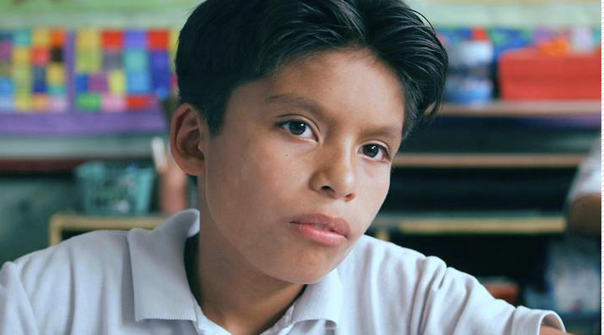
Pre-Webinar Video
EL student story example: Moises Video

Slide 8
An Equity-Based Mindset
A lens through which to view, think, consider, notice perspectives beyond your own
Strength-based not deficit-based
Everyone belongs and everyone is welcome!
Actionable, inquiry-oriented…one step at a time!
Notes:
I understand that in your roles you have limitations so it can be frustrating and even overwhelming to take in all that we are going to discuss today, but I invite you to (just like I tell our clients in schools who also feel that way given all that we are trying to do!) choose ONE next step…leave today with one thing to do—reach out to one state partner, one step forward!

Slide 9
Trends in the US
1/10 public school student is an “English Learner”/EL or ELL
Most are US-born
Fastest growing subgroup of students in schools
From NPR’s English Language Learners: How Your State is Doing, 2017

Slide 10
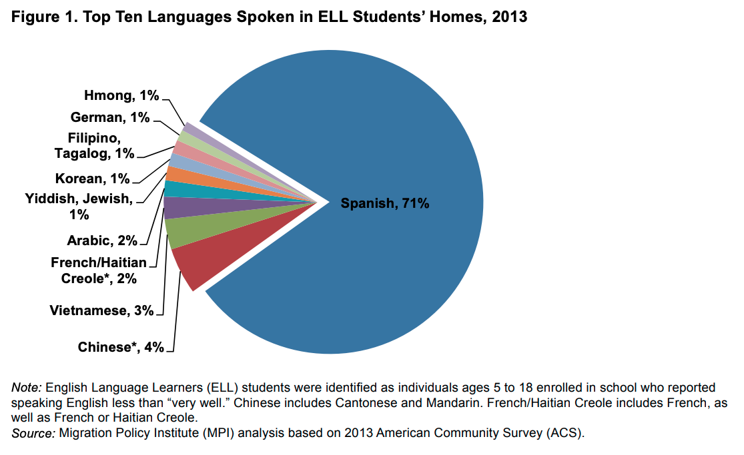
Trends in the US Chart
From Migration Policy Institute as featured in NPR’s English Language Learners: How Your State is Doing, 2017
Notes:
Chinese was the second most common language spoken in ELL students' homes representing 4 percent of ELLs, followed by Vietnamese (3 percent) and French/Haitian Creole (2 percent). A language other than Spanish was the top language spoken by ELLs in five states: Alaska, Hawaii, Maine, Montana, and Vermont. In 19 states and the District of Columbia, more than three-quarters of all ELL students spoke Spanish.
Chinese was the second most common language spoken in ELL students' homes representing 4 percent of ELLs, followed by Vietnamese (3 percent) and French/Haitian Creole (2 percent). A language other than Spanish was the top language spoken by ELLs in five states: Alaska, Hawaii, Maine, Montana, and Vermont. In 19 states and the District of Columbia, more than three-quarters of all ELL students spoke Spanish.
Chinese was the second most common language spoken in ELL students' homes representing 4 percent of ELLs, followed by Vietnamese (3 percent) and French/Haitian Creole (2 percent). A language other than Spanish was the top language spoken by ELLs in five states: Alaska, Hawaii, Maine, Montana, and Vermont. In 19 states and the District of Columbia, more than three-quarters of all ELL students spoke Spanish.

Slide 11
Assets of English Learners (ELs)
Funds of knowledge
Bilingualism/
multilingualism
Biculturalism/
multiculturalism
Windows to the world, our history, our future and our global society
Notes:
ID--self-reporting survey, immigration status

Slide 12
Challenges of ELs
Identification and referrals
Learning language and content simultaneously
Referral issues
Drop out issues
Culture of failure/deficit lens
Underprepared educators and systems
Notes:
ID and referrals also a challenge for YOUR students
Only 63 percent of ELLs graduate from high school, compared with the overall national rate of 82 percent.
Of those who do graduate, only 1.4 percent take college entrance exams like the SAT and ACT.

Slide 13
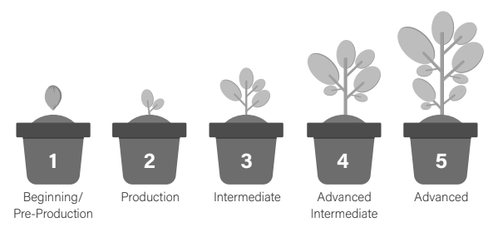
Levels of Language Acquisition
From The Language Lens from Sarah Ottow

Slide 14
Level 1: Beginning/ Pre-Production
Can understand and produce single words or phrases with general vocabulary
May have a “silent period”
Benefits from supports like visuals, gestures, language buddy, Y/N questions, simple commands (match, label, draw, circle)
Can last 2 months to a year
Water

Slide 15
Level 2: Production
Can understand and produce multiple, related simple sentences and general vocabulary with some specific vocabulary
May understand more than he/she can express
Benefits from focus on meaning (not correctness) and supports like cooperative grouping, word banks, sentence stems
Can last 6 months to a year
Water, can have?

Slide 16
Level 3: Intermediate
Can understand and produce short and some expanded sentences with emerging technical vocabulary
Oral language (L&S) may be more proficient than literacy (R&W)
Benefits from feedback around “errors” to improve writing like goal setting and using supports like graphic organizers
Can last 1-2 years (or more if fossilized!)
I want water please.

Slide 17
Level 4: Advanced Intermediate
Can understand and produce expanded and some complex sentences with a more technical vocabulary
Idioms/expressions and homonyms may still be challenging and require explanation
Benefits from expanding technical vocabulary, types of sentences and genres
I would really like please some water because I am thirsty.

Slide 18
Level 5: Advanced
Can understand and produce multiple complex sentences with more expanded vocabulary
May “sound like” a proficient English peer but can still benefit from scaffolds
Academic language has expanded in terms of both quality and quality
Excuse me, Ms. Ottow. May I have please have some water? I am extremely thirsty.

Slide 19
Go Beyond the Surface
SURFACE CULTURE:
Food, dress, music, language, arts, holidays
DEEP CULTURE:
Concepts of time, childrearing, disability, friendship, age, gender, personal space, body language
Notes:
What is culture? It is a shared system of meanings, beliefs, values and behaviors through which we interpret our experiences. Culture is learned, collective and changes over time. Culture is generally understood to be "what we know that everyone like us knows."

Slide 20
Some Aspects of Identity
Race
Gender
Age
Language
Religion or Spiritual Affiliation
Ability
Sexual Orientation
Socio-Economic Class
Ethnicity
Notes:
warn that these baseline concepts should never be used as descriptions for specific individuals, but as a place to begin the conversation around the different categories and groups that we use to define others and ourselves.

Slide 21
Start With Your Own Identity
I am…an educator/edu-prenuer
I am…bilingual/multilingual
I am…a sister of a person with disabilities
I am…a daughter of strong parent advocates
I am…a first generation college student
I am…a former ”free lunch student”
What is visible? Invisible? Both?
What assumptions could be made about me?
Notes:
What are the visible characteristics of your identity?
What are the invisible characteristics? –example: education, work role, socio-economic status
My own identity informs how I view others and my own biases
Bias: lacking a neutral viewpoint only noticing (and learned through) a group perspective

Slide 22
Consider our Own Biases:
What do I notice?
What am I NOT noticing…yet?
What am I going to do about it?
From We Must Always Look Inward from Confianza
Notes:
Example from my own “social location” OR ”cultural lens” which is informed by and linked to issues of power and perspective
If we are from the dominant culture or cultural groups, we may be reinforcing OR INTERRUPTING these power relations if we do not unpack our own biases
Helpful article from Confianza’s collection
In Dr. Dorinda Carter Andrew’s TED Talk, The Consciousness Gap in Education, she suggests three key questions to guide educators in critical reflection:
How does my own social location shape my mindset about teaching and learning?
What else is there that I need to know around culture, power, and difference?
How can I be a more critically conscious leader?

Slide 23
Example 1
What do I notice based on my cultural lens?
Hispanic population not participating in family events at school
Notes:
These questions help us identify our cultural lenses. We can simplify Dr. Carter Andrew’s questions to:
What can I see?
What can I NOT see…yet?
What am I going to do about it?
If we do not identify our cultural lenses, we won’t be able to articulate why we do the things we do. Without knowing our cultural lenses, our response to the question, “Why?” will be, “Because that’s the way WE have always done it.” WE being the ultra-exclusive dominant culture. If we want our classrooms to be inclusive spaces that prepare our students to be, “Better community members, more empathetic humans,” we must first identify the lenses that we use to interpret the world around us so that we can expand our cultural lenses to reveal perspectives that were once invisible to us. Thus I pledge, I must always look inward so that I can prepare students to look outward.

Slide 24
Example 2
What am I NOT noticing…yet that I need to learn about others?
Cultural values about schooling: maestra
Language barriers: translation/interpreters in place
Family obligations: working 2^{nd,} 3rd shifts
Other factors: trauma, socio-economic class, immigration status
Notes:
Go beyond surface level

Slide 25
Example 3
What am I going to do about it to be more critically conscious and anti-bias?
Learn from families by active listening and building relationships built on mutual respect and trust
Get outside of comfort zone and go below the surface to understand deeper levels of culture
Notes:
Perspective-taking and empathy-building

Slide 26
Cultural Responsiveness Starts with Anti-Bias Values
building and drawing on intergroup awareness, understanding and skills
creating [classroom] environments that reflect diversity, equity and justice
engaging families and communities in ways that are meaningful and culturally competent
encouraging students [and families] to speak out against bias and injustice
From Teaching Tolerance’s Critical Practices for Anti-Bias Education

Slide 27
Cultural Responsiveness Starts with Anti-Bias Values Continued
including anti-bias curricula/[approaches] as part of larger individual, school and community action
supporting students’ [and families’] identities and making it safe for them to fully be themselves
using [instructional] strategies that support diverse learning styles and allow for deep exploration of anti-bias themes
From Teaching Tolerance’s Critical Practices for Anti-Bias Education

Slide 28
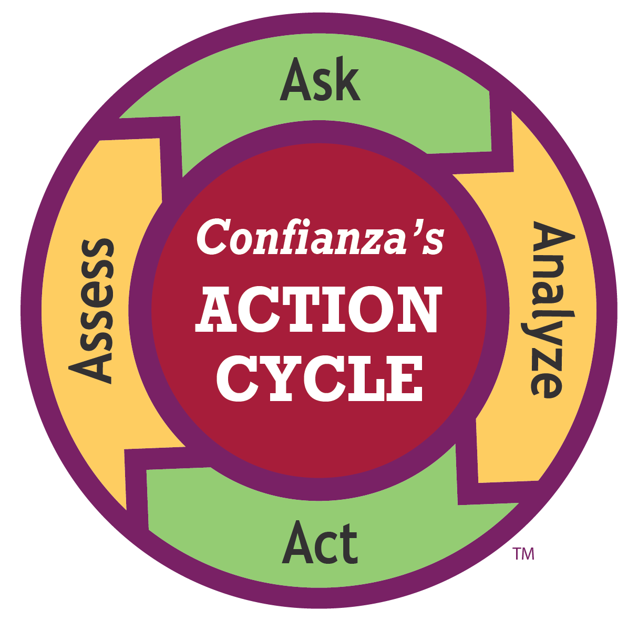
Let’s Take Action!
Notes:
Place within your sphere of influence given your limitations and your role
Instead of frustration, let’s find ONE ACTION STEP for a next step with one partner

Slide 29
Exploring Where Projects Can Look for State Partnerships
Knowing the learners
Knowing the families
Knowing the cultures
Knowing the resources
Discerning one next step!

Slide 30
Follow-Up Resources Check out links suggested in each of these resources, too!
We Must Always Look Inward
Developing Empathy for English Learners
Language and Culture Go Hand in Hand

Slide 31
Follow-Up Resources
Teaching Tolerance’s Critical Practices for Anti-Bias Education
NPR’s ELLs: How Your State is Doing

Slide 32
Recommended Guidebook about English Learners
25% off with code OTTOW25
Link to book

Slide 33
Thank You!

