Slide 1
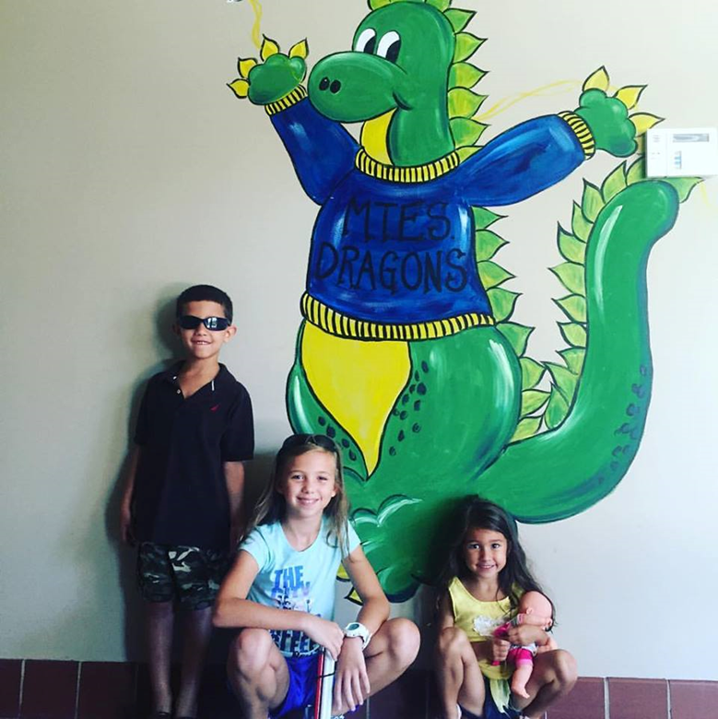
Hello MTES

Slide 2
What is Usher Syndrome
A condition that results in combined hearing and vision impairment.
The major types of Usher Syndrome are:
Type I
Type II
Type III
The degree of hearing loss associated with Usher Syndrome depends on the type of Usher Syndrome the person experiences.
Retinitis Pigmentosa is the eye condition associated with all types of Usher Syndrome.

Slide 3
AVA
Ava with Usher Syndrome
The “A’s” of Ava
Usher Syndrome Type I
Profoundly deaf at birth
Received cochlear implants
Right at age 1
Left at age 3
Retinitis Pigmentosa
Completely blind at night
Field Vision loss during the day
Avid reader
Always a competition
Athlete
Artist
Advocate
Anything is possible

Slide 4
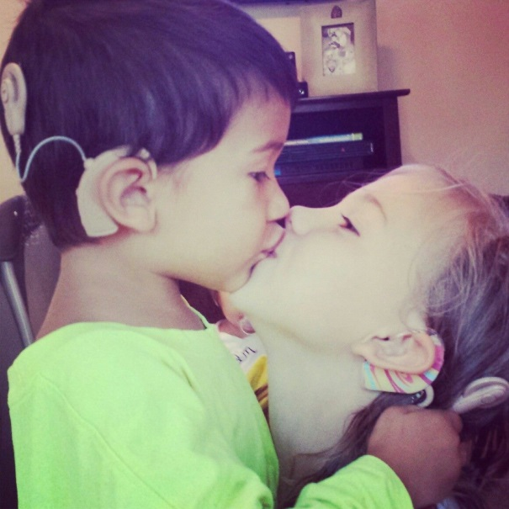
Profoundly Deaf
Although Ava receives benefit from the use of her Cochlear Implants, she is still deaf.
Cochlear Implant
Device that provides access to speech and language
Bypasses the ear and sends a signal to the part of the brain that processes speech
Hearing in large/noisy environments is difficult
FM System
The use of a personal FM System provides access to the “speakers” voice no matter where the person is in the room as long as they are in range

Slide 5
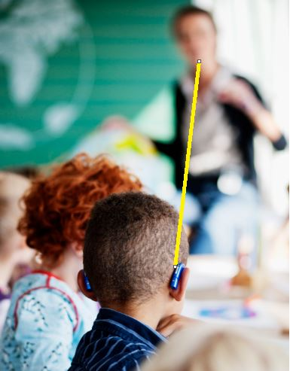
FM SYSTEM
Hearing Loss in the Classroom

Slide 6
Retinitis Pigmentosa
This is a condition of the retina that impacts the eye’s ability to send images to the brain.
The condition is characterized by:
Difficulty seeing at night or under conditions of low illumination (dim light)
Difficulty with changes in illumination
Difficulty with glare
Loss of peripheral vision
Progressive decrease in peripheral vision until the person is blind. This usually happens over a number of years. But, the progression is unique for each person experiencing it.
It is difficult to predict when or if the person will become totally blind.
Ava has 40 degrees of vision left in each eye 80/160 diameter and is completely blind at night
She has difficulty with contrast and transitioning in and out of lit places.

Slide 7
Ava LOVES
to read!
Black text on white background

Slide 8
Ava LOVES
to read!
White text on black background

Slide 9
What does the person with RP see? Here are several examples
Example 1
First image, a headshot of Mona Lisa with some background can be seen. Second image, view is limited to a circle showing only Mona Lisa’s face and some of her hair. Third image, view is limited to a smaller circle showing only a portion of Mona Lisa’s face.

Slide 10
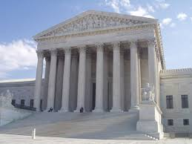
Example 2

Slide 11
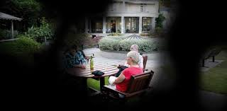
Example 3

Slide 12
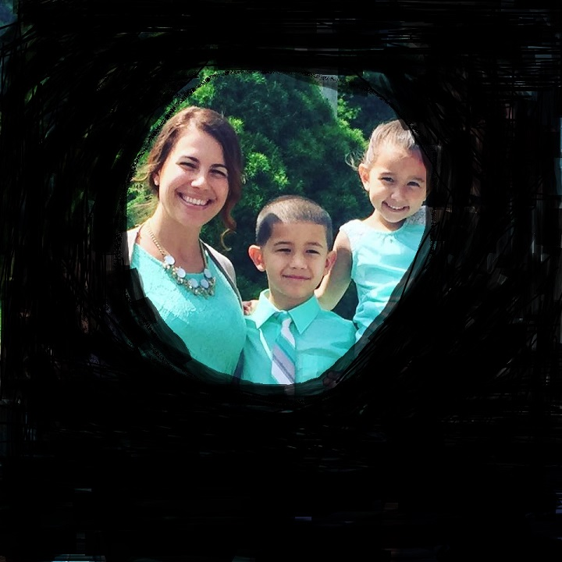
Example 4

Slide 13
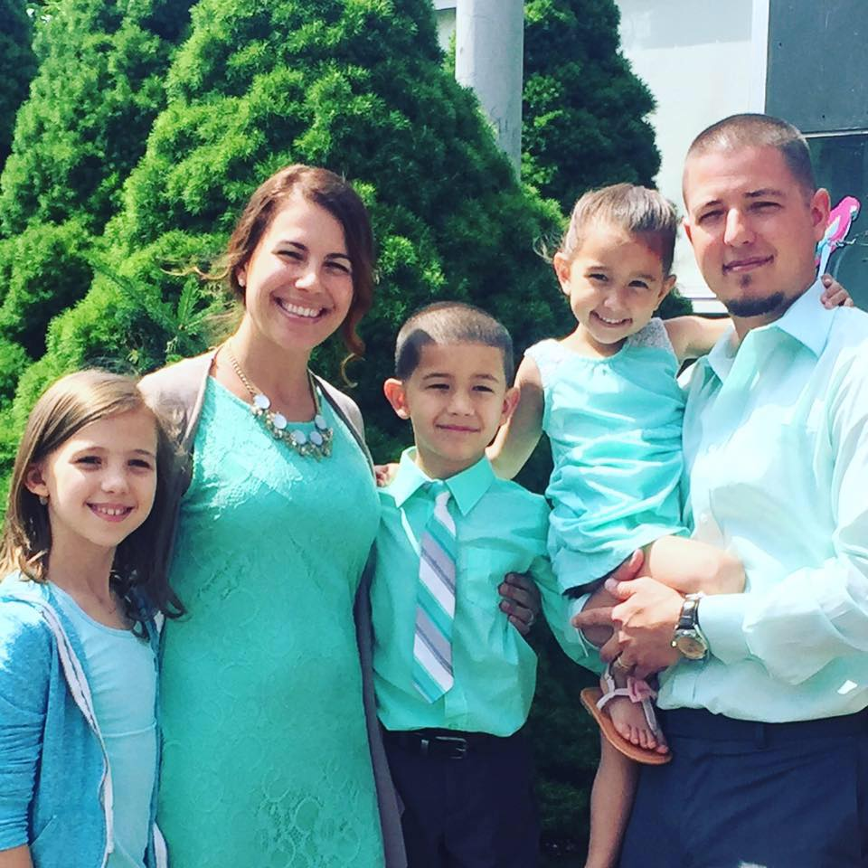
Example 4 cont.

Slide 14
Usher Syndrome & Balance
Due to limited vestibular functioning (originating in the middle ear) students with Usher Syndrome Type I often experience difficulty with balance.
This is especially problematic in conditions of low illumination.
Physical and occupational therapy can help improve balance.
Core strengthening and activities such as horseback riding can improve the ability to compensate for the decreased vestibular functionality.
Many students with Usher Syndrome Type I can participate in sports.
Sports such as swimming, wrestling, baseball, softball, karate, and track & field (including cross country) are particular favorites of students with Usher Syndrome.
Mobility training is also absolutely essential.

Slide 15
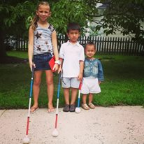
Orientation & Mobility
Stages of instruction
Navigating in the dark
Safety
Independence
AVA IS AWESOME!!

Slide 16
Modifications vs. Accommodations
Ava does NOT require any modifications to the curriculum
Hearing
FM system must be used by every instructional teacher/presenter*
Pass mic can be used by peers in group discussions
Teacher can restate the question prior to providing a response
Preferential seating
Use of dual audio cable when utilizing technology and during testing
Vision
Standing may be necessary to get optimal range of vision
Highlighting is beneficial to enhance contrast
Use of the ipad to make text books accessible
Items such as slant board and dark pencils may be used
Take care when lowering the lights in the classroom.
Alert the students when the lights will be lowered.
Avoid lowering lights when the students are on the move. Wait until they are standing still or seated.
Shade the windows on bright days to reduce glare.
Avoid standing in front of the window when teaching or speaking to the students.
O&M
Classroom should not contain boxes are items on the floor
Chairs should always be pushed in
Use of cane will support independence and obstacle avoidance
Awareness will promote safety for everyone in the building

Slide 17
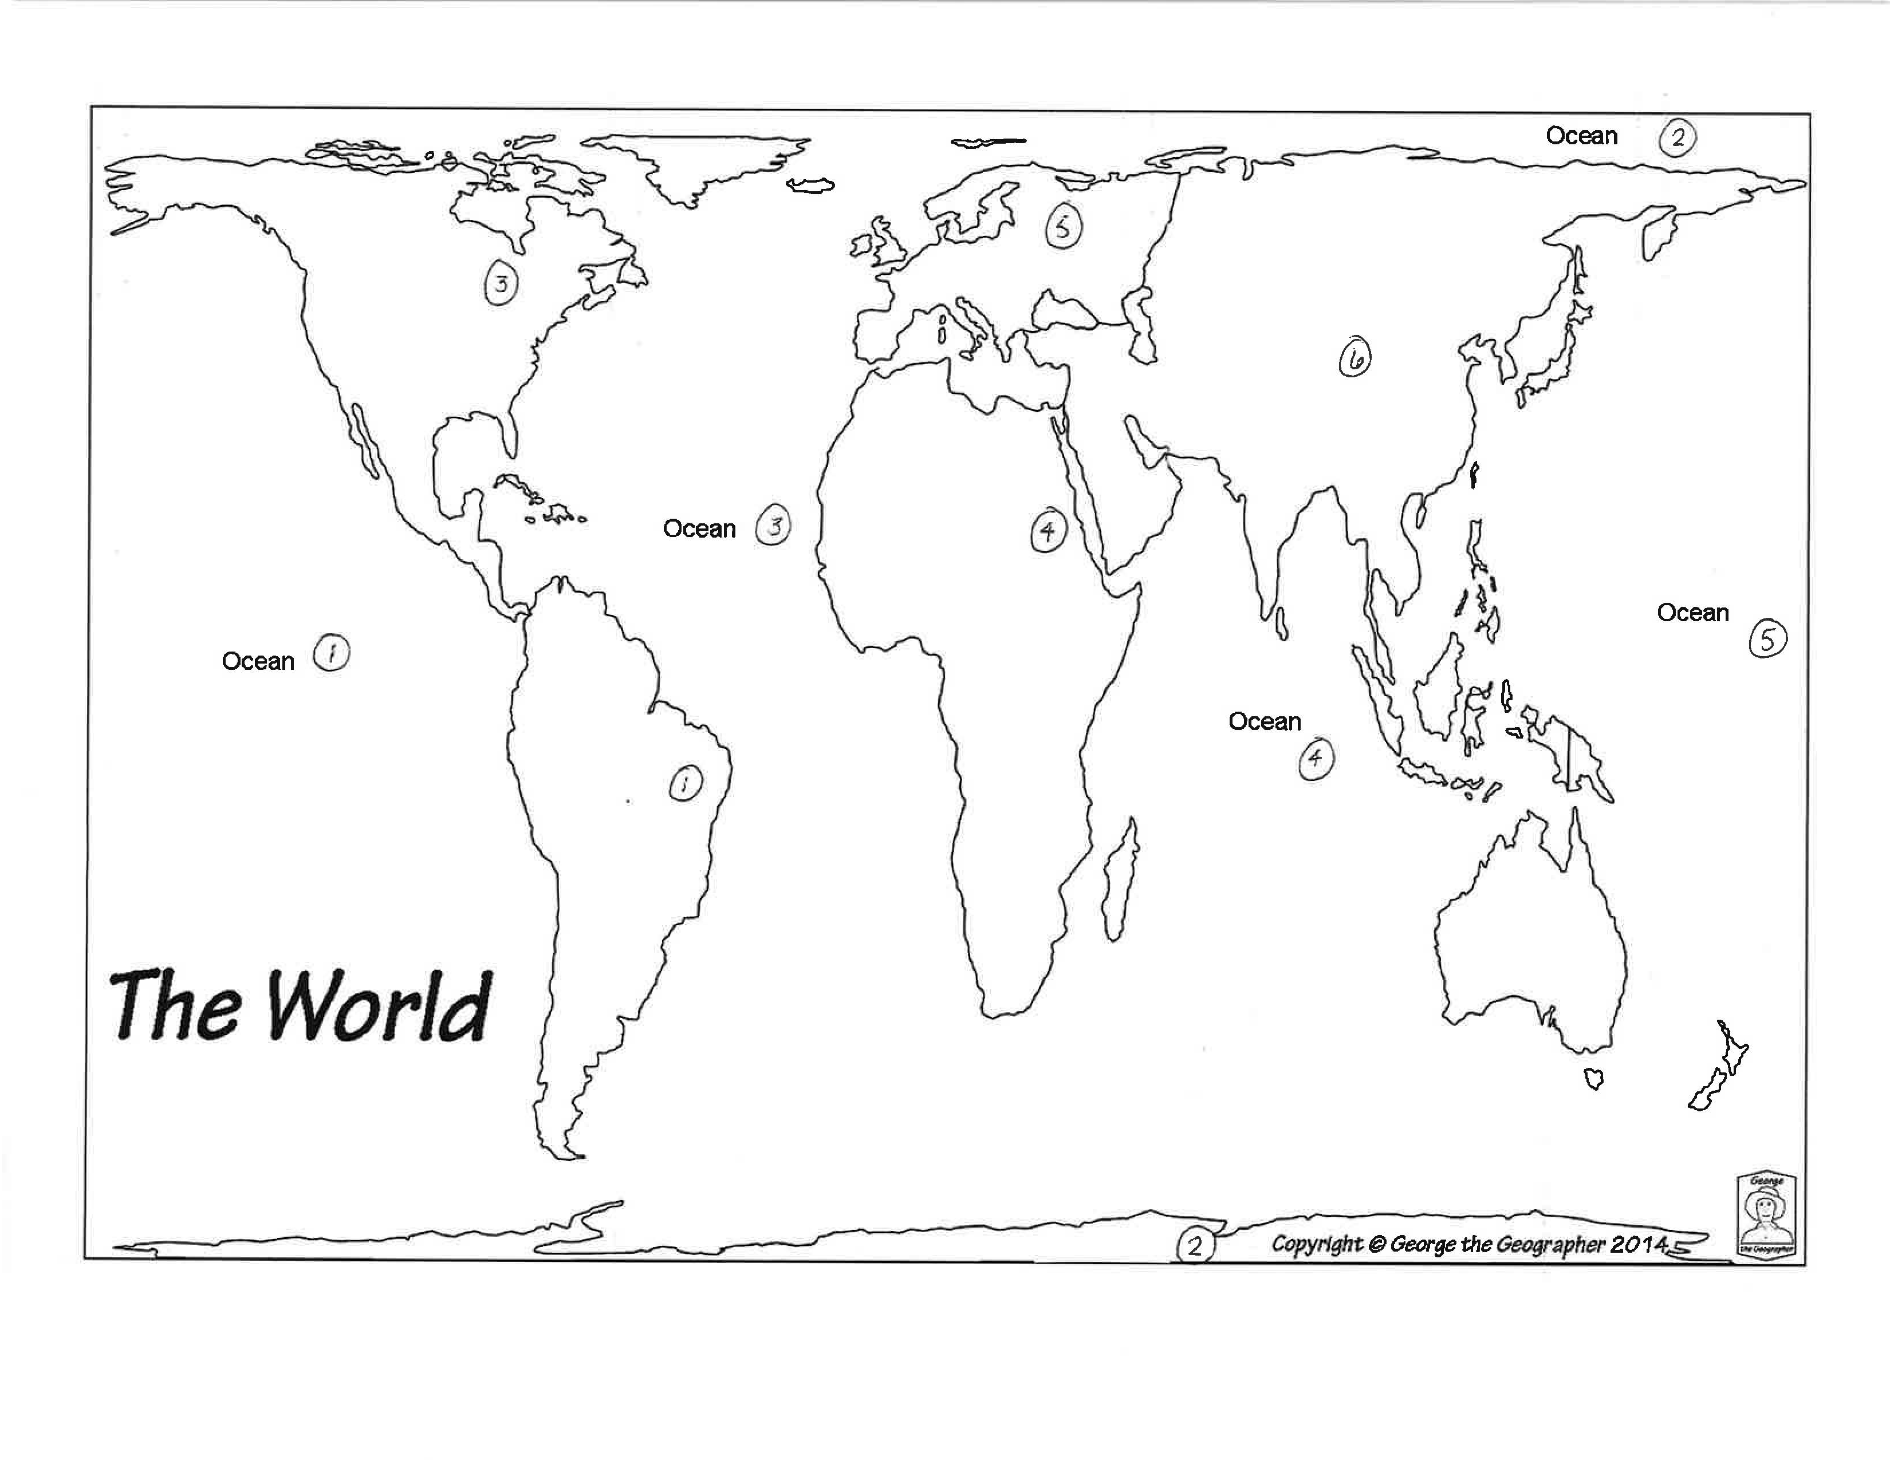
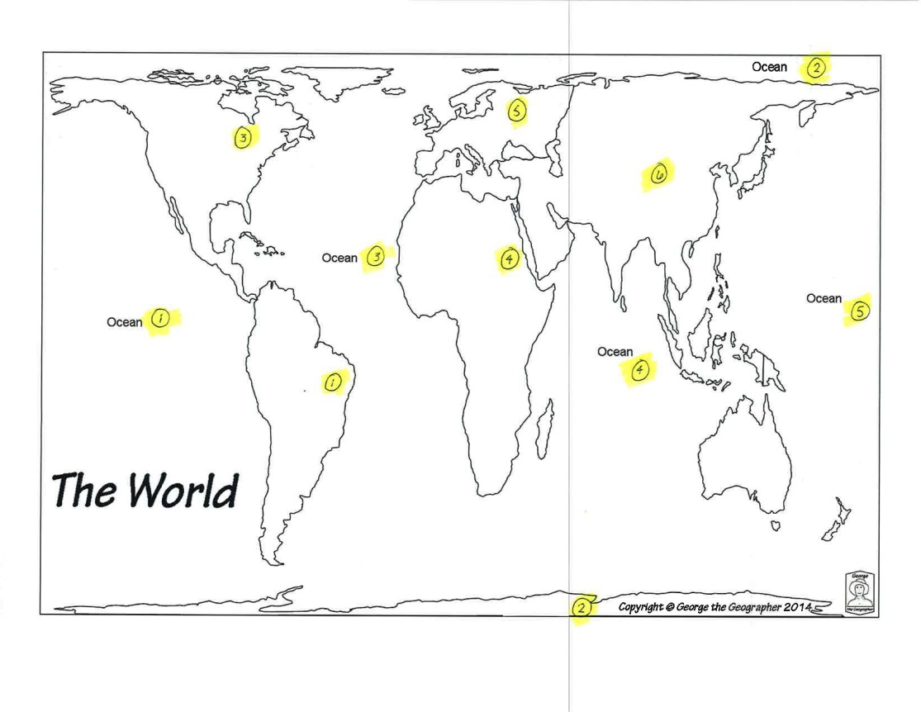
Comparison
VS.

Slide 18
RESOURCES
New Jersey Consortium on Deaf-Blindness at The College of New Jersey: https://njcscd.tcnj.edu/
Technical Assistance
Training
Family Support
Usher Syndrome Coalition: http://www.usher-syndrome.org/
National Center on Deaf-Blindness: https://nationaldb.org
Trainings
Literature
Support

Slide 19
Ava’s TEAM
DON’T BE AFRAID TO ASK QUESTIONS!!!!!!
Summit
Speech
School
Michele Murray
Teacher of the Deaf
TOD
mdmurray@aol.com
***In building two days per week
NJ Consortium on Deafblindness
Technical Assistance
Angel Perez
Project Director
pereza@tcnj.edu
Transition Specialist
Peggy Lashbrook
peggylashbrook@gmail.com
Events and Trainings
Michelle Ragunan
ragunan@tcnj.edu
Family Support
Carly.fredericks@tcnj.edu
Commission for the Blind and Visually Impaired
Sharon Wnorowski
Teacher of the Blind
Braille Instruction
TVI
Sharon.Wnorowski@dhs.state.nj.us
Donna Panaro
Orientation & Mobility Specialist
O&M
Donna.Panaro@dhs.state.nj.us

Slide 20
At the end of the day…
Alone we can do so little; together we can do so much
-Helen Keller

Slide 21
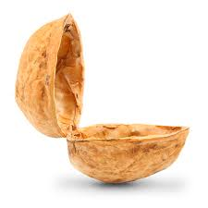
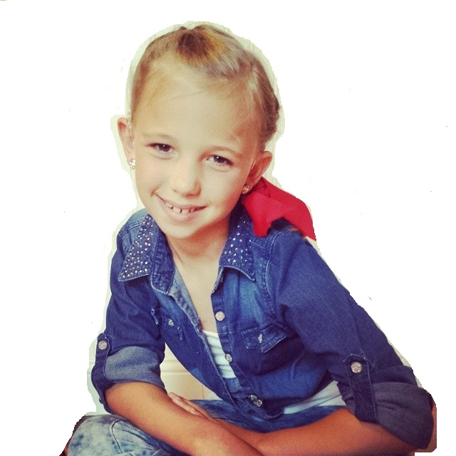
Ava in a NUTSHELL

