Slide 1
Strategies That Work
In the home and in the community
Sharon Stelzer, Teacher
Martha Majors, Assistant Education Director
Deafblind Program
Perkins School for the Blind

Slide 2
SETTING THE STAGE
OUR AGENDA: School based strategies that can be transferred to home and community
CHALLENGES for children with CHARGE
COMMUNICATION
WHAT OUR STUDENTS NEED TO LEARN

Slide 3
WHAT ARE THE CHALLENGES CHILDREN WITH CHARGE FACE EVERYDAY?
COMMUNICATION
VISION
HEARING
COGNITIVE CHALLENGES
PHYSICAL CHALLENGES
SENSORY NEEDS
MEDICAL
BEHAVIOR

Slide 4
What works best: COMMUNICATION
USE OF TOTAL COMMUNICATION
SUPPORTS TO USE OF SPEECH
TO INCLUDE: SIGN LANGUAGE, SIMPLE SIGNS,GESTURES, FACIAL EXPRESSION, PICTURES, PHOTOS, OBJECTS, LINE DRAWINGS, PRINT/BRAILLE, AAC/TECHNOLOGY

Slide 5
WHAT PARENTS HOPE THEIR CHILDREN CAN LEARN
PARENTS HAVE SHARED THESE IDEAS
TO BECOME AN EFFECTIVE COMMUNICATOR
TO BE SOCIAL
TO BE A PART OF A GROUP
TO BE A GOOD SELF-ADVOCATE

Slide 6
WHAT WE KNOW
We know that our students can generalize strategies across environment
HOW DO YOU DO THIS?
Consistent use of communication and expectations
WHAT WORKS FOR YOU?
Specific use of strategies that are used between home and school
CHALLENGE: HOW TO HAVE CONSISTENT ACCESS TO THE USE OF STRATEGIES

Slide 7
WHAT HAPPENS At HOME?? DISCUSSION POINTS
DOES YOUR CHIILD PLAY WITH AGE APPROPRIATE TOYS?
What do you do at home?
WHAT IS FUN AND MOTIVATING?
What excites your child?
LEARNING HAPPENS IN NATURAL ENVIRONMENTS
Where does your child learn best?

Slide 8
WHAT DOES YOUR CHILD LIKE??
VARIETY OF ACTIVITIES
What are your child’s favorites activities?
COMMUNITY BASED INSTRUCTION
What does your child like in the community?

Slide 9
Strategies that Work
These strategies work well for children with combined sensory loss
These strategies work well for children with CHARGE Syndrome
Strategies can be generalized between school and home

Slide 10
STRATEGIES
COMMUNICATION
TEACHING
BEHAVIOR

Slide 11
Teaching Strategies for ALL Learners
Beginning-middle-end | Choice Making | Organization, structure, routine
Partial vs. Full Participation | Accessibility (visual, motor, auditory) | Prompt Levels
Motivating Activities | Clear Expectations | Negotiation
Age Appropriate | Natural Environments | Modeling

Slide 12
Money Skills for Shopping

Slide 13
Age Appropriate and FUN

Slide 14
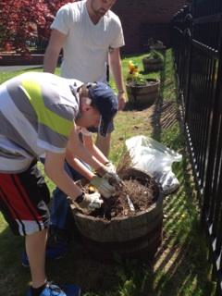
Backyard FUN Motivating

Slide 15
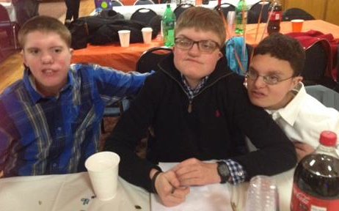
Birthday Party, Friends, Age Appropriate

Slide 16
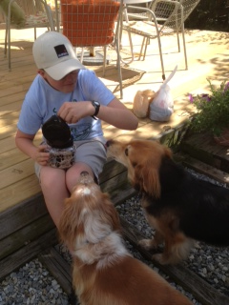
He LOVES Animals Age Appropriate

Slide 17
PLAY CHOICES

Slide 18
CHOICEMAKING: SENSORY

Slide 19
SCHEDULE INCLUDING SENSORY BREAK

Slide 20
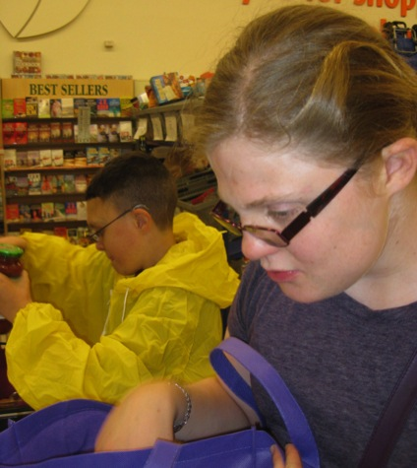
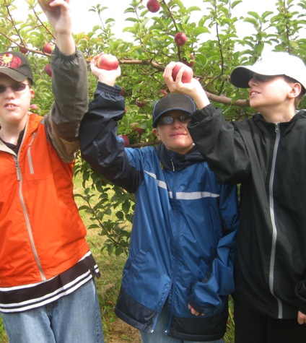
FOCUS: SOCIAL AND FRIENDS

Slide 21
Communication Strategies for ALL Learners
Total Communication | Sign Language, speech, simple signs | Tangible symbols, touch cues, AAC Print/braille
Modeling Higher levels of Communication | Conversation Same topic, joint attention, turn taking | Calendars/ Routine
Positioning | Clear and Simple Language | Pacing/Pause time for Response

Slide 22
SCHEDULE SEQUENCE

Slide 23
NEEDS BOARD

Slide 24
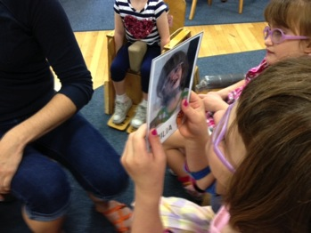
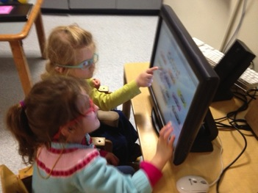
FOCUS: SOCIAL, SIGN LANGUAGE, PICTURES

Slide 25
Behavior Strategies for ALL Learners
Positive behavioral practices | Reinforce good behavior | Ignore negative behavior
Behavior is Communication | Mood Induction | Negotiation
Strategies to Assess Causes Of Behavior | Behavior Support Plan | Data

Slide 26
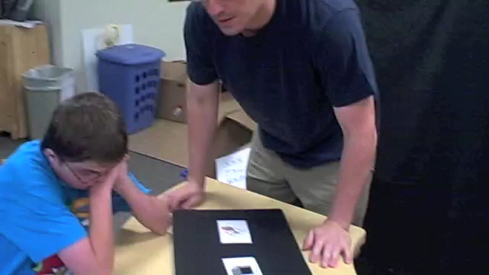
NEGOTIATION: FIRST …..THEN USING SYMBOLS

Slide 27
SHARE WHAT WORKS
WITH US

Slide 28
Strategies for Children with CHARGE Syndrome
The need to know the schedule | Use of Calendar system; beginning, middle and end
The need to be in “charge” | Negotiation, choice making, people preferences
The need to complete tasks | 1 more minute; 1 more than finished; base choice on time available
Show frustration with schedule change | Use of calendar system; use of red X; offer alternative
The need to know what is happening next | Use of calendar system
The need to be organized with belongings | Organizational checklist; designated space
The need to have choices | Offer but limit choices

Slide 29
Strategies for Children with CHARGE Syndrome
The need for sensory breaks/relax time | Offer choices for relaxation
Clear beginning-middle-end of activities | Help with transitions with each activity
Choice making | Encourages communication and Self-advocacy
Structure and Routine | Sense of security, anticipation, memory
Organizational Skills | Helps to structure, anticipate, and follow sequences
Motivation | Promotes attention and focus on activities
People Preferences | Promotes positive responses; respect

Slide 30
IMPLICATIONS OF THE USE OF TEACHING STRATEGIES
Students’ needs for strategies are “Life long”
Starting young can provide time to “practice” skills
Skills can develop and mature over time
Provides structure early on that can be a life long tool
Provides consistency throughout all environments

