Slide 1
National Intervener Certification E-portfolio (NICE) Orientation to the NICE
Amy T. Parker, Ed.D. & COMS, National Center on Deaf-Blindness
Ritu Chopra, Ph.D., Executive Director of the PAR²A Center
Notes:
Image: Four circle overlap to create a Venn diagram, the four circles are artifacts, standards, technology, and explanation/reflection

Slide 2
Introductions
National Center on Deaf-Blindness (NCDB)
The Paraprofessional Resource and Research Center (The PAR²A Center), University of Colorado Denver
State, University and Family Partners
Enter your name and affiliation in the chat pod to get acquainted with each other
Please share your interest in supporting qualified interveners

Slide 3
Orientation Learning Outcomes
Develop understanding of the background of NICE, collaboration of NCDB and the PAR²A Center.
Understand the roles and responsibilities of state and university partners who want to support trained interveners to use the system.
Develop understanding roles and responsibilities of NICE Review Board
Understand the roles of the community in creating a high quality system for the United States

Slide 4
NICE: Background
Office of Special Education Programs’ (OSEP) directed initiative that has developed into a partnership between The PAR²A Center & NCDB have around certification processes and systems for interveners who serve students who are deaf-blind.
NICE, is an e-portfolio system that leads to a national certificate for interveners through digital artifacts, virtual mentoring, online scoring and feedback, and analytics regarding the reliability of the scoring process.
Developed over 2 years using a participatory and iterative approach which incorporated technical and process feedback data from interveners, state partners, university experts, and reviewers.

Slide 5
NCDB Provides Technical Assistance to NICE Board
Identifying needed qualifications for Reviewers and Advisers
Support with recruiting NICE Board members
Support with developing training materials and policy guidelines
Maintaining Venture platform for use
Identifying and designing needed analytics and evaluation within the Venture system

Slide 6
NCDB Provides Technical Assistance to DB Network
Assistance to State Deaf-Blind Projects and Universities for accessing and using training NICE modules and materials
Assistance to states in planning models of outreach and technical assistance with cohorts of interveners and mentors through a technical assistance planning form and process
Coordinate a participatory process with state partners and the PAR²A Center to produce mentor training materials for using the NICE system
Assistance to interested state and university partners through a virtual community of practice on the NCDB website

Slide 7
Roles and Responsibilities The PAR²A Center
Manages the the review board with technical advice from NCDB. Overall responsibilities include maintaining:
A high quality, fair, and systematic process for verifying the knowledge and skills competencies of interveners.
the use of the digital infrastructure platform (Venture) for NICE
the use of training materials for reviewers
the use of analytics in assessing technical and performance data
the training of reviewers in use of the scoring protocol
the process of providing feedback to intervener applicants
dissemination of guidelines to intervener applicants and intervener training programs (shared responsibility of NCDB and PAR²A
Payment processes for intervener applicants

Slide 8
Roles and Responsibilities State and University Partners
Interested partners, who have interveners that are ready to pursue certification, should get in touch with NCDB to explore models of supporting interveners that will work for their state/college (partnering with other states; hosting small groups)
Interested state and university partners support interveners in using two free, introductory modules that provide information about building the e-portfolio, developing artifacts from practice, using the CEC competencies, and using the e-portfolio platform.
When NCDB hears from interested interveners via our website or email, NCDB reaches out to the state or university partners to let them know and to take the next steps.

Slide 9
State/University Partners Assign or Act As Mentors
The mentor is selected with support from the state deaf-blind project or university partner for the intervener. Typically the mentor is a person from the intervener’s home state that is interested in supporting the intervener’s success.
Mentors should understand the NICE process and should be selected based upon their understanding of the intervener model, their commitment to mentoring, and their availability.
Mentors and interveners follow an individualized written agreement form that outlines roles, responsibilities and the mentoring relationship.

Slide 10
Interveners’ Responsibility
Interveners, who use NICE, cultivate artifacts from their practice with students or clients. Interveners review artifacts and receive feedback from mentors and other intervener participants in a state or multi-state cohort. State deaf-blind project or university partners act as hosts for interveners and mentors who are ready to use the NICE process.
The National Intervener Certification E-portfolio is based on 7 CEC standards or domains. Standards are made up of 79 knowledge and skills competencies that the candidate must address in their portfolio. Candidates develop 20-35 artifacts that represent all 79 competencies (using each competency only once within an artifact).

Slide 11
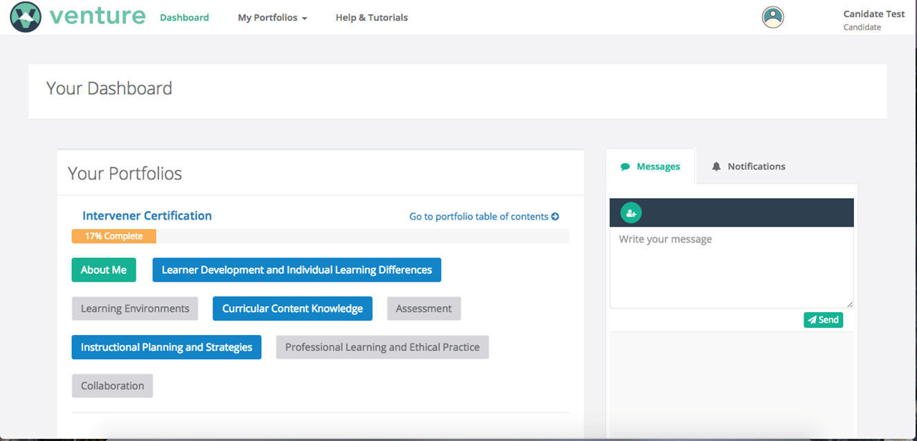
Venture Dashboard
Notes:
A screenshot of the Venture system Dashboard- Across the top there is a Venture logo with the word Venture, Dashboard, My Portfolios, Help & Tutorials. Two boxes display below. The “Your Portfolio” box on the left shows portfolio categories: About Me; Learner Development and Individual Learning Differences; Learning Environments; Curricular Content Knowledge; Assessment; Instructional Planning and Strategies; Professional Learning and Ethical Practice; Collaboration. The box on the right displays a messaging and notification system.

Slide 12
NICE: Stage of Development Over Two years
Established a National Review Board in September 2016 – October 2016 consisting of:
Reviewers: 27
Advisers: 15
States: 16
Reviewers are experts in the area of intervention and knowledge of national intervener standards.
Advisers are representatives from respected community organizations in the field of deaf-blindness
NICE Officially launched on October 1, 2016

Slide 13
Role and Responsibilities Reviewers
Reviewers on the NICE Review Board will be assigned e-portfolio submissions to independently score and comment upon using the field-tested rubric and framework. All scoring will be conducted confidentially and submitted virtually. Specific responsibilities of the Reviewers include:
Review and sign a confidentiality and impartiality NICE Review Board agreement
Reviewer training materials
Participation in a NICE Reviewer virtual orientation meeting (1.5 hours) Attending 4 virtual NICE Review Board meetings per year (1.5 hours each- 6 hours total)
Virtually, independently reviewing and scoring 5 e-portfolios per year
Taking an optional, one time survey at the end of the year about your experience and offering feedback (15 minutes)

Slide 14
Roles and Responsibilities Advisers
Advisers are responsible for:
Reviewing overall progress data with the PAR2A Center, for asking questions and for offering feedback on the review process as it is launched. Both Reviewing and signing a confidentiality and impartiality NICE Review Board agreement (10 minutes)
Participation in a NICE Reviewer virtual orientation meeting
Taking the online NICE Reviewer training module, with learning activities to understand the roles of reviewers and the review process before attending meetings or offering advice (6-8 hours)
Virtually attend 2 of the 4 NICE Review Board meetings per year to observe, ask questions and offer feedback (3 hours)
Taking an optional, one time survey at the end of the year about your experience and offering feedback (15 minutes)

Slide 15
Reviewers and Advisers
Receive a training packet of materials that guide roles Reviewer or an Adviser:
NICE Board Handbook
Recorded tour of Venture and short screencasts
Reviewer Checklist; CEC knowledge and skills competencies for interveners
Reviewer “Sandbox”- a place to practice scoring
All Advisers take the Reviewer training too to understand the process.

Slide 16
Important Considerations for Our Work
Using a process with accountability to the community
Using a process for fidelity for the field of deaf-blindness
Using a process that was designed with intervener and state buy-in
Using a process that is defensible and understandable

Slide 17
Technology- an equalizer in low incidence fields
Practice of DB intervention is under-recognized
Use of technology to create digital, authentic, practice narratives
Use of technology to create systems for mentoring, scoring and review
Use of technology to beta test and refine e-platforms
Use of technology to create a performance database for reporting and analytics
Technology helps us leverage our strengths and knowledge across distance and time to support the advancement of national competencies.

Slide 18
Need for Intervener Certification to Increase Role Recognition and Identity for Practice
In order to fully develop and sustain the practice of intervention for students who are deaf-blind, representatives from family organizations, state deaf-blind projects, interveners, teachers, and university faculty members broadly agreed upon the need to expand opportunities for interveners to validate their specific knowledge and skills through national or state certification/ credentialing processes
(NCDB, 2012).
Notes:
Image: A young boy signs hand under hand with a woman

Slide 19
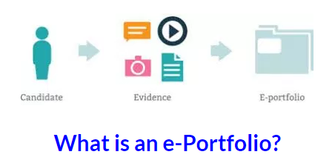
Using a tool to evaluate and recognize standards for a practice
Notes:
Image: A diagram titled "What is an e-Portfolio." The outline of a person underneath saying candidate with an arrow pointing to media icons underneath saying evidence pointing to a file folder that says E-portfolio.

Slide 20
The importance of national intervener standards
One of the ways that most professions ensure adequate outcomes is by regulation through a system of standards for their members (Easterbrooks & Putney, 2008).
Defining the essential knowledge and skills provides what some describe as “excellence” and “accountability” (CEC, 2015)
Implementation of standards within a field is seen as a marker of maturation (CEC, 2015)
E-portfolio certification as a way to “link” and “think” about the competencies, helps make learning visible and supports identity development. Can cohesively align with national standards.

Slide 21
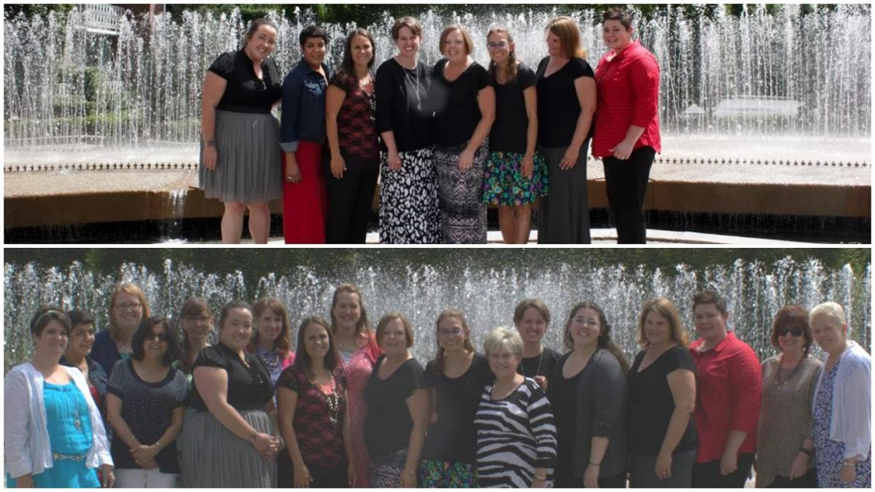
Designing a sustainable and scalable path
Distance
Time
Shared Expertise
Feedback
Network
Competency Dialogues
Notes:
Image: Two stacked photos, the top of the eight interveners that participated in the beta test, below a picture of the interveners, state partners, and NCDB staff who worked on the Beta Test

Slide 22
NICE: Stage of Development Over Two Years
Development and refinement through systematic beta and field testing, portfolio development and scoring process which aligns with national competencies.
Beta Testing Phase I: April 2015 - September 2015
Refinement involving data based changes to the design and scoring rubric: September 2015 - November 1 2015
Beta Testing Phase II: December 2015- March 2016.
Further refinement and finalization: April 2016 - September 2016

Slide 23
Other Considerations
E-Portfolio design based upon an assessment of an individual’s competence, not a program of study review; Demonstrating competence that is not completely based on training methodologies.
E-portfolio dialogues can be used to improve or align training program efforts
Inclusion of practicing interveners whose role was recognized and understood within their district or place of employment; some infrastructure for state support of the intervener role (administrative support)
Interveners invited by state partners for the opportunity (mentoring advice and dialogues); looking at a state capacity model

Slide 24
Validity for the Practice
Contextual validity for practice- something developed for interveners should have significant input by interveners as well as those who train/support them.
Nursing, teacher, or other types of e-portfolios have higher validity measures when they are designed by and tested within practice settings.
Application of “real world” knowledge; provides “authentic” assessment (Hubert & Lewis, 2014)
Validity is seen when independent evaluators, recognize and can evaluate the practice using a review protocol.
E-portfolios provide a platform for “new literacies” with a fusion of media to describe authentic practice contexts.

Slide 25
Considering Validity in the Design
“We have considered validity evidence as a part of integrative, evaluative judgement. The e-portfolio assessment had content validity in that it was developed for specific purposes by local experts to sample the key features and learning outcomes” (Roberts, Shadbot, Clark & Simpson, 2014)
“Aggregate complex assessments” related to performance in a meaningful way.
We designed our beta test with iterative feedback from four state partners, eight interveners, and two university faculty members who recognize the practice within diverse local contexts and settings.

Slide 26
CEC Knowledge and Skills Competencies Framework- An Element of Construct Validity
Provided a consistent reference point for design and development of the portfolios
Allowed interveners to organize their e-portfolios around the CEC Standards framework
CEC competencies are approved through a rigorous consensual validation process and are aligned with standards across special education (CEC, 2010).

Slide 27
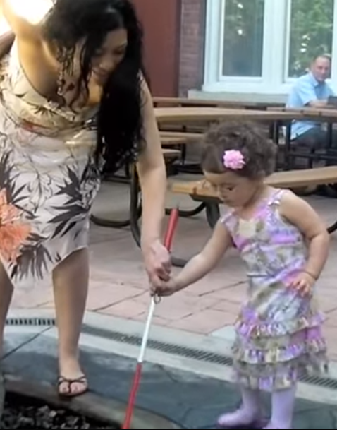
Reliability
How will two reviewers who look at a portfolio evaluate it?
Interobserver Agreement (IOA) A procedure for enhancing the believability of data that involves comparing independent observations from two or more people of the same events.
IOA is computed by taking the number # agreements between the independent reviewers and dividing by the total # agreements + disagreements X 100 = % Agreement
Evaluating practice using standards is the ultimate goal of the e-portfolio work!
Notes:
Image: A young girl with an intervener holds a cane with assistance

Slide 28
Purpose of the E-portfolio Assessment
To determine if individuals have sufficient initial knowledge and skills to serve as an Intervener for students who are deafblind.
Knowledge and Skills sets as identified under Standards for Interveners
7 Council for Exceptional Children (CEC)

Slide 29
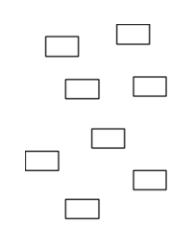
Structure of the E-portfolio
Competencies
Build Artifacts
Build Standard Page
Build the ePortfolio
Notes:
Image: Small blocks spread-out not connected or touching.
Image: Small blocks put together creating medium size block
Image: 8 medium size blocks put together in groups of four to form two separate large blocks.
Image: 4 larger blacks put together in a group to form an even larger block.

Slide 30
Elements of E-portfolio
Two Elements:
“About Me” section
Seven CEC Intervener Standards pages where Interveners upload artifacts to demonstrate their understanding of CEC competencies.

Slide 31
Element # 1: “About Me” Section
Contains information about the intervener, the student/s or client/s whom they serve, any training they have received, and letters of recommendations (from instructors , mentors, or other supervisors) in the field of deafblindness
Not scored but provides context for scoring and using the rubric criteria for scoring the CEC standard webpages with artifacts,
Note: The first step in scoring a portfolio is to carefully review the “About Me” section of the Portfolio before beginning to review the Intervener’s E-Portfolio.

Slide 32
Element #2: CEC Standards Pages
Each of the 7 Standards is represented as an individual webpage with specific sets of knowledge and skills competencies under that standard listed on top of each standard page
Interveners select and upload artifacts from their own practice that that best represent/demonstrate their mastery of the knowledge and/or skills competency
One artifact may be used to demonstrate up to 5 competencies within the Standard page.
Each competency can be selected only one time from the list to be represented within an artifact.

Slide 33
Artifacts
The artifacts are the unit of evaluation for reviewers.
Coursework
Professional Development
Self-Study
Video Work Sample
Photo Work Sample
Written Work Sample
Performance Evaluation
Observation
Scores are given for each individual artifact. Scores for all artifacts on a CEC Standards page are averaged, yielding a score for that standard page.
Scores for each of the 7 standards are averaged to determine the overall portfolio score.

Slide 34
Artifact Sections
Each artifact consists of three sections, the first two of which are scored by the reviewer.
Technical Demonstration of Competence (Documentation) -scored
Contextual and Conceptual Understanding (Artifact Explanation) – scored
Artifact Elements - NOT scored

Slide 35
Important Consideration
Focus primarily on demonstration of competency
e.g. it’s good if the video quality is nice but is it demonstrating the competencies that the intervener has identified?
e.g. the commentary is well written ( grammar, usage of language etc.) but ..does it articulate how the artifact demonstrates the competencies identified, and provides sufficient information to determine the way in which the evidence supports the competencies identified

Slide 36
Section 1 : Technical Demonstration of Competence (Documentation) - scored
Once the Intervener identifies the competencies within a standard to address with an artifact, the Intervener selects evidence to demonstrate the identified competencies.
The Intervener may select one or a combination of artifacts as evidence of their competence.

Slide 37
Section 2 : Contextual And Conceptual Understanding (Artifact Explanation) -Scored
A commentary is meant to provide the reviewer with sufficient information about what the reviewer will see demonstrated in the evidence.
Writing prompts linked to the different types of documentation include questions.

Slide 38
Mandatory Question:
How did this sample address each of the Council for Exceptional Children’s Knowledge and Skill Competencies for Interveners?
Candidates Select Two of the Following Questions:
How did you apply this information in your practice with students who are deaf-blind?
Describe the activity and what the student is doing. How does the activity relate to the student’s goals or needs?
Why did you include this sample, or why is this significant in your practice with this student?
What did you learn about yourself as an intervener, and about your student, because of what was demonstrated in this sample?
What is your role on the team?

Slide 39
Section 3: Artifact Elements (not scored)
After an artifact is added to a CEC Standard web page, interveners uses a series of checkboxes to provide reviewers with details and a context for the selected artifact (see Appendix C of the protocol)
What is the format of the artifact?
What does the artifact contain?
Where did the documentation(s) in the artifact take place?
The artifact elements are not scored but including them is a prerequisite for portfolio submission and review.

Slide 40
Scoring Summary
Score | Mastery
50-74% | Emerging
75-89% | Proficient
90-100% | Advanced
Rubric scores for each artifact will be computed (60% demonstration, 40% understanding) yielding one score per artifact.
The scores for each artifact in a CEC Standard will be averaged, resulting in one score per CEC Standard.
The average of the 7 scores for each of the 7 CEC Standard is the overall portfolio score.

Slide 41
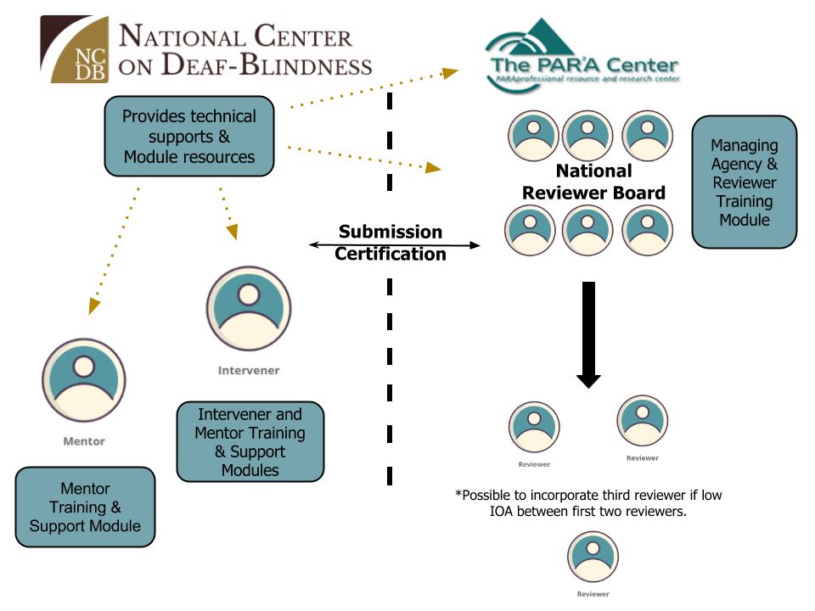
Intervener Certification Process
Notes:
Image: The graphic is divided into two main sections, the National Center on Deaf-Blindness on the left and The PAR’A Center on the right. The National Center on Deaf-Blindness with a box that reads: “Provides technical support and module resources” with arrows leading to four different categories. The first two arrows lead to information on the left and the last two arrows lead to information on the right. Between these two sections is dashed line separating them with a horizontal double-headed arrow that reads: “Submission Certification.”
In the left section the two categories are two icons representing a Mentor and Intervener. Below the mentor icon a text box reads: “Mentor Training and support module.” Below the intervener icon a text box reads: “Intervener and mentor training and support modules.”
In the section to the right the two categories are The PAR’A Center and the National Reviewer Board. National reviewer board: Managing agency and reviewer training module. From the National reviewer board an arrow leads to two icons representing two separate reviewers. Under these reviewer icons txt reads: “*possible to incorporate third reviewer if low IOA between first two reviewers.” Under this text is a third icon representing a third reviewer.

Slide 42
Who to contact
NCDB Support and Planning
Amy Parker – parkera@wou.edu
Questions with regards to Reviewer/Adviser Responsibilities
Ritu Chopra - ritu.chopra@ucdenver.edu

