Slide 1
Educational Considerations for Students with Usher Syndrome
October 11, 2017
Presented by:
Carly Fredericks
Family Engagement Coordinator-New Jersey/Founder of Ava’s Voice/NFADB
Patti McGowan
Family Engagement Coordinator-Pennsylvania/NFADB
Nancy O’Donnell
Director, USH Trust Registry-Usher Syndrome Coalition
Facilitated by:
Megan Cote
NCDB Initiative Lead for Early Identification/ Referral & Family Engagement
nationaldb.org
info@nationaldb.org
The contents of this presentation were developed under a grant from the U.S. Department of Education #H326T130013. However, those contents do not necessarily represent the policy of the Teaching Research Institute, nor the US Department of Education, and you should not assume endorsement by the Federal Government. Project Officer, Jo Ann McCann.

Slide 2
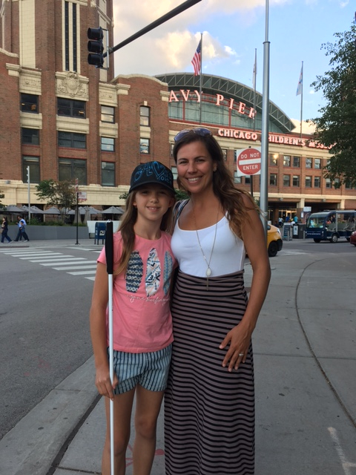
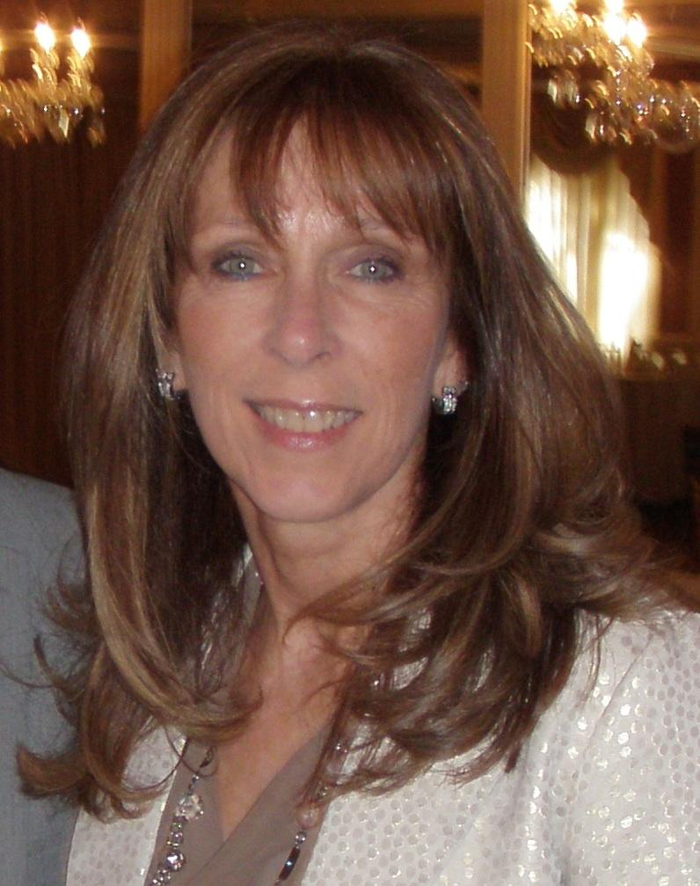
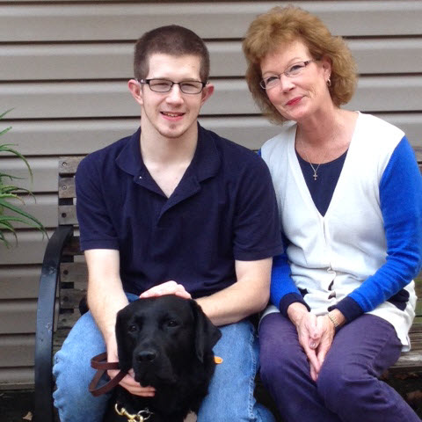
“This is US”
Notes:
Megan-Introductions

Slide 3
Webinar Outcomes
Participants will:
increase their knowledge about the impact that combined vision and hearing loss (due to Usher syndrome) has on their child’s learning
understand some of the educational considerations that may be needed now and in the future
Notes:
Patti: as parents we not only have to think of the NOW for our children with Usher syndrome- we have to always prepare for the FUTURE

Slide 4
History of USH
1914 - Charles Usher, British ophthalmologist studied 69 individuals. Usher syndrome named for him. What have we learned in 103 years?
Notes:
Nancy

Slide 5
What is Usher syndrome
Congenital bilateral sensorineural hearing loss (SNL)
Retinitis pigmentosa (RP)
Vestibular issues
Notes:
Nancy

Slide 6
Usher Syndrome Fun Facts
Most common genetic cause of combined vision and hearing loss
Recessive; affects males and females
Types 1, 2 and 3 and 14 subtypes
Hereditary Hearing Loss website
Notes:
Nancy

Slide 7
Usher type 1
Profound hearing loss (deaf)
Early onset RP (first decade of life)
Vestibular (balance) problems
1B, 1C, 1D, 1E, 1F, 1G, 1H, 1J, 1K
Notes:
Nancy

Slide 8
Usher type 2
Moderate to severe hearing loss (hard of hearing)
RP evident in teen years
No balance problems
2A, 2C, 2D
Notes:
Nancy

Slide 9
Usher type 3
Progressive hearing and vision loss.
Progressive balance loss.
Rare - more common in Finland and Ashkenazi Jews
3A and 3B
Notes:
Nancy

Slide 10
Atypical Usher
Doesn’t fit any of the first three categories OR
symptoms do not fully express OR
symptoms are absent
Notes:
Nancy

Slide 11
Population estimates
USA USH population estimated to be between 20-50,000.
# kids, ages birth to 21, could be between 7560 and 25,200.
Notes:
Nancy

Slide 12
What do we know - NCDB
NCDB’s 2015 child count showed just under 300 kids with Usher syndrome, birth to 21.
Notes:
Nancy

Slide 13
What do we know - USC
Usher Coalition registry has less than 200 kids with Usher syndrome, birth to 21.
Notes:
Nancy

Slide 14
Where is everyone??
Not yet identified with Usher
Identified but still functioning visually with CI or H/A
Don’t want to “say anything” yet.
Notes:
Nancy

Slide 15
Those 5 words...
Your child has
Usher syndrome...
Notes:
Carly: We all have our own story…we can remember exactly where we were, who was with us, what we were wearing and that indescribable moment that took over our bodies. Little did we know what an amazing journey we would embark on with our child, our families and this community of remarkable resilient individuals living with Usher Syndrome. No matter the age or time of diagnosis we all know the feeling, it’s not the most pleasant, but we hope you are comforted knowing you are not alone!

Slide 16
Grieving and Believing
The initial shock of the diagnosis
The unknown is the worst
Unraveling the unknown
Embracing the journey
Notes:
patti: As parents we are heartbroken of the news- but our children will do and can do amazing things. There is the initial Shock, natural to grieve, - where to begin, diagnosis of the “unknown” when sight loss, more hearing loss? educate yourself and others,
Embrace the journey- I knew my son was capable of learning I just knew he was going to learn in a different way- began my network and support system, as I could not do this alone

Slide 17
Fill your toolbox
“Knowledge is POWER”
Notes:
Carly: This picture of a toolbox with “ “ is the tools we are talking about however, Early on there were moments I found myself fearful of introducing a new skill or support (cane) because it was like facing the reality or that now that I did now she was going to need it. I never wanted to rush it, but I found more and more that we learned together Ava received a little more of an understanding about her reality and had the opportunity to overcome the obstacle or challenges without fighting them.

Slide 18
What’s first?
Making connections...
Educate yourself!
Set a Goal for yourself!
Network with other families
Meet adults with Usher syndrome
Connect to your State Deaf-Blind Project and the National Center on Deaf-Blindness (NCDB)
Usher Syndrome Coalition- USH Trust registry
Parent Groups (NFADB,PTI,) local, state, national
HKNC- get your child on the registry
Notes:
Patti- it was all about gaining knowledge in the beginning- understanding the impact of the dual sensory loss- educating myself to be able to explain to others- process, will take years
-Set a goal for myself: Advocate FOR my son, Advocate BESIDE my son, Advocate BEHIND my son
-Got connected, ongoing developing a network, take advantage of trainings, forums,
-other families, meeting adults w/Usher, getting connected and networking,

Slide 19
One size does NOT fit all!
Learn
Consider
Make educated decisions
Follow your child’s lead
ADVOCATE
Notes:
Carly
photo description:

Slide 20
Exploring Modes of Communication
Total Communication
Auditory/Oral spoken Language
American Sign Language
Tactile Sign Language
Follow your child’s lead...
Notes:
Patti-definition(s)- options- no right or wrong- personal decision as a family and then watch for the lead of your child
Total Communication (TC) is an approach to Deaf education that aims to make use of a number of modes of communication such as signed, oral, auditory, written and visual aids, depending on the particular needs and abilities of the child.
The Auditory/Oral (A/O) approach teaches infants and young children to use hearing and speech to develop spoken language for communication and learning.
ASL:is a language which chiefly uses manual communication to convey meaning, as opposed to spoken language.
Tactile signing is a common means of communication used by people with both a sight and hearing impairment which is based on a sign language or other system of manual communication.
Carly- What does it look like using multiple modes of communication

Slide 21
PART WHAT?
Early Intervention Program - Part C – serves children birth-3
Lead Agency designated by the state
Services must be provided to children experiencing developmental delay or a condition that is highly likely to result in a developmental delay and therefore needs early intervention
Individualized Family Service Plan (IFSP)
Family Involvement – Participation on all teams making decisions about the child’s individualized plan for services
Receive services to improve the family’s ability to meet the needs of their child with a disability
Location of Services - Natural Environment—to the maximum extent appropriate, the child is served in environments that are normal or natural for a child of that age (including the home and integrated child care settings).
Costs for Services - States may charge for services (e.g. sliding scale), but must ensure no one does not receive services because of inability to pay.
Notes:
Carly

Slide 22
PART WHAT? (cont.)
Special Education Program – Part B – children ages 3-21
Lead Agency is the State Department of Education
Special education must be provided to children who fit 1 or more of the following categories of disability: Mental retardation, a hearing impairment (including deafness), a speech or language impairment, a visual impairment (including blindness), a serious emotional disturbance (referred to in this part as emotional disturbance), an orthopedic impairment, Autism, Traumatic brain injury, other health impairment, a specific learning disability, Deaf-blindness, or multiple disabilities
Individualized Education Plans (IEP)
Family Involvement - Participation on all teams making decisions about the child’s individualized plan for services
Location of Services - Least Restrictive Environment—to the maximum extent appropriate, the child receives services and participates in the general curriculum, non-academic, and extra-curricular activities alongside peers without disabilities.
Costs for Services - All services must be provided for free.

Slide 23
Early Intervention (birth-3yrs)
Early intervention refers to educational services for young children (birth to age 3) who have disabilities. Part C
Early intervention focuses on helping eligible babies and toddlers learn the basic and brand-new skills that typically develop during the first three years of life, such as:
physical (reaching, rolling, crawling, and walking);
cognitive (thinking, learning, solving problems);
communication (talking, listening, understanding);
social/emotional (playing, feeling secure and happy); and
self-help (eating, dressing).
Notes:
Carly- Falls under Part C

Slide 24
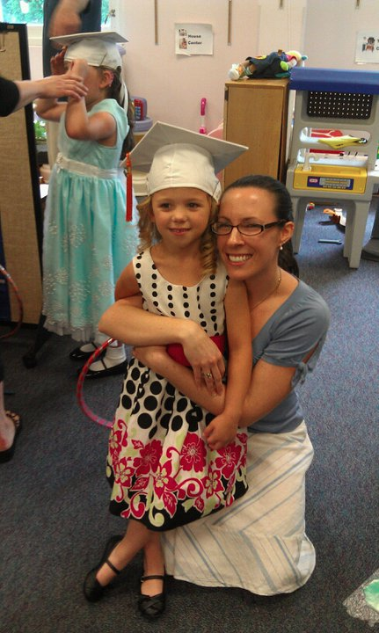
Preschool (age 3-5yrs)
Services for preschool children (ages 3 through 5) are provided free of charge through the public school system. These services are available through the same law—the Individuals with Disabilities Education Act—
Notes:
Carly
Inclusion:
Most restrictive setting:

Slide 25
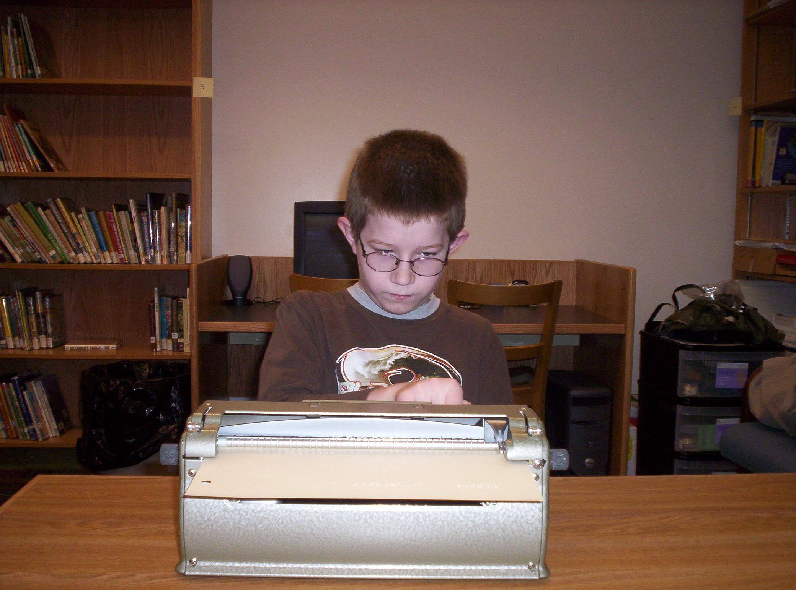
School Age (age 6 - 21yrs)
For school-aged children and youth (aged 3 through 21), special education and related services are provided through the school system. Part B
The student must both be eligible for and in need of special education in order to be entitled to special education services.
Notes:
Patti: Students with disabilities have the right under the IDEA law to attend school through their 21st year.
Entitlement vs Eligibility . Check in with your state DB Project for state specific information-
You have an option to take advantage of the extended school years, and this may be important for all the “extras” that our children need to learn on top of the general ed curriculum. ex: braille, O&M,

Slide 26
Who’s on my team?
Parent, Student
Family member, guardian
Special Ed Director, LEA/Case Manager
General Education Teachers
Special Education Teachers
Teacher of Visual Impairment (TVI)
Teacher of the Deaf (TOD)
Educational Interpreter
Intervener, Para-professional
Audiologist
AT Consultant
Deaf-Blind Consultant
Speech Pathologist
OT, PT
Notes:
Carly
Open lines of communication between team members.
“Core team” of the sensory team members should be discussed

Slide 27
Classification
Federal Definition:
Deaf-blindness means concomitant hearing and visual impairments, the combination of which causes such severe communication and other developmental and educational needs that they cannot be accommodated in special education programs solely for children with deafness or children with blindness. 34 CFR 300.8 (c) (2)
Notes:
Patti- heavy word- (3 yrs to say it)- thinking only of Helen Keller-understanding not total deafness nor blindness but understanding the impact of the dual loss especially in the educational system. Our kids w/Usher will miss information and they have a right to not miss information. They do not know what they have not seen or heard- we owe to our kids not to allow this to happen. This is why supports are so important- Our children with Usher may need supports to be independent- break the myth!

Slide 28
Assessments
The evaluation must use a variety of assessment tools and strategies to gather relevant functional, developmental, and academic information about the child, including information provided by the parent. When conducting an initial evaluation, it’s important to examine all areas of a child’s functioning to determine not only if the child is a child with a disability, but also determine the child’s educational needs. This full and individual evaluation includes evaluating the child’s:
Health,
Vision and hearing
Social and emotional status
General inteliligence
Academic performances
Communicative status and
Motor abilities
Notes:
Carly: As IDEA states, the school system must ensure that—
…the evaluation is sufficiently comprehensive to identify all of the child’s special education and related services needs, whether or not commonly linked to the disability category in which the child has been classified.
Initial assessment: SPAN doc. ADD NOTES HERE
Functional Vision Assessment (FVA)
Learning Media Assessments (LMA)
*Classification comes in
Patti- Suggestions: You know your child that also plays as a factor. Usher changes over periods of times so good idea to keep up with assessments and evaluations regularly -both educationally and medically - good idea to share medical assessments with the educational team- Suggest to always have a deafblind consultant with these assessments.
EA: Key components include: Parent and/or caregiver interview-Teacher and/or service provider interview-Review of records-Child Observations-Child or Student Interview-Current Learning and Literacy Functioning-Functional Reading and Writing
FVA: It is an assessment of how a child uses the vision he or she has in everyday life, so it is usually not done with children who are totally blind or have light perception only.
LMA: conducted by the Teacher of Students with Visual Impairments (TVI), is required to determine what kinds of literacy and functional learning materials are appropriate.

Slide 29
Develop IEP
Based on the results of the Assessment, the team develops educational goals for the school year.
The IEP tells his story and designs a path for him to achieve his educational outcomes. This includes adaptations, accommodations or modifications for him/her to access the general ed curriculum.
Notes:
Carly-performance may “hh” staying competitive at their academic capability

Slide 30
Accomodations vs. Modifications
Accommodations alter how a student learns. They do not change what the student is expected to learn. Accommodations describe an alteration of the environment, curriculum format, or equipment that allows an individual with a disability to pursue a regular course of study and/or complete assigned tasks.
VS-
Modifications describe very fundamental changes in the curriculum. They may include altering the standard expectations for a course or assessment, as the student may be unable to learn all of the material, or particular portions of the material presented
Notes:
Patti-Examples- accommodations> same work as peers, extended test time, test questions read orally,
Modifications> might be only 10 of the 30 questions on a test, instead of writing an essay you may have multiple choice questions
Carly-examples:

Slide 31
Examples of Specially Designed Instruction (1 of 4)
Intervener
CCTV for distant and near viewing
Written or verbal descriptions for materials that are color coded for identification
Digital book player
Hand­held magnifier
Braille Notetaker
Long Cane
OCR­ Scan and read program
Notes:
Patti-Sharing of my son Hunter and his IEP- Special design instruction and related services or direct services for a student with adaptations, accommodations - So what does this mean? Look at IEP - Related Services- Special Design Instruction.
Bring up Carly’s tool box- Hunter knew when and where some of the SDI’s were needed

Slide 32
Examples of Specially Designed Instruction (2 of 4)
Preferential seating (as determined by Hunter and his teachers)
Use of hat indoors when needed to reduce glare
Desk copy of notes or note taker (hard copy or electronic copy of notes prior
Large print (129% on 17x11 size paper) or scanned materials
Digital Textbooks
Notes:
Patti-Special design instruction and related services for a student - So what does this mean? Look at IEP - Related Services- Special Design Instruction

Slide 33
Examples of Specially Designed Instruction (3 of 4)
High contrast marker on whiteboard
2 Personal FM transmitters
Gain student's attention before speaking to him
Repeated directions
Multi­sensory instruction (auditory/visual/hands­ on)
Frequent opportunities for review and checks for understanding
Word prediction software
Notes:
Patti- Talk a little about PRE-Teaching and RE-Teaching- best practice of what to expect and then to make sure all was heard after the fact. There also needs to be that additional time of processing. We call this WAIT TIME.
With my son it always takes twice as long to do half the work- not an excuse but a fact. Now he has to prove it is a fact by getting all required work done.

Slide 34
Examples of Specially Designed Instruction (4 of 4)
Oral testing
Opportunities for sensory breaks (one-on-one quiet time)
Teachers need to identify self when speaking and identify name of the student who is about to provide answers and/or comments
Teacher restates student comments
Digital recorder
Tablet with Scientific/Graphing calculator
Notes:
Patti- share the importance of identifying oneself- parents may need to model this for others including educators

Slide 35
Related Services
Speech - Language Therapy - at least 50 sessions of 20 minutes
Intervener - 180 days during the school year
Hearing Support - 56 sessions for 42 minutes per IEP year, barring absences, inclement weather or special classroom activities
Audiological Services - at least 2 hours per IEP year
Assistive Technology Support - at least 2 hours/per IEP year
Orientation & Mobility - at least 16 hours per IEP year
Vision Support - 300 sessions for 42 minutes barring absences, inclement weather or special classroom activities
Occupational Therapy - at least 1 session for 42 minutes per IEP year
Notes:
Patti-Special design instruction and related services for a student - So what does this mean? Look at IEP - Related Services- Special Design Instruction

Slide 36
Support for School Personnel General Ed
General Education Teachers
In­ service with classroom teachers about deaf­ blindness, assistive technology, and accommodations
Consultation from the Intervener
Academic collaborative meetings
FM system in­service training
Consultations regarding hearing loss as needed
Notes:
Patti- Support will be needed for the General Education Staff- chances are they have not worked with a student with a dual loss (Usher) - and again this would be individualized and unique- Indirect Services

Slide 37
Support for School Personnel Other
Example of staff who will receive support:
Teacher of the Visually Impaired, Teacher of the Deaf/HOH, Intervener, Audiologist, AT Consultant
In­ service with classroom teachers about deaf­blindness, assistive technology, and accommodations
Transitional collaborative meetings
Consultation from Occupational Therapist
Notes:
Patti- This would be an example of indirect services to the educational team members working with a student with dual loss, and they do would do indirect service as colleagues.

Slide 38
Collaboration
“You don’t know what you don’t know”
break barriers
communicate
overcome challenges
be open minded
Notes:
Carly: Model of collaborative trainings

Slide 39
Teacher of the Deaf (TOD)
May work with children from preschool to college age
Works in a variety of environments
Understanding of complexity of language and its development
Deep understanding in which hearing loss may affect language
Notes:
Carly
pre-teach,
Provided by district
Through Itinerant program
School for the Deaf
*They become your go to

Slide 40
Teacher of the Visually Impaired (TVI)
Typically - licensed special education teacher with certification and specialized training in meeting the educational needs of students who are blind or have visual impairments ages birth through 21 (states vary on the criteria for certification as a Teacher of Students with Visual Impairments).
This is an instructional position, as opposed to a related service or vision therapy.
Notes:
Patti -Key player on Hunter’s team: in tandem w/Hunter did accommodations/Braille instruction/ key player on core team and team at large.
Worked well with TOD-Intervener-Speech-O&M-

Slide 41
Occupational Therapy (OT)
Occupational therapy (OT): combines the art and science of providing and directing activities that serve to restore and enhance performance of skills needed for functional daily living.
Notes:
Patti- OT aspect/tactile defensiveness/ writing/

Slide 42
Physical Therapy (PT)
Uses a variety of treatments to help build strength, improve movement, and strengthen skills needed for daily activities: crawling, walking, balance and coordination activities.
OTs and PTs - part of IEP; do assessment and establish clearly defined goals for everyone to follow
Notes:
Nancy- “reiterate balance with different types
Carly- balance issues early on with type/sitting up/walking/core training
OT PT team - including school officials, educators and the therapists assigned as part of the school-based services program.

Slide 43
Speech
The purpose is to promote communicative and linguistic as well as to optimize outcomes for deaf and hard of hearing children.
Notes:
Carly
qualifications
importance when newly implanted or aided
“it has to go in to come out”

Slide 44
What is an Educational Interpreter?
Very different scope of practice than interpreter for adult community:
part of the educational team
federal obligation to educate a student with special needs
is a related service provider,
legal responsibility to support child’s education/access to the general curriculum.
Notes:
Nancy-RID
Interpreters vs. aides who sign

Slide 45
Professional training for EIs
Collaboration and partnership between Registry of Interpreters for the Deaf and National Association of Interpreters in Education
Certified - Educational Interpreter Performance Test
USDOE created classroominterpreting.org
Notes:
Nancy-RID/EI
Interpreters vs. Aides who signs

Slide 46
Interveners
Provide consistent one-to-one support to a student who is deaf-blind (age 3 through 21) throughout the instructional day;
Provide access to information and communication;
Facilitate the development of social and emotional well-being for children who are deaf-blind;
Specially trained in understanding deaf-blindness and the process of intervention.
Notes:
Patti
May require interpreter and an intervener - Intervener 1:1 w/specific training in the dual loss/deafblindness. Should be as unique and individualized as the students IEP. Do WITH not FOR the student. Simply the EYES and EARS of the student. The student does not know what he/she may miss and they have the right to know everything in their environment and going on around them. Bridge of Access
Para-professionals:
Para (in role of an Intervener):
Para- in classroom setting:

Slide 47
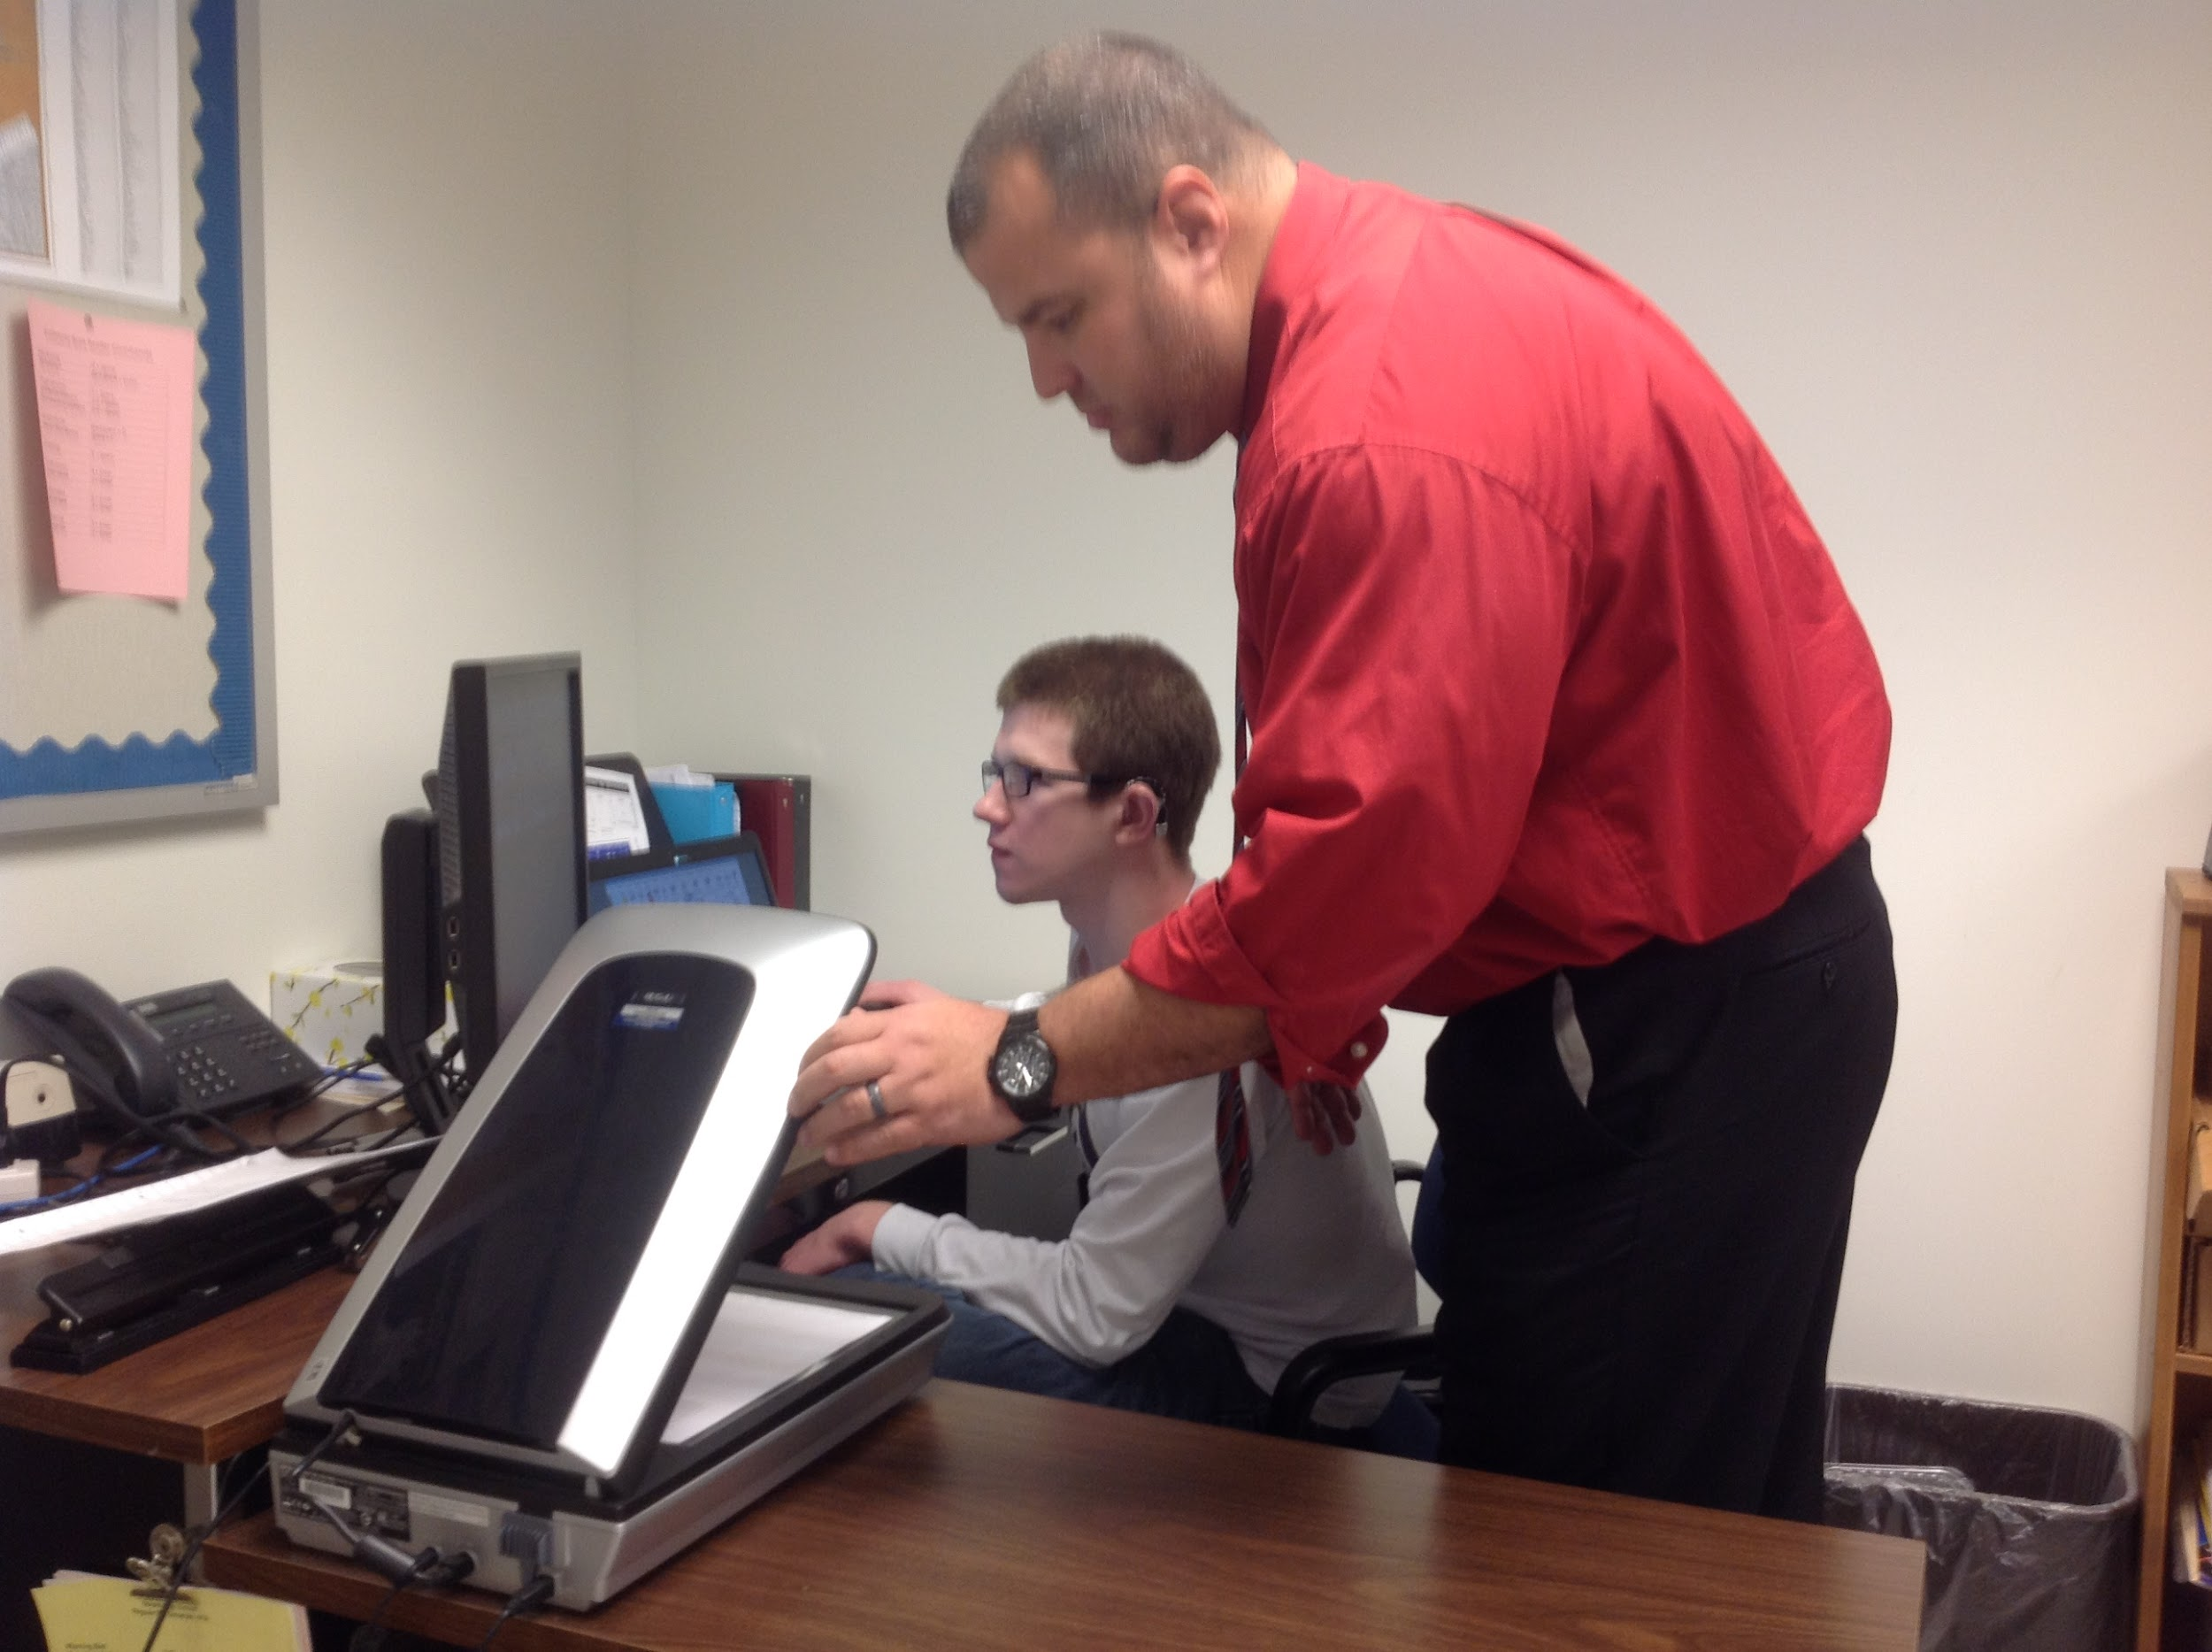
Interveners in action!
Notes:
Patti
May require interpreter and an intervener - Intervener 1:1 w/specific training in the dual loss/deafblindness. Should be as unique and individualized as the students IEP. Do WITH not FOR the student. Simply the EYES and EARS of the student. The student does not know what he/she may miss and they have the right to know everything in their environment and going on around them. Bridge of Access
Para-professionals:
Para (in role of an Intervener):
Para- in classroom setting:

Slide 48
O&M
Orientation and mobility (O&M) specialists teach individuals with low vision or no usable vision to travel safely, confidently and independently in their environment. They work with infants, children and adults usually on a one-to-one basis in a home, school, hospital or in the community.
Notes:
Carly- trailing for safety in home, cane, transitioning day/night
Low Vision or No usable Vision- talk about the word “impairment”
Patti-orientation ( new school/different classrooms/ offices in the school building/ football stadium/ Pool area) High School years: learning public transit, subways, guide dogs ( research/applying/ follow up after teamed with a guide dog for the blind)

Slide 49
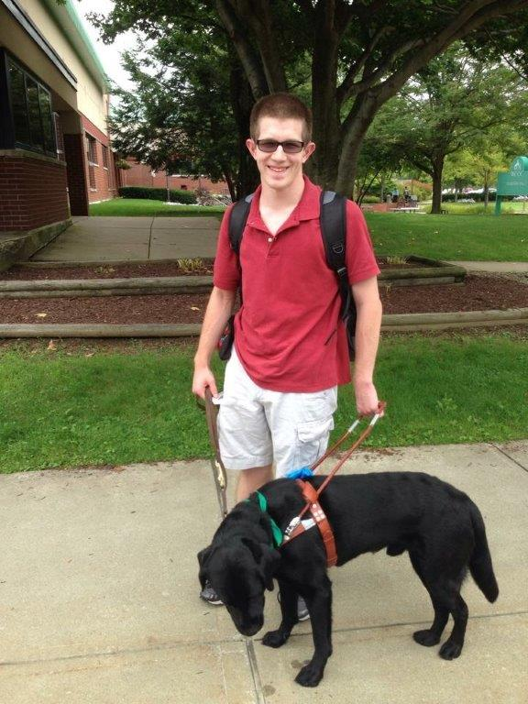
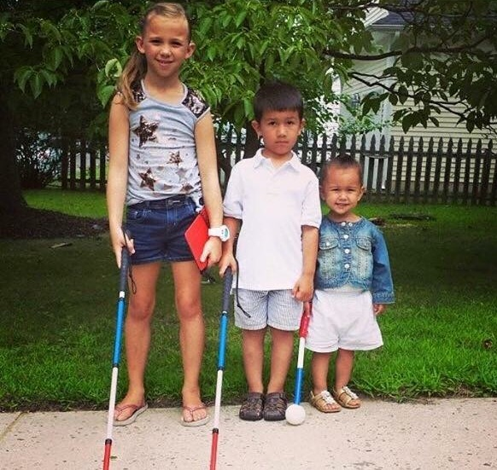
Independence

Slide 50
Extra Curricular Activities
The Rehab Act requires that students with disabilities be provided equal opportunity for participation in interscholastic, club, and intramural athletics programs offered or sponsored by a school.
Notes:
Carly
Patti- In community: Agua Club- Boy Scouts (Eagle)- Church-Volunteered at our Local Food Bank Monthly- School: High School Varsity Swim Team
*Accomodations

Slide 51
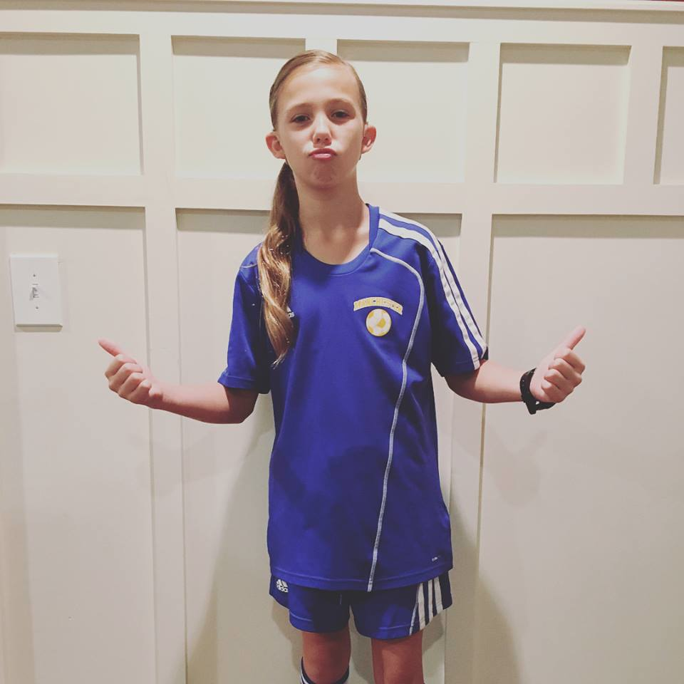
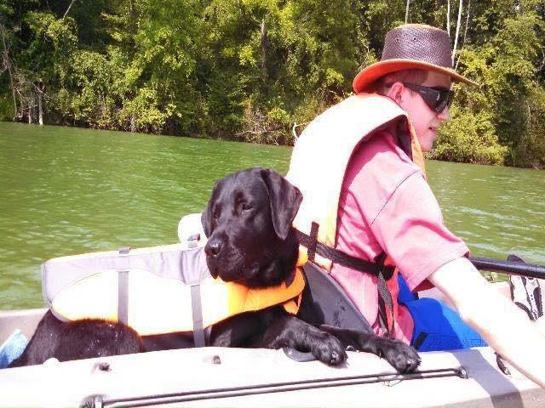
Keep your eye on the prize!

Slide 52
Not already!
Identify new team members
Share student profile
Focus on strengths
Introduce team “mates”
Begin forming a relationship
Thank you goes a long way
Notes:
Carly- importance of meeting prior to end of school, identifying staff and attend last team meeting “Passing of the torch” Just as important to the teacher
*Most important person on the team, consistency, know your child the best
Patti: Important to have team meetings outside of the IEP meeting ( we met quarterly) Hunter did “All about Me” PPT for new teachers- passing the “torch” at the end of the school year-encouraging teachers to talk about Hunter- Supplementary Aids and Services Toolkit-

Slide 53
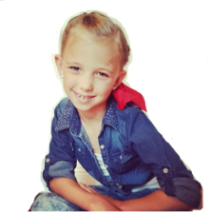
“Ava is a nutshell”
A’s of AVA
Avid reader
Always a competition
Athlete
Artist
Advocate
Anything is possible
Notes:
Carly- importance of meeting prior to end of school, identifying staff and attend last team meeting “Passing of the torch” Just as important to the teacher
*Most important person on the team, consistency, know your child the best
Patti: Important to have team meetings outside of the IEP meeting ( we met quarterly) Hunter did “All about Me” PPT for new teachers- passing the “torch” at the end of the school year-encouraging teachers to talk about Hunter- Supplementary Aids and Services Toolkit-

Slide 54
Me at a Glance
Hunter prepares and presents a power point presentation to share with his educational team and peers.
Notes:
Hunter prepared and presented a ppt about himself to teachers and peers , including overview of usher syndrome, technology that he used this was the beginning of his self determination and self advocay

Slide 55
Identity
Self-determination involves many attitudes and abilities including: self-awareness, assertiveness, creativity, and pride, and problem solving and self-advocacy skills. To take charge of your own life, you must be able to set goals, evaluate options, make choices and then work to achieve your goals.
Students who have self-determination skills have a stronger chance of being successful in making the transition to adulthood, including employment and independence (Wehmeyer & Schwartz, 1997).
Notes:
Patti - will describe slide as is, Your child will decide his or her identity - make sure you support - Nancy will add in DB vs. Db
Usher can be misleading, invisible...resourceful & clever. They will fill in information. So, who is this person with Usher? They decide, not us.

Slide 56
Secondary Transition Planning
Generally begins at age 14
Transition plan is part of IEP
Establishes goals for post graduation through career awareness exploration activities.
Based on student's needs, strengths, skills, and interests.
Involves student and individuals directly involved in helping them prepare to enter a post-school environment.
Notes:
Patti Three areas to cover and have good goals
• Postsecondary Education/Training (higher ed or vocational)
• Employment
• Independent Living/Community Participation

Slide 57
Transition to Adulthood (18+)
Postsecondary Education: Many high school students with disabilities, including those with deaf-blindness, continue their education in post-secondary schools including vocational and career schools, 2 and 4 year colleges, and universities. While a free and appropriate public education (FAPE) is guaranteed through the Individuals with Disabilities Education Act (IDEA), once a student graduates from high school public funding is not guaranteed. Some students may be eligible for support from vocational rehabilitation agencies.
Notes:
Patti- beginning this new piece of the journey

Slide 58
Adult Services
Eligibility not Entitlement
Commission for the Blind
http://ncsab.org/List/StateDirectors
Gallaudet/NTID/CSUN or any college with supports for individual
Department of Vocational Rehabilitation
https://www.csavr.org/state-vr-directors
HKNC Reps, Registry, Trainings
SSP services

Slide 59
It’s the climb
“Alone we can do so little, together we can do so much”- Helen Keller
Notes:
Carly

Slide 60
Links & Resources Usher Syndrome Coalition
Website: www.usher-syndrome.org
USH Trust Registry:
http://www.usher-registry.org
USH Blue Book:
https://www.usher-syndrome.org/our-story/join-the-ush-blue-book.html
USH Blog:
https://www.usher-syndrome.org/our-story/ush-blog.html
USH Talks:
https://www.usher-syndrome.org/what-is-usher-syndrome/presentations/ush-talks-library.html
USH Connections Conference:
https://www.usher-syndrome.org/our-story/ush-connections-conference-summaries.html

Slide 61
Links & Resources
NCDB
Website: www.nationaldb.org
State DB Projects: https://nationaldb.org/members/list?type=State+Project
Family Matters Stories:
http://nfadb.org/stories/
Resources:
https://nationaldb.org/families
Training Opportunities:
https://nationaldb.org/events

Slide 62
Links & Resources
NFADB
www.nfadb.org
HKNC
www.helenkeller.org/hknc

Slide 63
Contacts
Megan Cote
megan.cote@hknc.org
Carly Fredericks
frederc5@tcnj.edu
Patti McGowan
pmcgowan@pattan.net
Nancy O'Donnell
nancy.odonnell0813@gmail.com

